Slide 1
Reducing (Racial) Bias through Intergroup Contact and Dialogue: Opportunities for Interdisciplinary Collaboration
Dr. Jordan Soliz
Department of Communication Studies
jsoliz2@unl.edu

Slide 2
CURRENT RESEARCH ON COMMUNICATION AND RACE
COMMUNICATION, IDENTITY, & DIFFERENCE

Slide 3
CURRENT RESEARCH ON COMMUNICATION AND RACE
Racial Identity in Family Interactions
COMMUNICATION, IDENTITY, & DIFFERENCE
Racialized Experiences and Well-Being
Socialization of Attitudes

Slide 4
CURRENT RESEARCH ON COMMUNICATION AND RACE
Racial Identity in Family Interactions
COMMUNICATION, IDENTITY, & DIFFERENCE
Racialized Experiences and Well-Being
Socialization of Attitudes
Changing Racist Attitudes and Racialized Spaces

Slide 5
Intergroup dialogue and intergroup contact refer to interactions between individuals from different social groups
Intergroup Dialogue
Intergroup Contact
Notes:
Discuss

Slide 6
Intergroup dialogue and intergroup contact refer to interactions between individuals from different social groups
Intergroup Dialogue
Intergroup Contact
How can we communicate across difference in a manner that leads to constructive outcomes and/or alliance building?
Notes:
Discuss

Slide 7
Intergroup dialogue and intergroup contact refer to interactions between individuals from different social groups
Intergroup Dialogue
Intergroup Contact
How can we communicate across difference in a manner that leads to constructive outcomes and/or alliance building?
How can negative attitudes toward groups change through contact with different social groups?
Notes:
Discuss

Slide 8
Intergroup dialogue and intergroup contact refer to interactions between individuals from different social groups
Intergroup Dialogue
Intergroup Contact
How can we communicate about race, racism, and racial inequities in a manner that leads to constructive outcomes and/or alliance building?
How can racist attitudes change through contact with different racial groups?
Notes:
Discuss

Slide 9
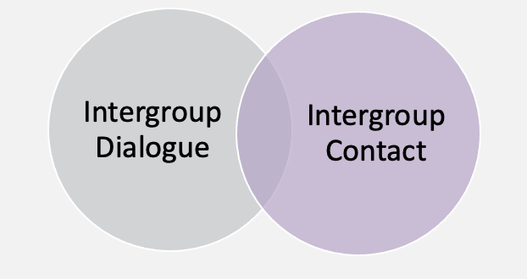
INTERDISCIPLINARY CONNECTIONS AND OPPORTUNITIES

Slide 10
INTERDISCIPLINARY CONNECTIONS AND OPPORTUNITIES
UNDERSTANDING SOCIAL NETWORKS, “VICARIOUS CONTACT,” AND ATTITUDE CHANGE

Slide 11
INTERDISCIPLINARY CONNECTIONS AND OPPORTUNITIES
UNDERSTANDING SOCIAL NETWORKS, “VICARIOUS CONTACT,” AND ATTITUDE CHANGE
COLLABORATING WITH COMMUNITY PARTNERS TO DEVELOP SUSTAINED AND CONTRUCTIVE ENGAGEMENT ABOUT RACE

Slide 12
INTERDISCIPLINARY CONNECTIONS AND OPPORTUNITIES
UNDERSTANDING SOCIAL NETWORKS, “VICARIOUS CONTACT,” AND ATTITUDE CHANGE
COLLABORATING WITH COMMUNITY PARTNERS TO DEVELOP SUSTAINED AND CONTRUCTIVE ENGAGEMENT ABOUT RACE
DEVELOPING AND ASSESSING INNOVATIVE ”CONTACT SPACES” THAT CAN CHANGE ATTITUDES
MEDIATED INTERACTIONS
HISTORICAL ARCHIVES
LITERATURE AND ARTS

Slide 13
INTERDISCIPLINARY CONNECTIONS AND OPPORTUNITIES
UNDERSTANDING SOCIAL NETWORKS, “VICARIOUS CONTACT,” AND ATTITUDE CHANGE
COLLABORATING WITH COMMUNITY PARTNERS TO DEVELOP SUSTAINED AND CONTRUCTIVE ENGAGEMENT ABOUT RACE
DEVELOPING AND ASSESSING INNOVATIVE ”CONTACT SPACES” THAT CAN CHANGE ATTITUDES
MEDIATED INTERACTIONS
HISTORICAL ARCHIVES
LITERATURE AND ARTS
ATTITUDE CHANGE IN VARIOUS SOCIAL & RELATIONAL CONTEXTS
FAMILY
EDUCATIONAL INSTITUTIONS
NEBRASKA COMMUNITIE S

