Slide 1
‘Getting Ready’ to Change the World
Lisa L. Knoche, Ph.D.
Nebraska Center for Research on Children, Youth, Families and Schools
@lisaknoche

Slide 2

Promoting Early Childhood Education and Development: HOW?
  Supporting children’s learning and development by strengthening relationships and building competencies among families and educators in all early childhood settings.

Slide 3

Promoting Early Childhood Education and Development: HOW?

Slide 4
Promoting Early Childhood Education and Development: WHY?
75%
of Nebraska children ages 0-6 have all available parents in the workforce

Slide 5
Promoting Early Childhood Education and Development: WHY?
Generally, teachers felt less prepared to work with families than children. K-3 teachers felt the least prepared to work with families at the beginning of their careers; less than half (44.2%) reported feeling well-prepared.
Nebraska Early Childhood Workforce Survey: A Focus on Providers and Teachers
https://buffettinstitute.nebraska.edu/our-work/elevating-the-early-childhood-workforce/survey

Slide 6
Promoting Early Childhood Education and Development: IMPACTS?
Rigorous research trials since 2004 have shown the effectiveness of the model.
  CHILDREN BENEFIT
        Social-Emotional Competencies
        Language and Literacy
        Self-Regulation
  PARENTS BENEFIT.
    Parents are more responsive to children’s needs.
  EDUCATORS BENEFIT.
    Family connections are collaborative.
  Anxiety and Withdrawal

Slide 7

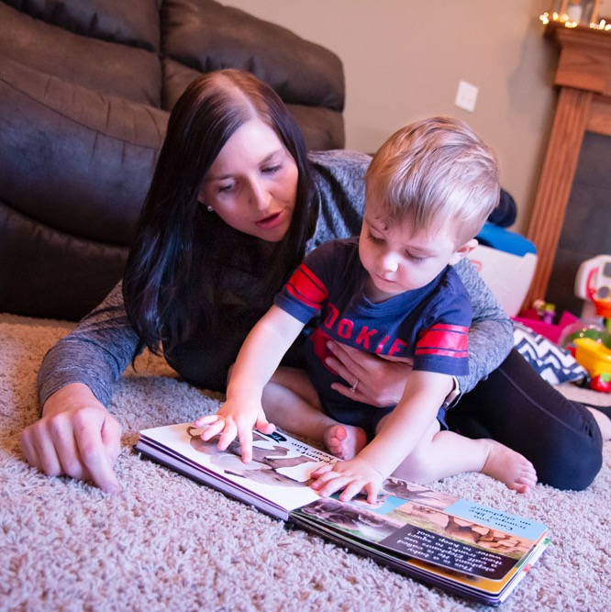

Promoting Early Childhood Education and Development: IMPACTS?

Slide 8
Promoting Early Childhood Education and Development: INTERDISCIPLINARY CONNECTIONS
Education
Child
Educational and Social Policy
Economics
Psychology
Communication Studies
Child and Family Health
Family Systems
Technology
Sociology

Slide 10
Lisa L. Knoche
  Co-Director, Nebraska Center for Research on Children, Youth, Families and Schools (CYFS)
  Director, Nebraska Academy for Early Childhood Research
  Research Associate Professor, CYFS
  Email: lknoche2@unl.edu
https://gettingready.unl.edu/

