Slide 1
iEAT: A Multi-Level Community Learning Health System
Dipti Dev
Betti and Richard Robinson Associate Professor
Extension Specialist: Childhood Health Behaviors
University of Nebraska-Lincoln

Slide 2
iEAT Goals and Early Childhood Education (ECE) and Development Grand Challenge
iEAT
Healthy Eating
ECE Workforce Development
Parent-ECE Provider Engagement

Slide 3
iEAT Learning Community Health System
Smart Technologies
Capacity Building Intervention
Feedback Loop System
A major challenge for improved community population health outcomes is to accelerate progress toward the development of a community learning health system (LHS).
An LHS is “one in which science, informatics, incentives, and culture are aligned for continuous improvement and innovation.”
-The National Academy of Medicine

Slide 4
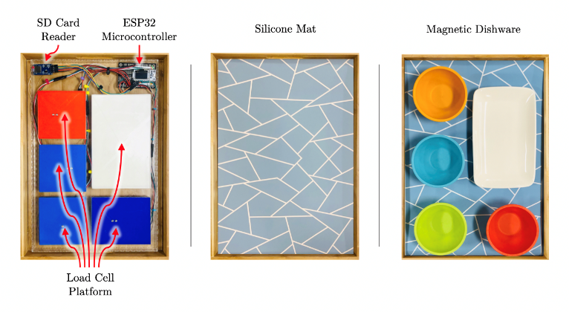

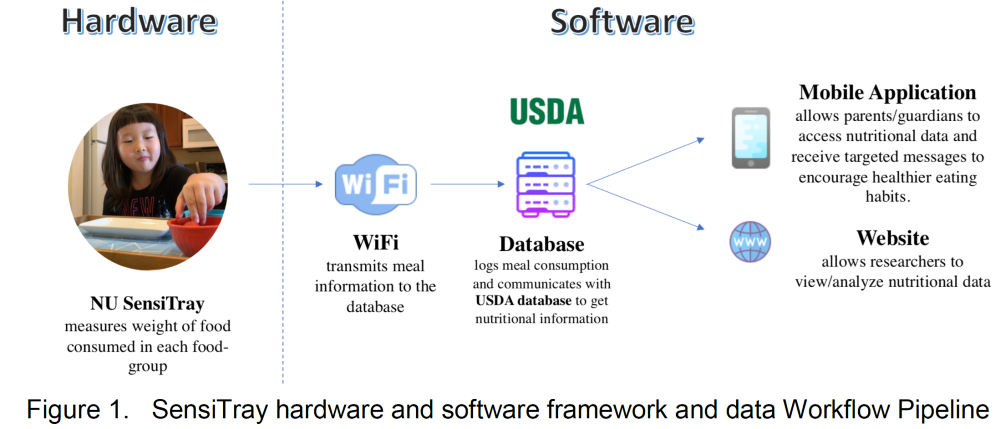
Significant Outcomes and Impacts: NU SENSI TRAY
iEAT
Smart Technologies
Dev D. A., Pitla S., Guru A., Weng A., & Guru H. International Patent Application No. PCT/US2019/057770; Filed: October 24, 2019
Claiming Priority to U.S. Serial No. 62/749,700; filed October 24, 2018. Entitled: Methods and Systems for Measuring Diet and Nutrition in Children

Slide 5
NU SensiTray: Interdisciplinary Collaborations
Software
Ashu Guru
Hongfeng Yu
Hardware
Santosh Pitla
NU Tech Ventures, Raikes School
NU SensiTray
Dev D. A., Pitla S., Guru A., Weng A., & Guru H. International Patent Application No. PCT/US2019/057770; Filed: October 24, 2019
Claiming Priority to U.S. Serial No. 62/749,700; filed October 24, 2018. Entitled: Methods and Systems for Measuring Diet and Nutrition in Children
Guru, H. S., Weng, A. D., Pitla, S., & Dev, D. A.* (2021, May). SensiTray: An Integrated Measuring Device for Monitoring Children's Mealtime Dietary Intake. In 2021 IEEE International Instrumentation and Measurement Technology Conference (I2MTC) (pp. 1-6). IEEE.

Slide 6
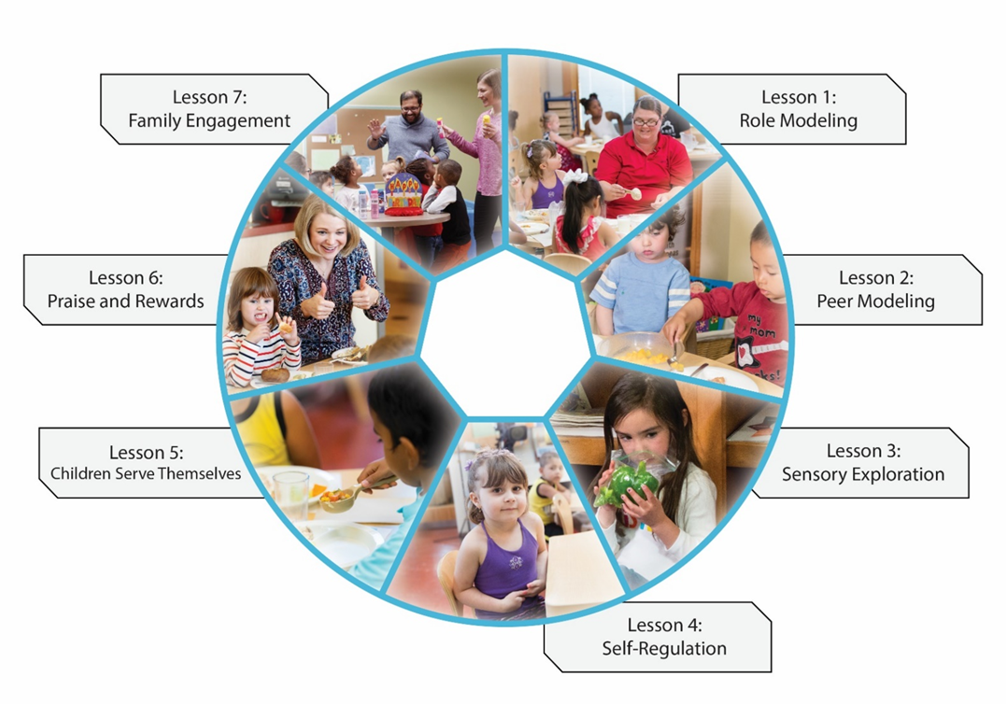

Early Childhood Workforce Development
iEAT Learning Community Health System
Capacity Building Intervention

Slide 7
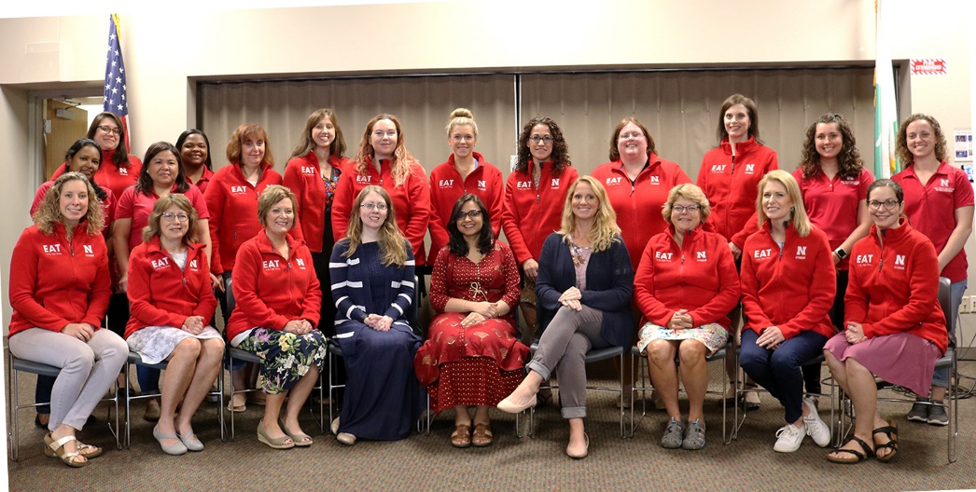
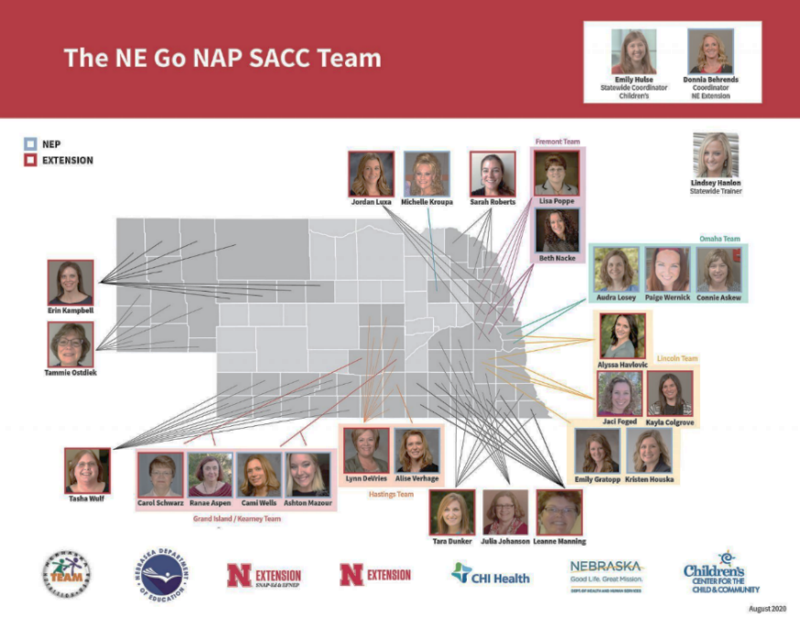
Interdisciplinary Partnerships: NEBRASKA EXTENSION

Slide 8
EAT Family Style Multilevel Implementation Model through Cooperative Extension
iEAT Learning Community Health System
Feedback Loop System

Slide 9

Significant Outcomes and Impacts
iEAT Learning Community Health System
Capacity Building Intervention
Feedback Loop System
1. Significant Improvement in Children’s Dietary Intake and Childcare Providers’ evidence-based Practices.
Dev, D. A., Dzewaltowski, D., Hasnin, S., Hatton-Bowers, H., Rida, Z., Franzen-Castle, L., ... Sisson, S. (2019). EAT Family-Style Dining intervention improves child care providers' responsive feeding practices and children's dietary intake. Journal of Nutrition Education and Behavior, 51(7), S58-S59.
2. Connection to the Racial Equity and Health Equity Grand Challenge
Sleet, K., Sisson, S. B., Dev, D. A., Love, C., Williams, M. B., Hoffman, L. A., & Jernigan, V. B. B. (2020). The impact of responsive feeding practice training on teacher feeding behaviors in tribal early care and education: The Food Resource Equity and Sustainability for Health (FRESH) Study. Current Developments in Nutrition, 4(S1), 23–32 . https://doi.org/10.1093/cdn/nzz105
Dev, D.A., Richmond, M., Hillburn, C. (2021, November 18-20). Using Culturally Responsive Strategies in the Diagnosis and Treatment of Pediatric Feeding Disorders [Seminar]. Accepted for presentation at the American Speech-Language-Hearing Association National Conference (Virtual), United States.
3. National Reach through Better Kid Care: Penn State Extension

Slide 10
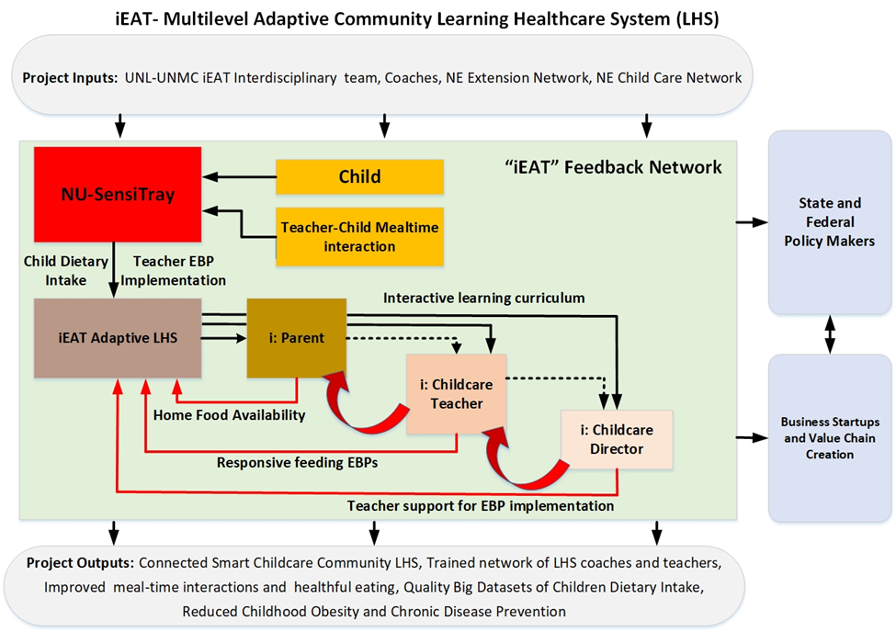

Slide 11
Connection to Other Grand Challenge Themes and Partnerships Needed
Health Equity and Sustainable Food and Water Security
Child Care Settings: An Avenue to End Child Hunger and Ensure Nutrition Security in Nebraska?
Reducing Health Disparities in Rural Communities
Racial Equity
2. Improved Diversity and Inclusion in Early Childhood Research and Extension through a learner-engaged continuous quality improvement system?
Next Generation Child Care

Slide 12
Questions
Dipti Dev
Betti and Richard Robinson Associate Professor and Child Health Behaviors Specialist.
University of Nebraska-Lincoln
E-mail. ddev2@unl.edu

