Slide 1
Promoting climate resilience through integrated planning
Zhenghong Tang, Professor
Community and Regional Planning Program

Slide 2
Climate Resilience projects
Adaptive planning for community resilience under extreme climate
(A land-grant mission service project & a collaborative NOAA project)
2. Geospatial visualization tool to address potential climate challenges
(Funded by NeDNR)
Ecosystem (wetland) resilience research in changing climate
(Funded by USDA, EPA and DIO)

Slide 3
Climate Resilience projects
Adaptive planning for community resilience under extreme climate
(A land-grant mission service project & a collaborative NOAA project)
2. Geospatial visualization tool to address potential climate challenges
(Funded by NeDNR)
Ecosystem (wetland) resilience research in changing climate
(Funded by USDA, EPA and DIO)

Slide 4
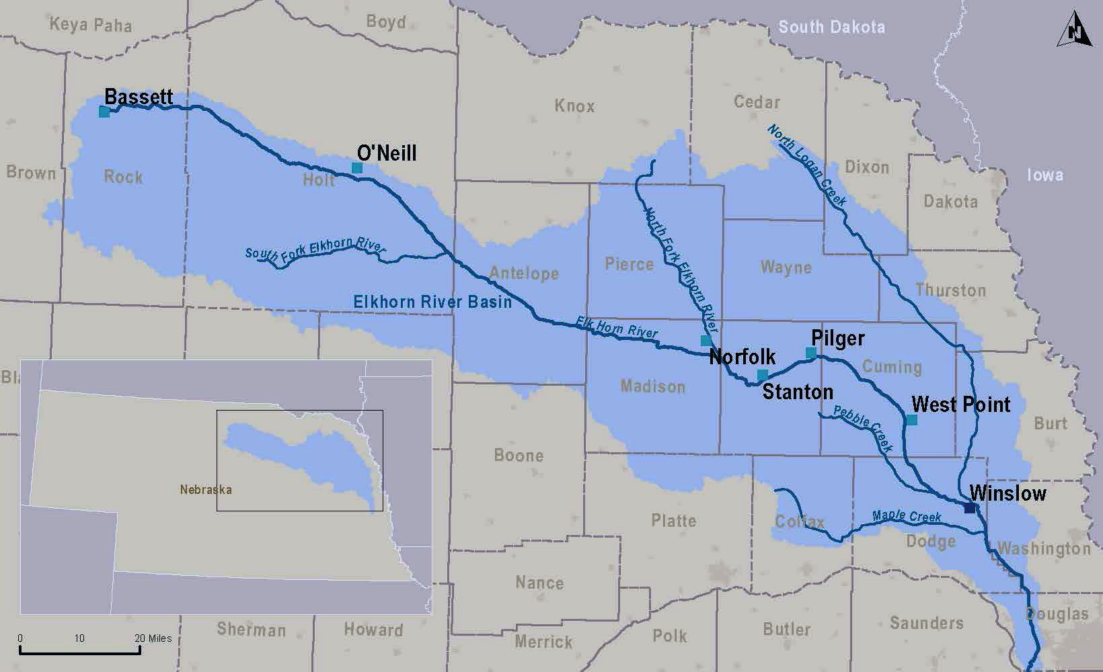
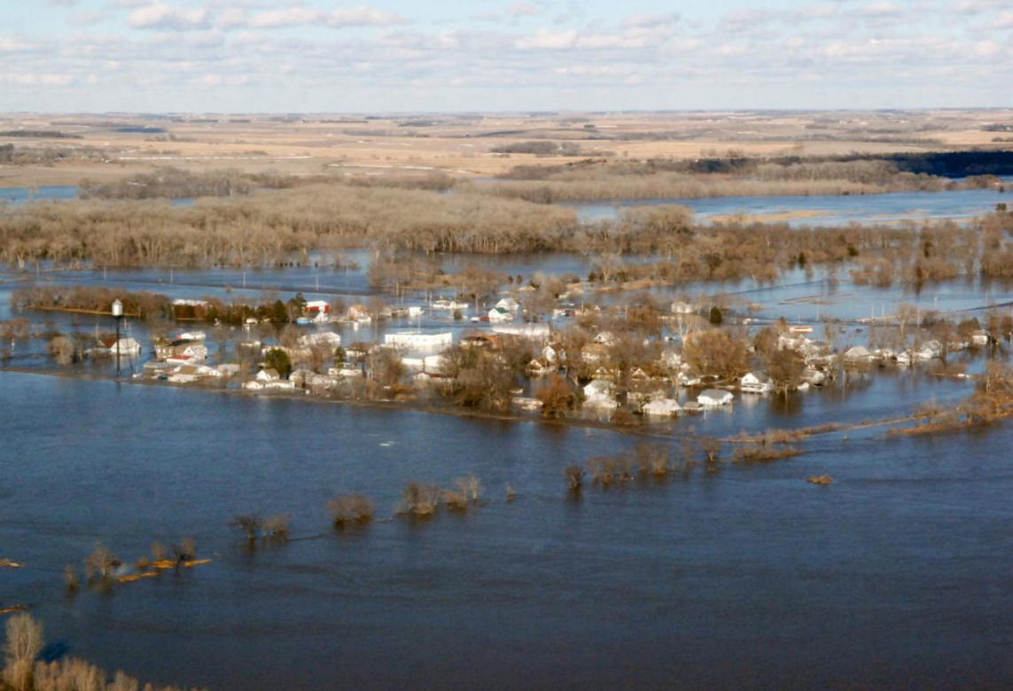
Adaptive planning for community resilience under extreme climate

Slide 5
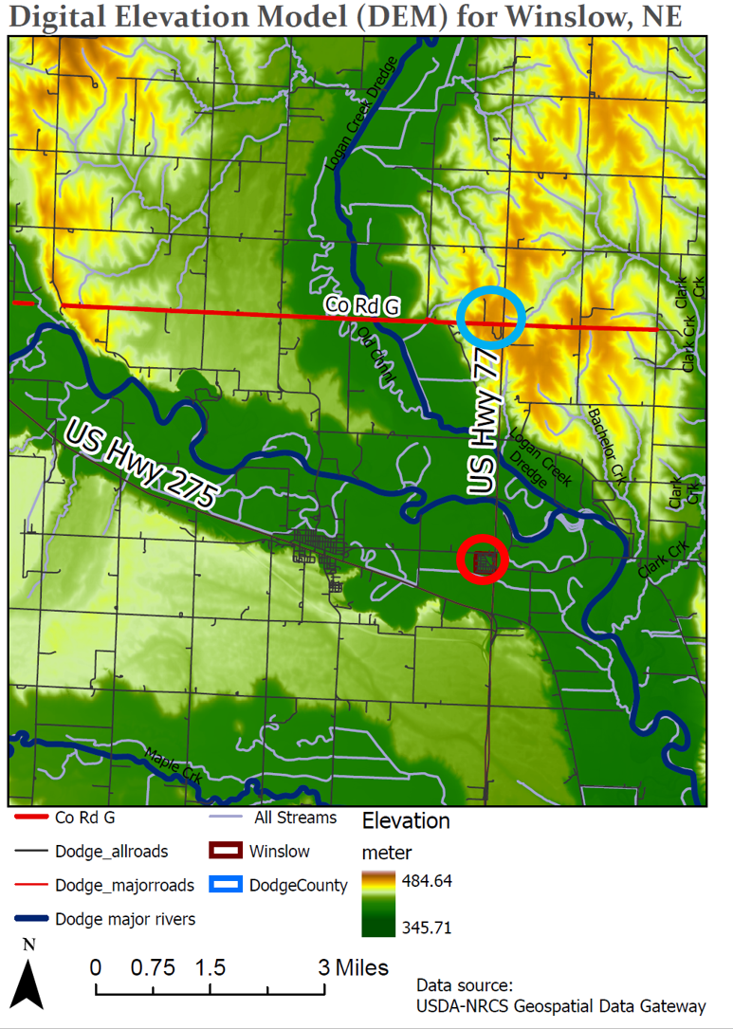
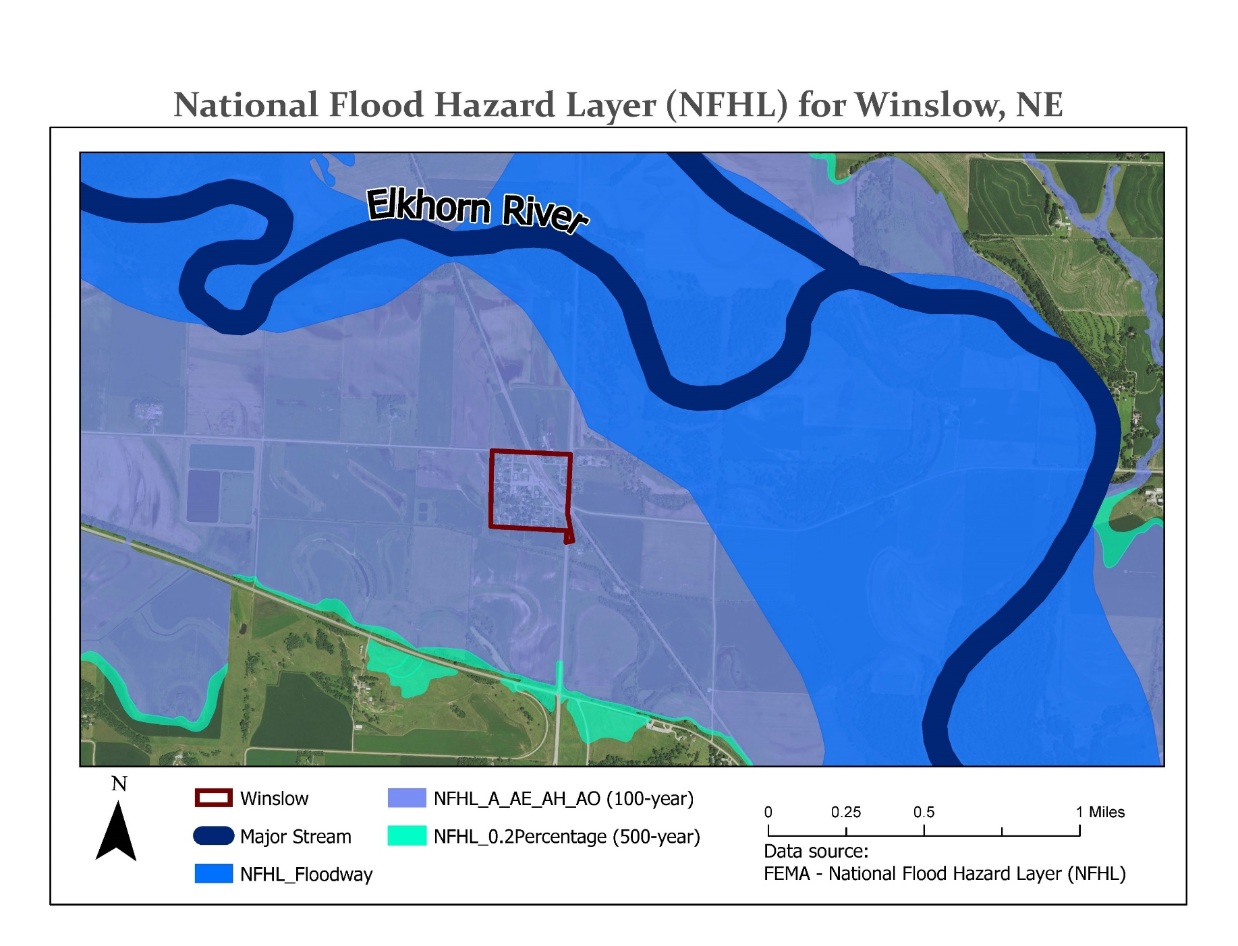
Adaptive planning for community resilience under extreme climate

Slide 6
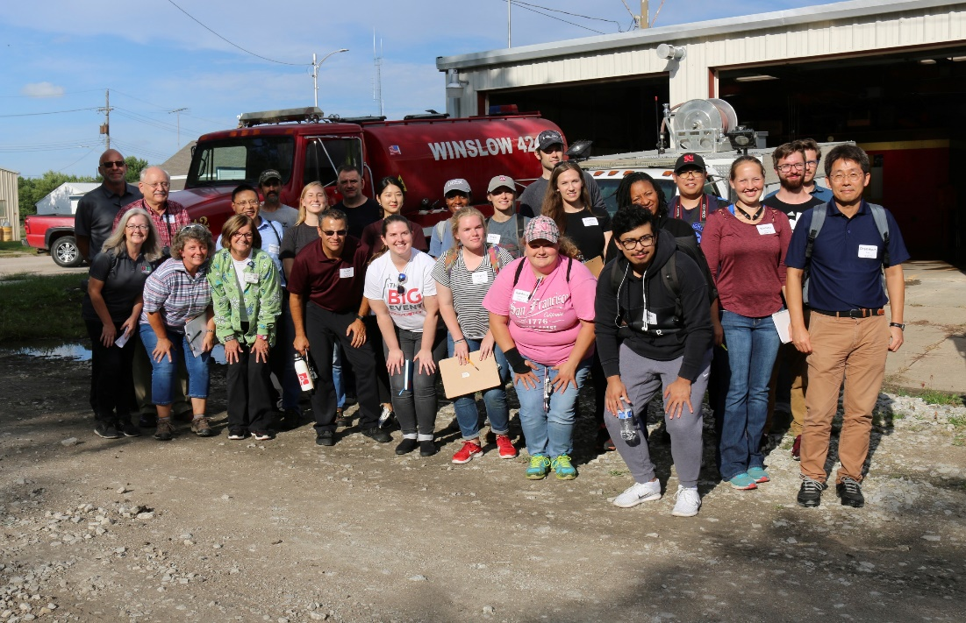
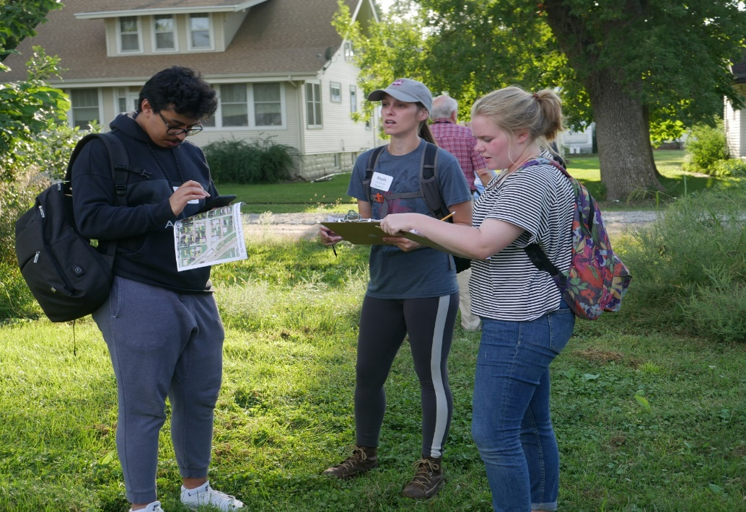
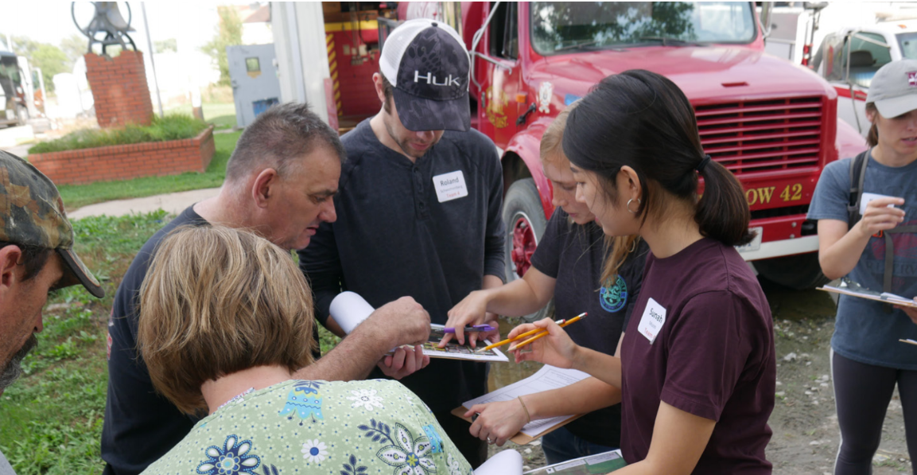
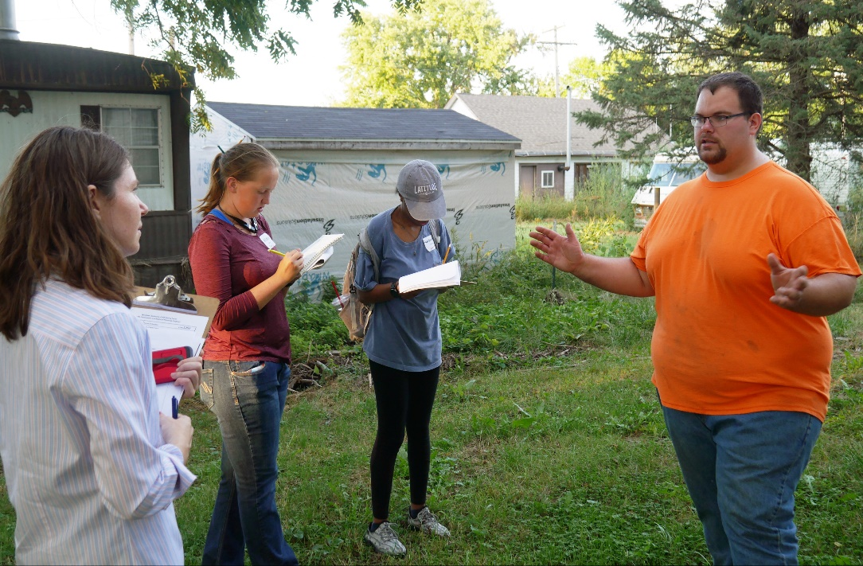
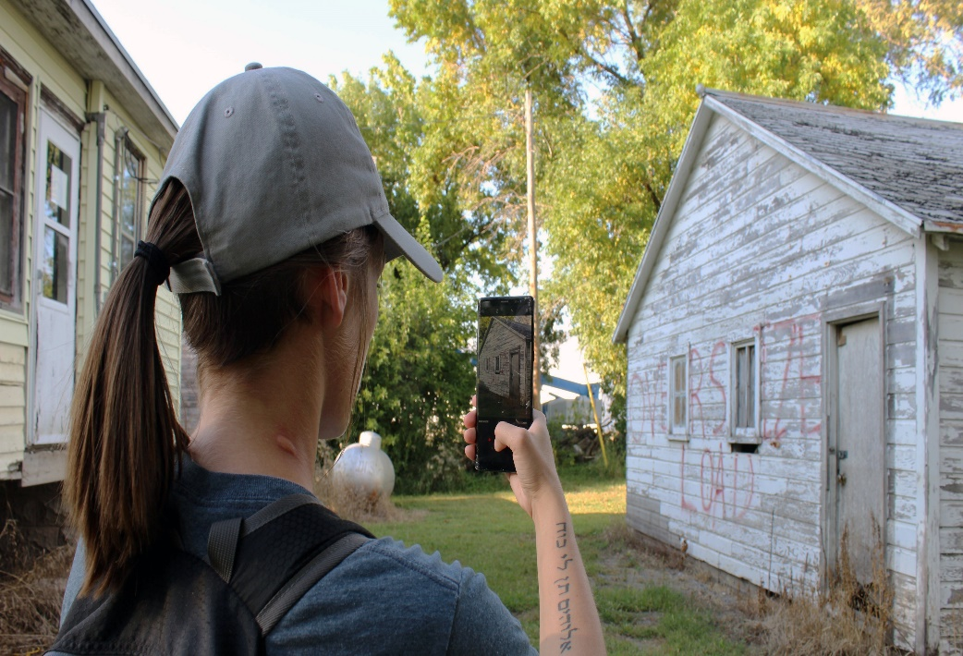
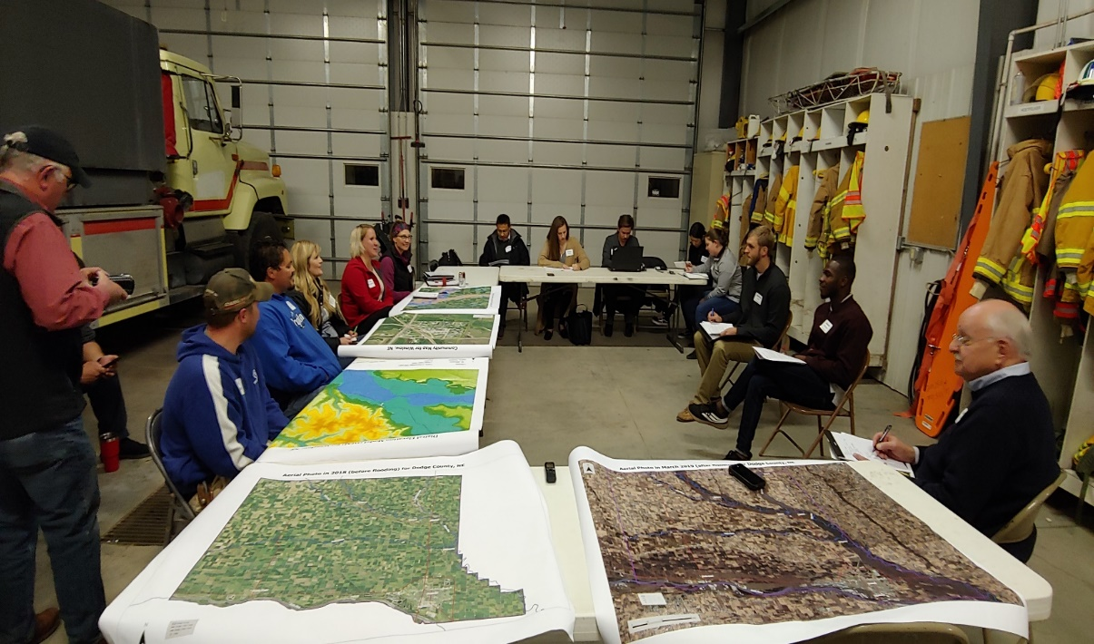
Adaptive planning for community resilience under extreme climate

Slide 7
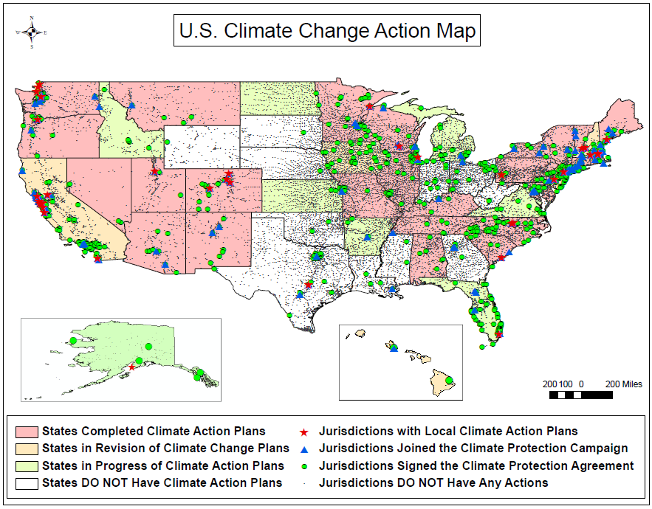
Adaptive planning for community resilience under extreme climate
Tang et al. (2010) J of Environmental Planning and Management

Slide 8
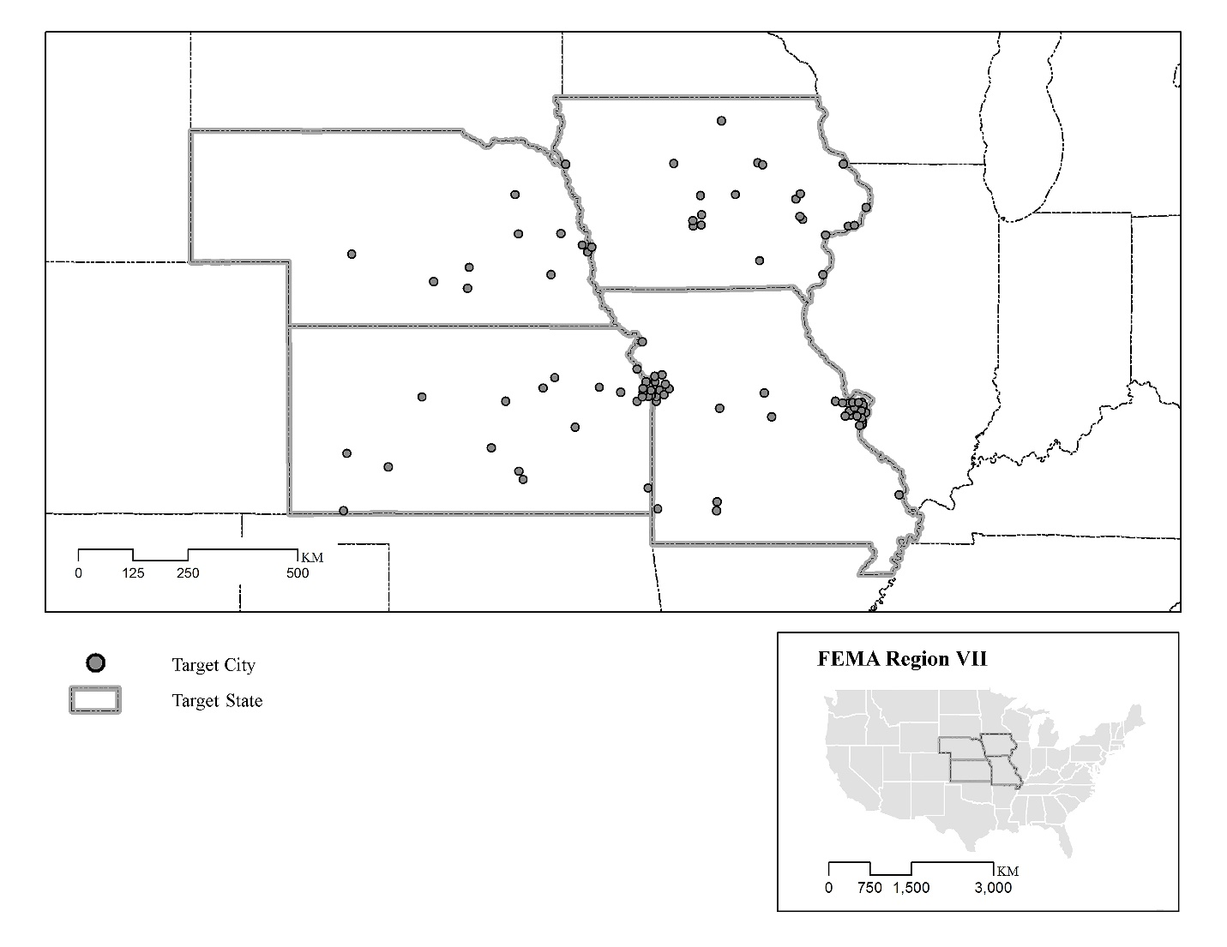
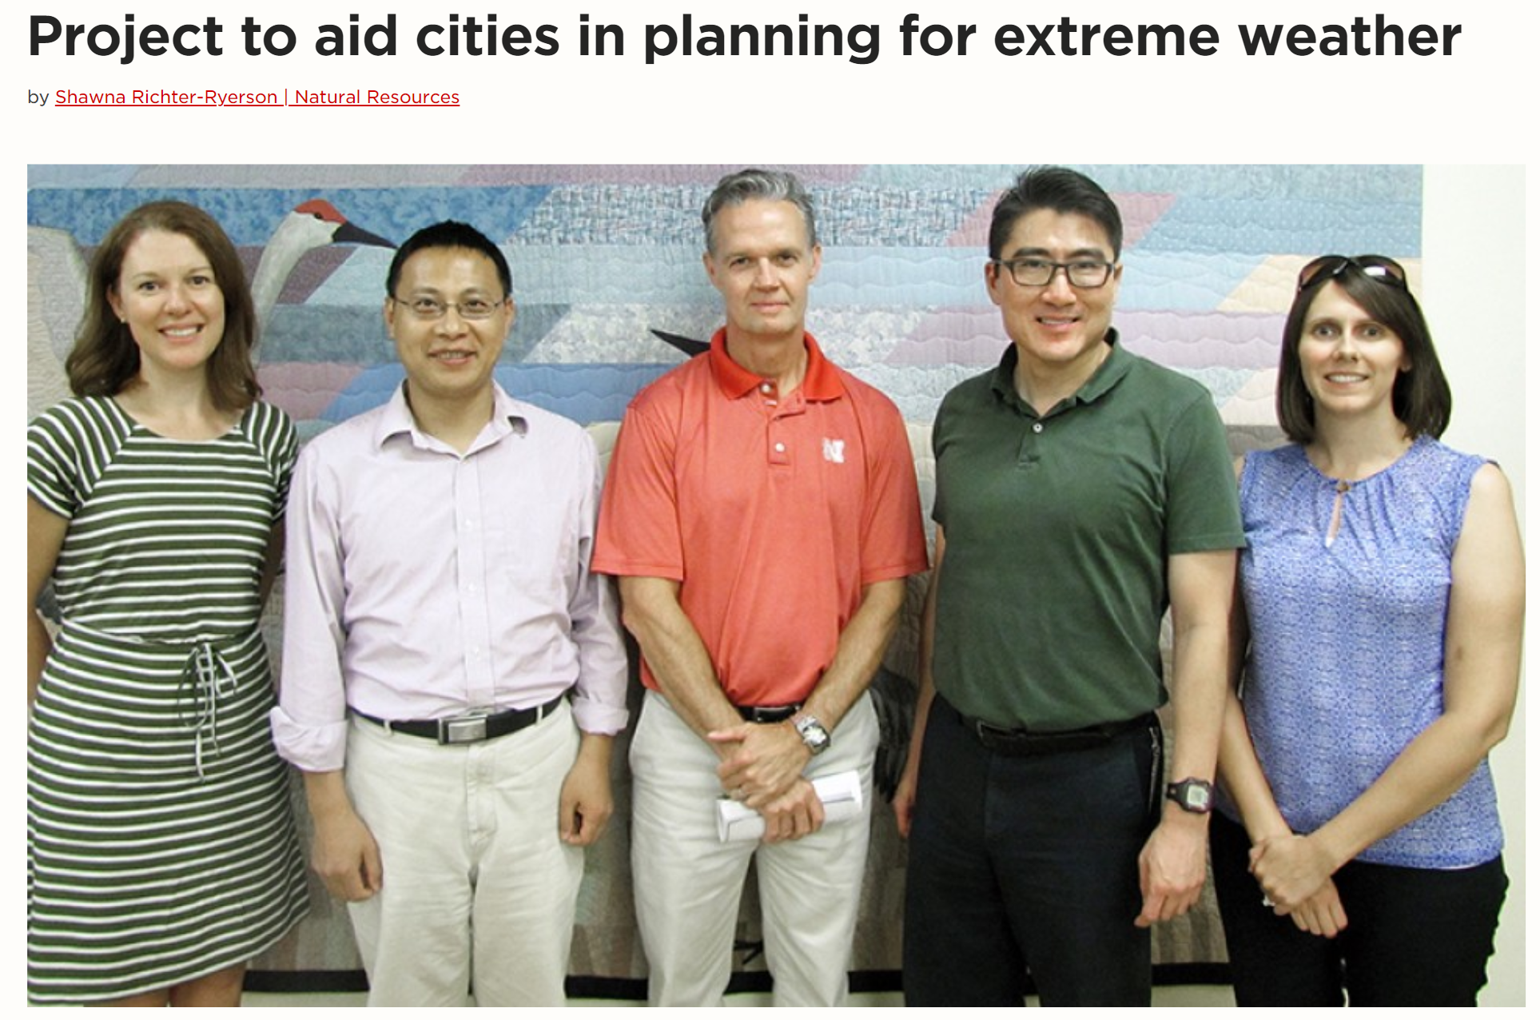
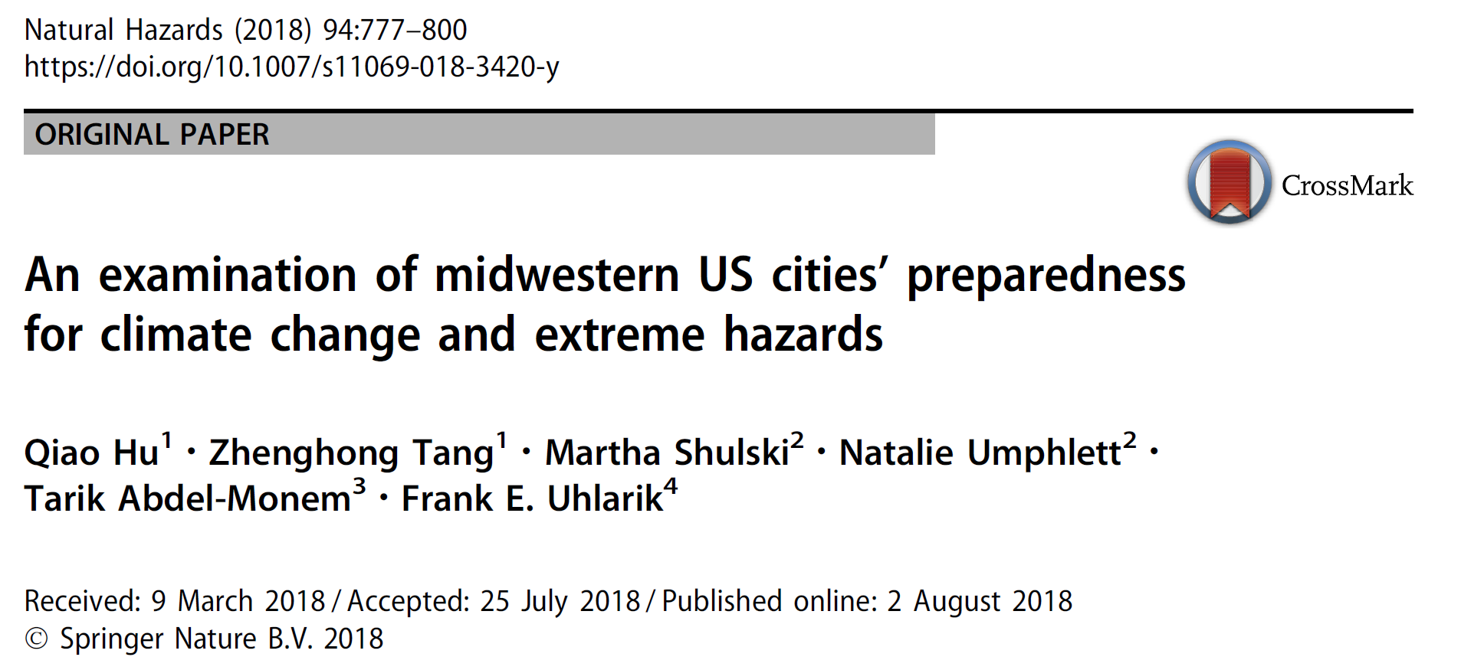
Adaptive planning for community resilience under extreme climate
A collaborative NOAA project
Led by Dr.Martha Shulski

Slide 9
Climate Resilience projects
Adaptive planning for community resilience under extreme climate
(A land-grant mission service project & a collaborative NOAA project)
2. Geospatial visualization tool to address potential climate challenges
(Funded by NeDNR)
Ecosystem (wetland) resilience research in changing climate
(Funded by USDA, EPA and DIO)

Slide 10
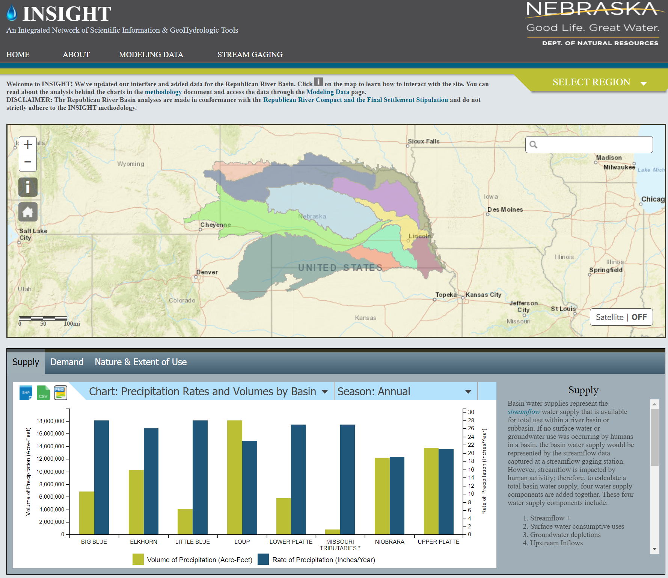
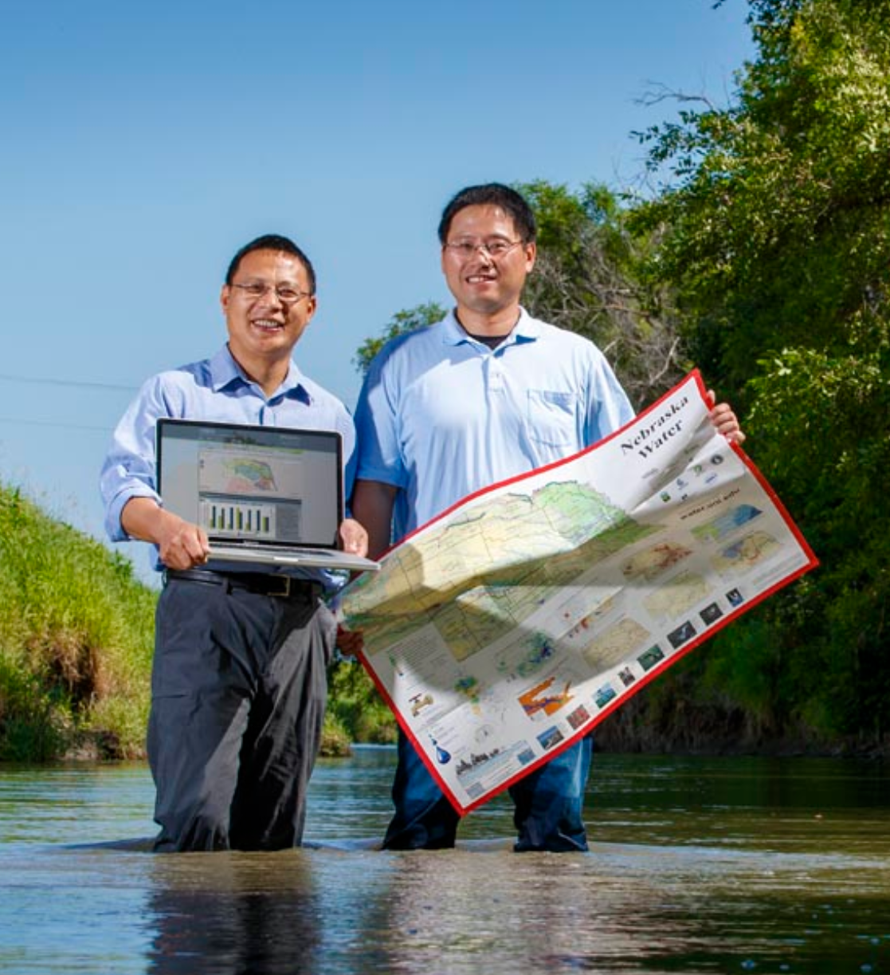
Geospatial visualization tool to address potential climate challenges

Slide 11
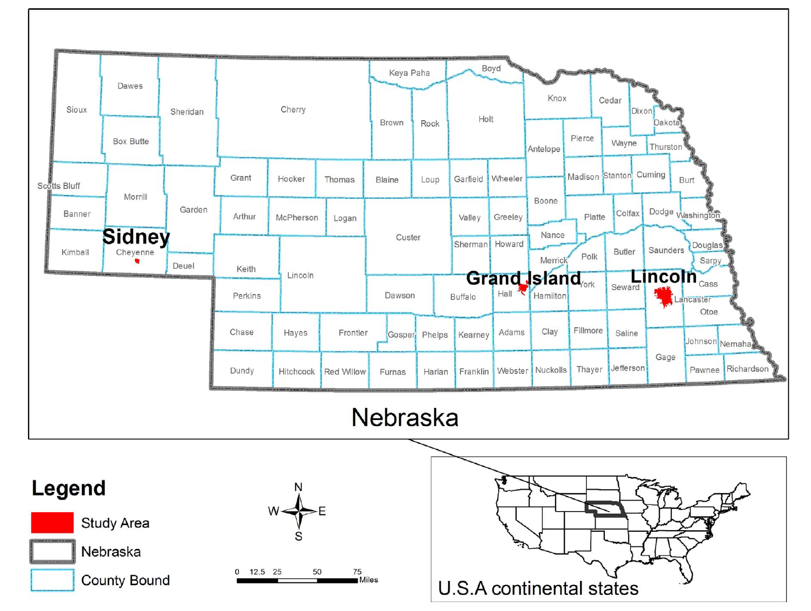
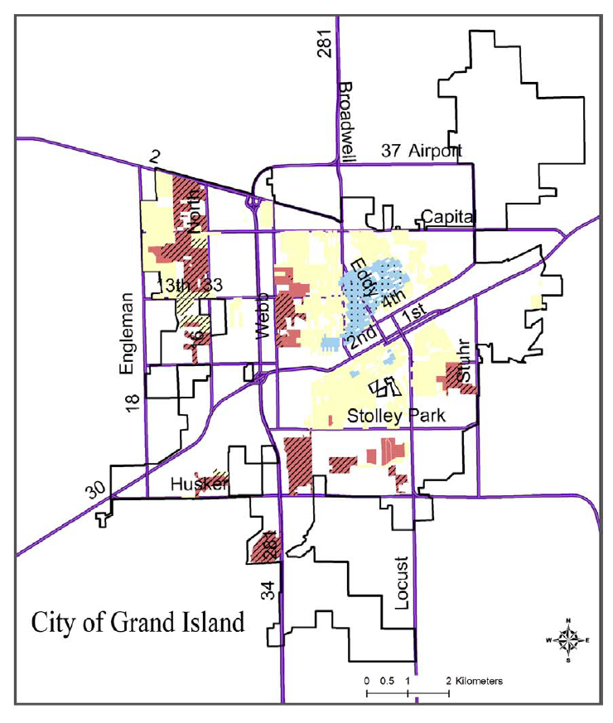
Geospatial visualization tool to address potential climate challenges
Li, Tang, et al. (2017)

Slide 12
Climate Resilience projects
Adaptive planning for community resilience under extreme climate
(A land-grant mission service project & a collaborative NOAA project)
2. Geospatial visualization tool to address potential climate challenges
(Funded by NeDNR)
Ecosystem (wetland) resilience research in changing climate
(Funded by USDA, EPA and DIO)

Slide 13
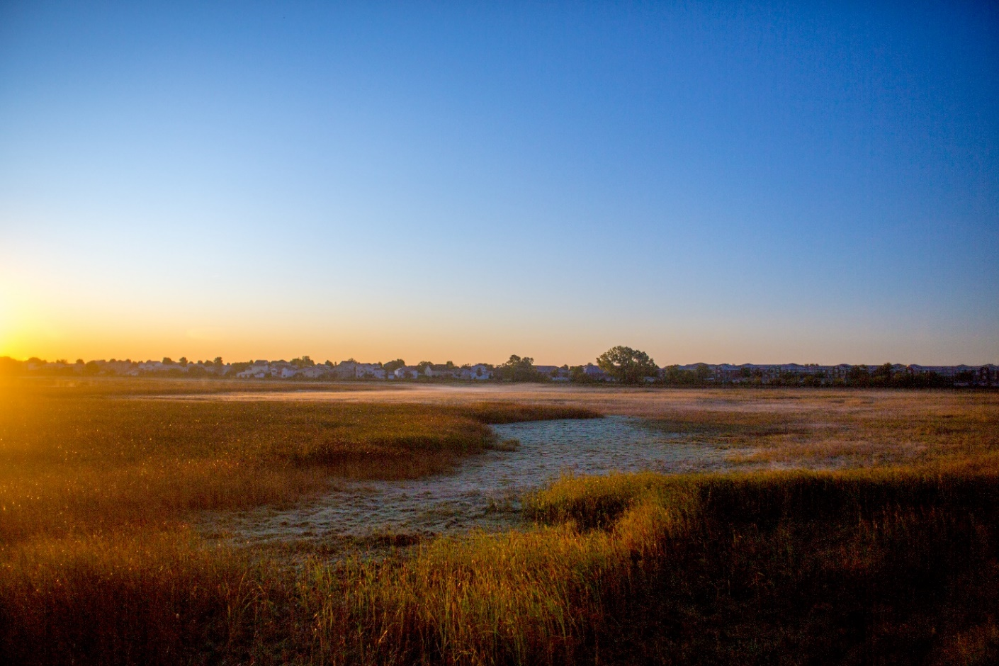
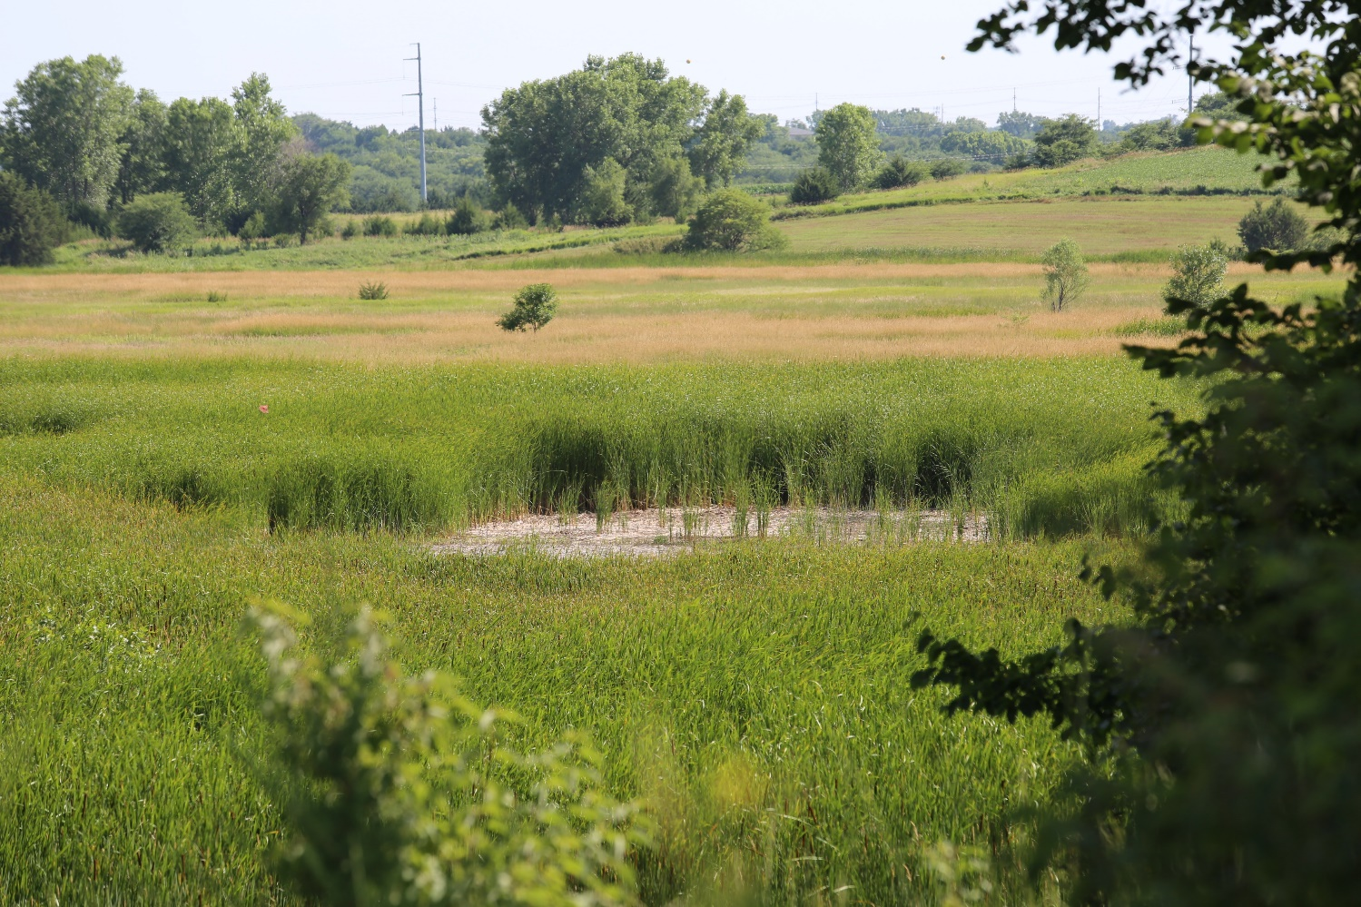
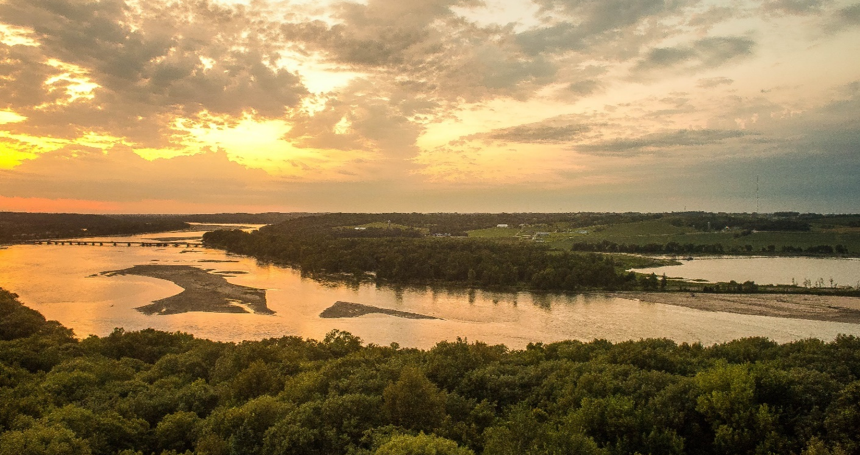
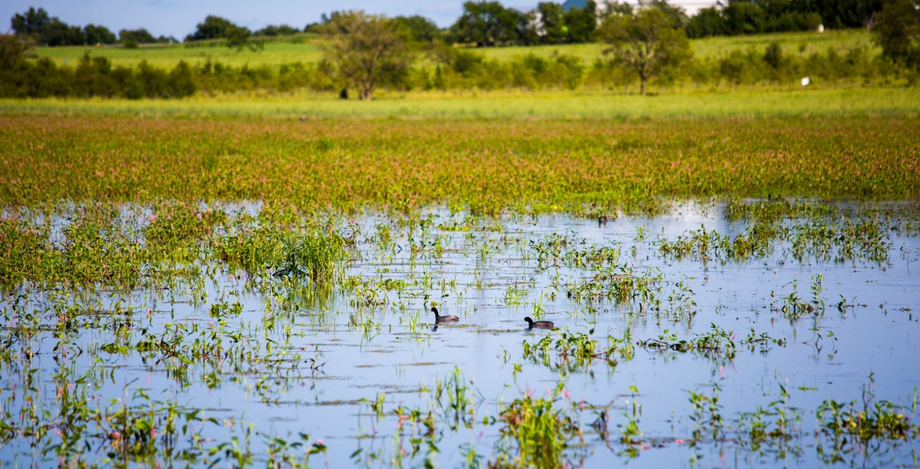
Ecosystem (wetland) resilience research in changing climate

Slide 14
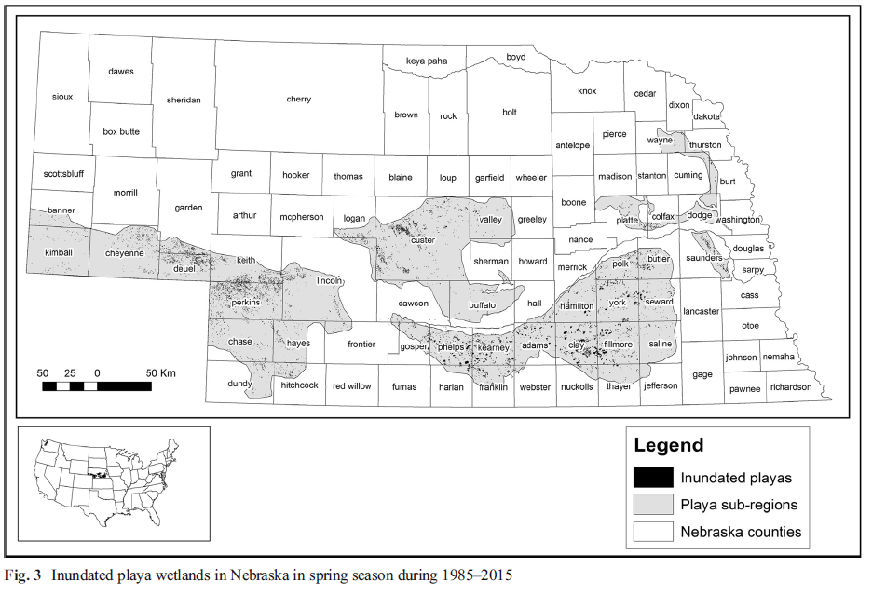
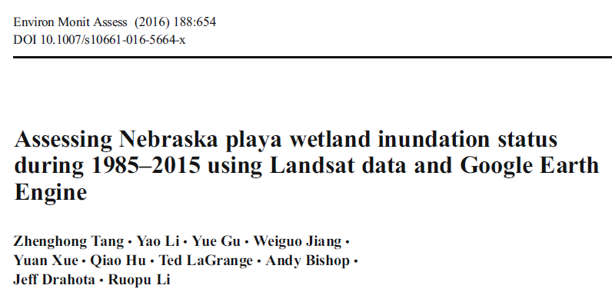
Ecosystem (wetland) resilience research in changing climate

Slide 15
Highlights
Start with the real research problem
(e.g. low-capacity of rural communities, aging infrastructure, vulnerable ecosystem)
2. Sharp the toolkit with expertise
(e.g. community planning, geospatial informatics, etc.)
2. Collaborate with interdisciplinary research team
(e.g. Natural Resources, Computing/Data Science, Agriculture, Engineering, Public policy, etc.)
3. Build up long-term “win-win” partnerships
(e.g. Local, regional, state, federal, NGO, industry, etc.)

