Slide 1
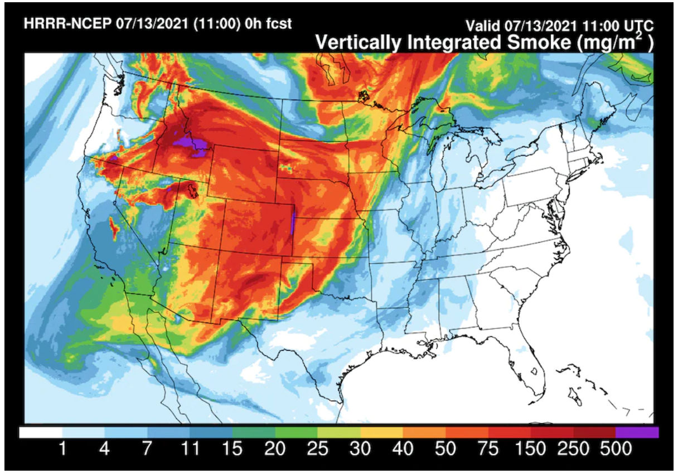
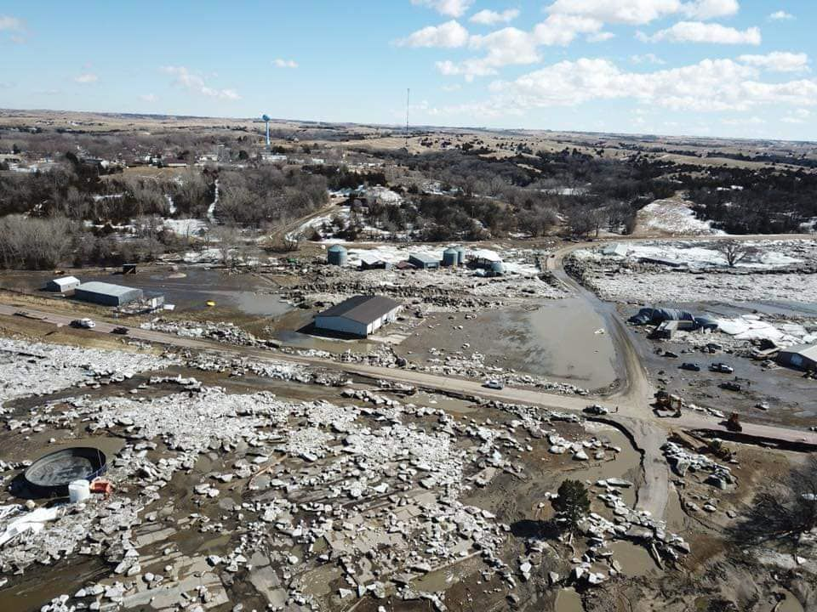
Climate resilience . . . To what?
Unprecedented warming, shifting seasonality of precipitation.
More and worse extremes (flood, drought, heat).
Greater variability.
Wildfire smoke (Summer, 2021)
Spring snowmelt flood (Niobrara, 2019)
Notes:
Here I outlined the similar trends for the Nebraska and global annual average temperature. I also point out the high variability in Nebraska and difference in regional vs. global scales. I use the analogy that global change is like an escalator that is increasing at an accelerating rate. The variability is like we jump up or down a few steps while still going up.

Slide 2
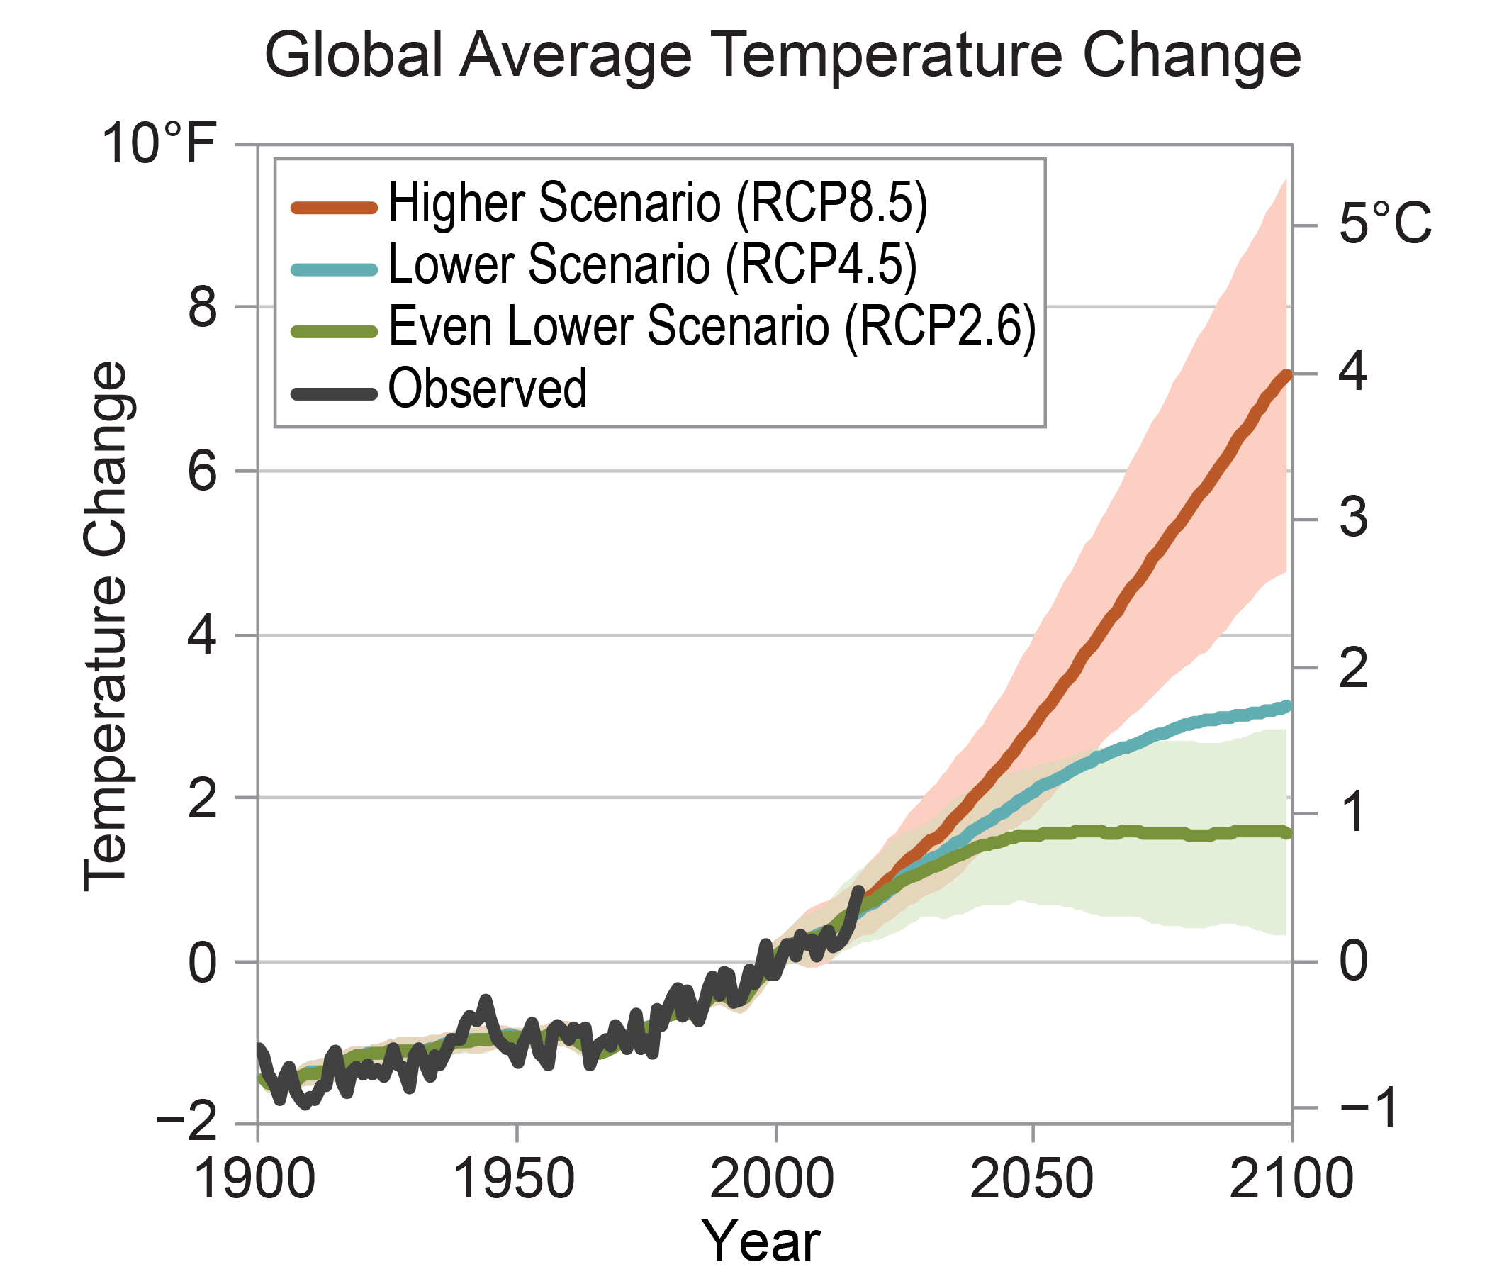
To what . . . is up to us.
Mitigation is a MUST.
We are all the problem, and all the solution.
Think innovation and transformative change.
High risk
Catastrophic impacts
Less risk
Large-scale impacts
Notes:
Here I outlined the similar trends for the Nebraska and global annual average temperature. I also point out the high variability in Nebraska and difference in regional vs. global scales. I use the analogy that global change is like an escalator that is increasing at an accelerating rate. The variability is like we jump up or down a few steps while still going up.

Slide 3
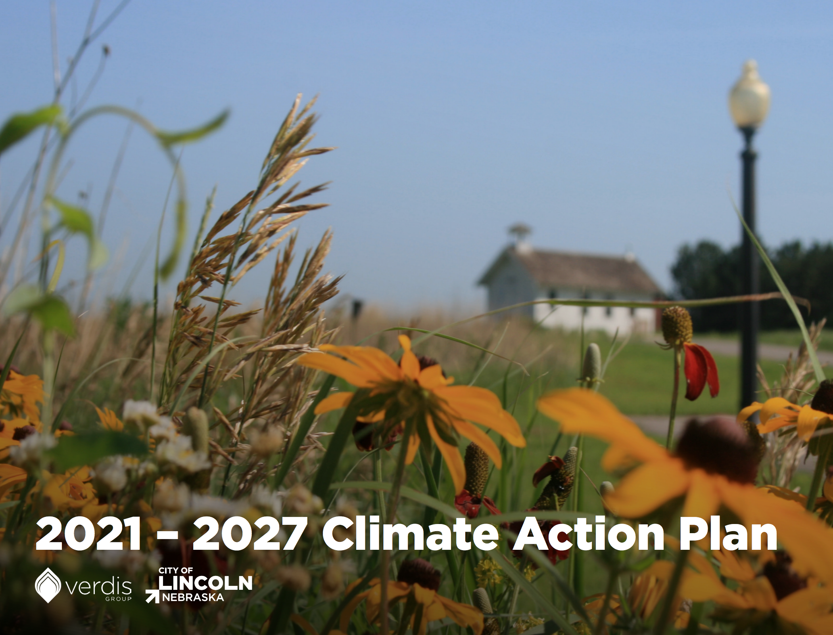
Climate resilience . . . Of what?
Health
Agriculture
Water
Energy
Ecosystems
Communities
Built environment
Action requires:
- Recognition. - Relationship building. - Risk assessment.
https://www.lincoln.ne.gov/City/Projects-Programs-Initiatives/Resilient-Lincoln
Notes:
Here I outlined the similar trends for the Nebraska and global annual average temperature. I also point out the high variability in Nebraska and difference in regional vs. global scales. I use the analogy that global change is like an escalator that is increasing at an accelerating rate. The variability is like we jump up or down a few steps while still going up.

Slide 4
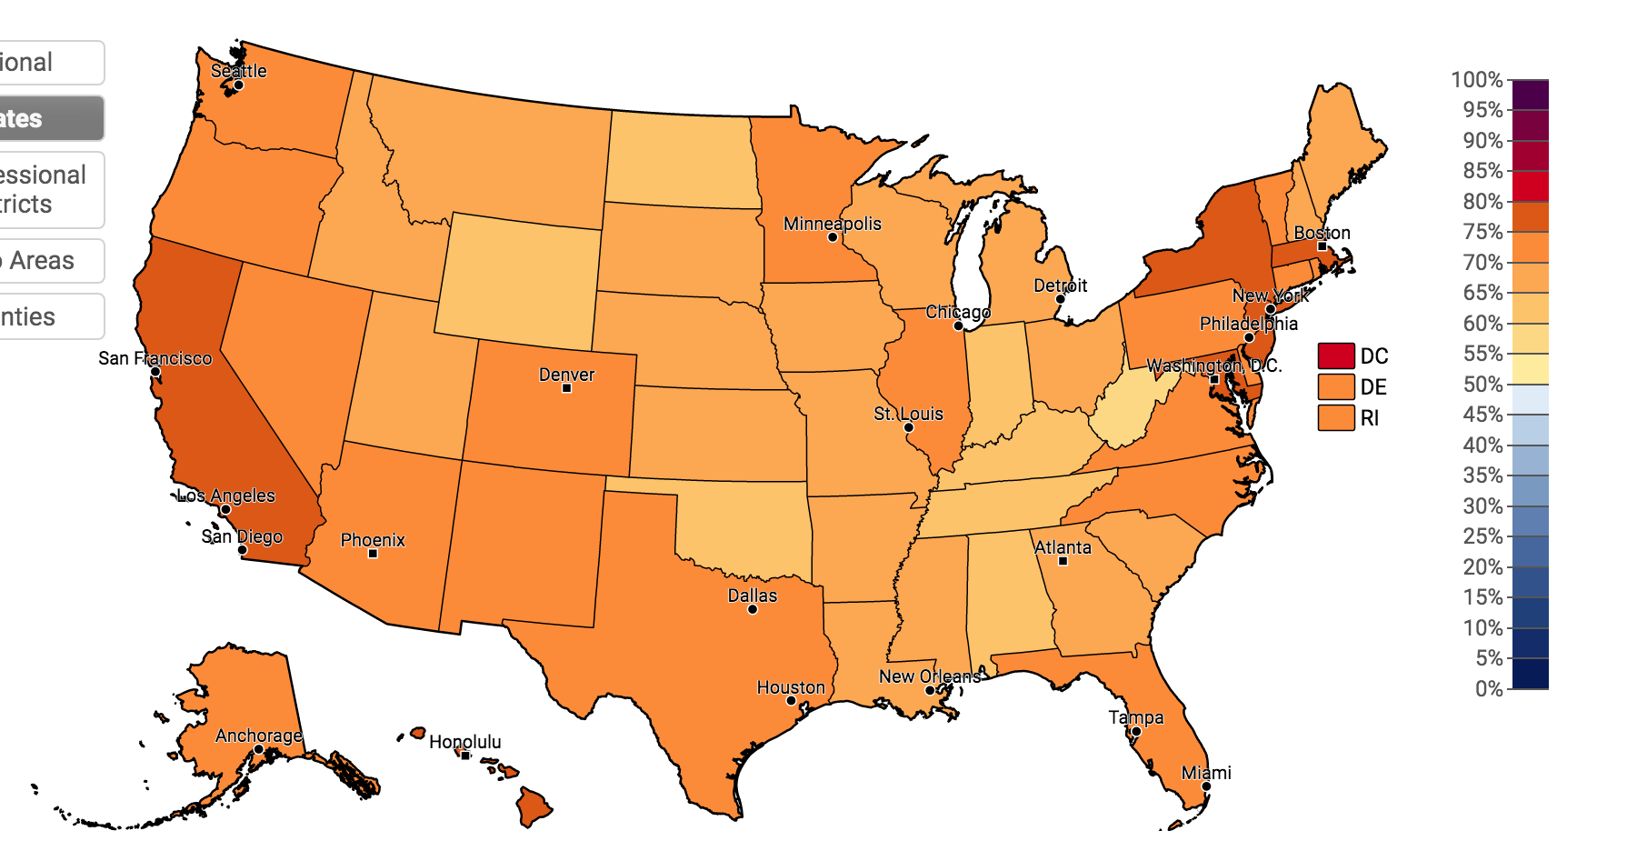
Perceptions matter.
Yes, global warming is happening.
66%
https://climatecommunication.yale.edu/
Notes:
Here I outlined the similar trends for the Nebraska and global annual average temperature. I also point out the high variability in Nebraska and difference in regional vs. global scales. I use the analogy that global change is like an escalator that is increasing at an accelerating rate. The variability is like we jump up or down a few steps while still going up.

Slide 5
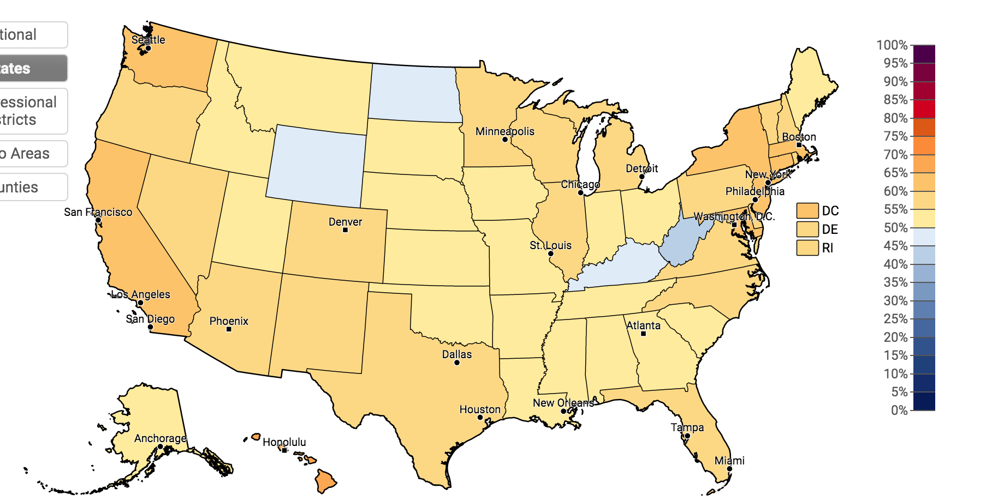
Perceptions matter.
It is caused mostly by humans.
52%
Notes:
Here I outlined the similar trends for the Nebraska and global annual average temperature. I also point out the high variability in Nebraska and difference in regional vs. global scales. I use the analogy that global change is like an escalator that is increasing at an accelerating rate. The variability is like we jump up or down a few steps while still going up.

Slide 6
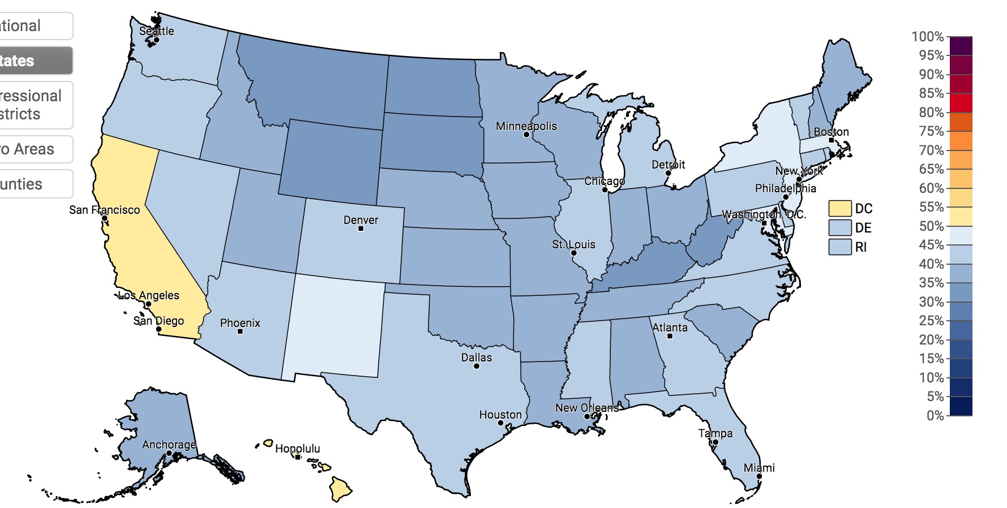
Perceptions matter.
It will harm me personally.
35%
Notes:
Here I outlined the similar trends for the Nebraska and global annual average temperature. I also point out the high variability in Nebraska and difference in regional vs. global scales. I use the analogy that global change is like an escalator that is increasing at an accelerating rate. The variability is like we jump up or down a few steps while still going up.

Slide 7
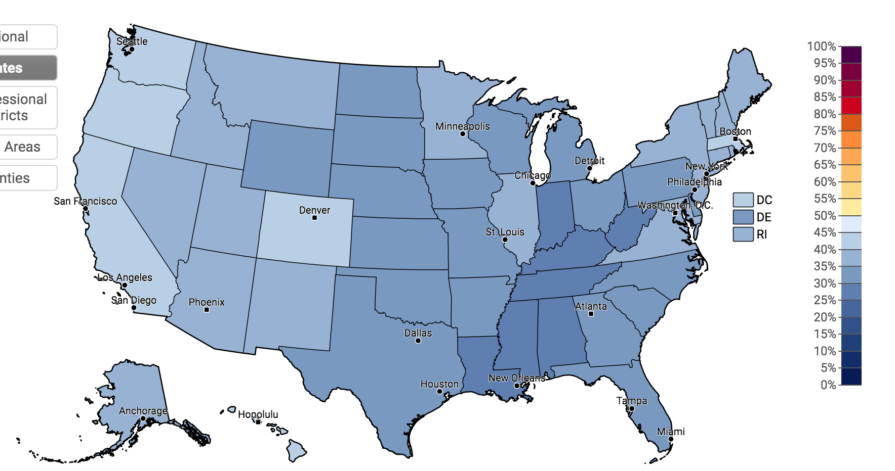
Perceptions matter.
I talk about climate change.
33%
Notes:
Here I outlined the similar trends for the Nebraska and global annual average temperature. I also point out the high variability in Nebraska and difference in regional vs. global scales. I use the analogy that global change is like an escalator that is increasing at an accelerating rate. The variability is like we jump up or down a few steps while still going up.

Slide 8
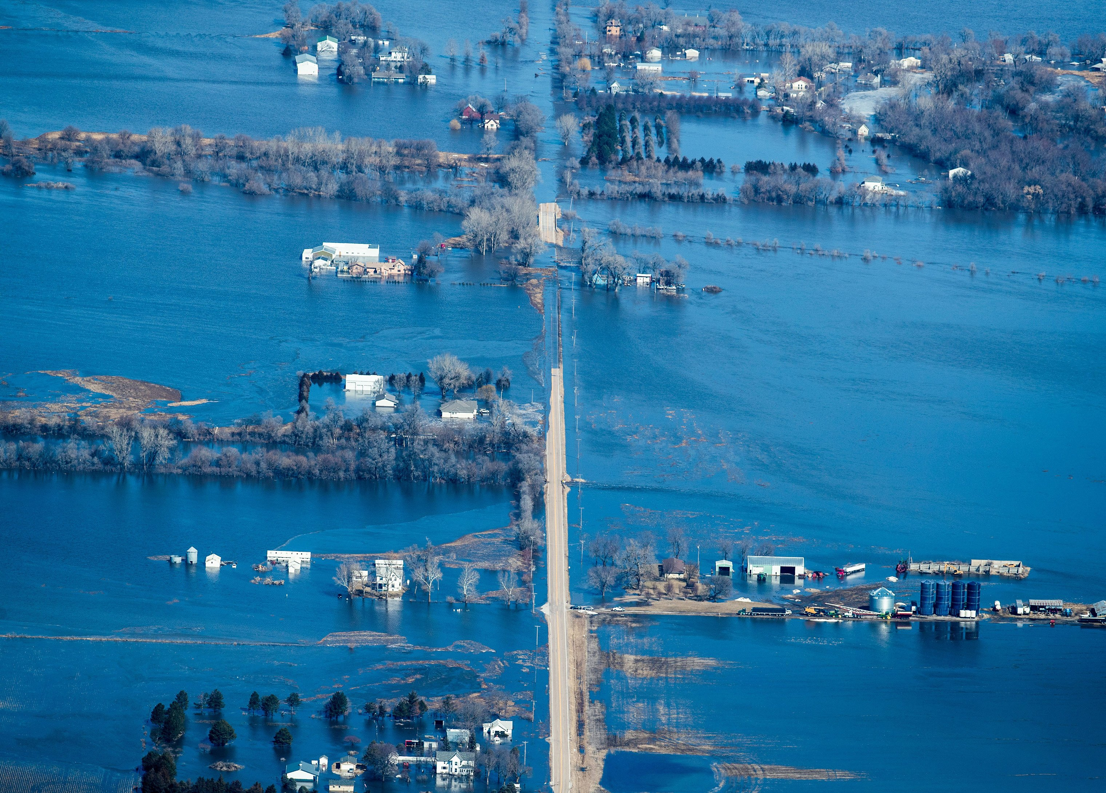
Climate change realities
It is already here and impacting us all.
The impacts are disproportional.
Action requires recognizing, responding and managing.
Action can/should occur in creative ways.
Notes:
Here I outlined the similar trends for the Nebraska and global annual average temperature. I also point out the high variability in Nebraska and difference in regional vs. global scales. I use the analogy that global change is like an escalator that is increasing at an accelerating rate. The variability is like we jump up or down a few steps while still going up.

