Slide 1
Challenges of Regional Climate Prediction
Ross Dixon
rddixon@unl.edu
Department of Earth and Atmospheric Sciences
26th October 2021

Slide 2
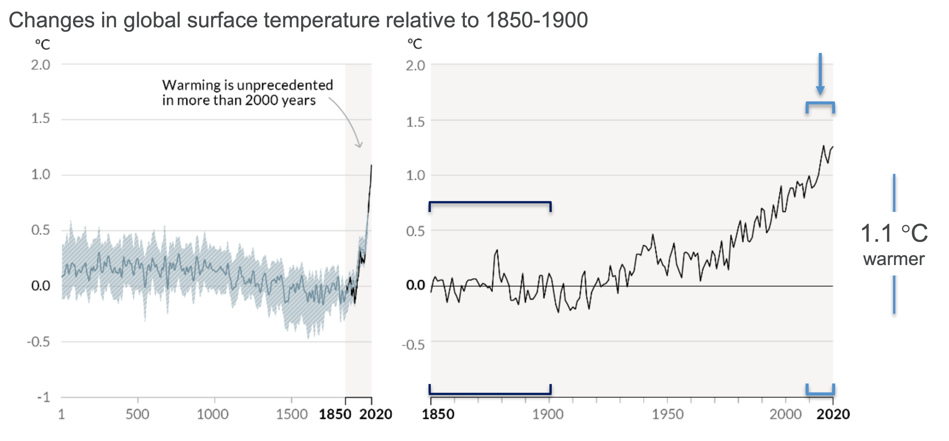
IPCC AR6

Slide 3
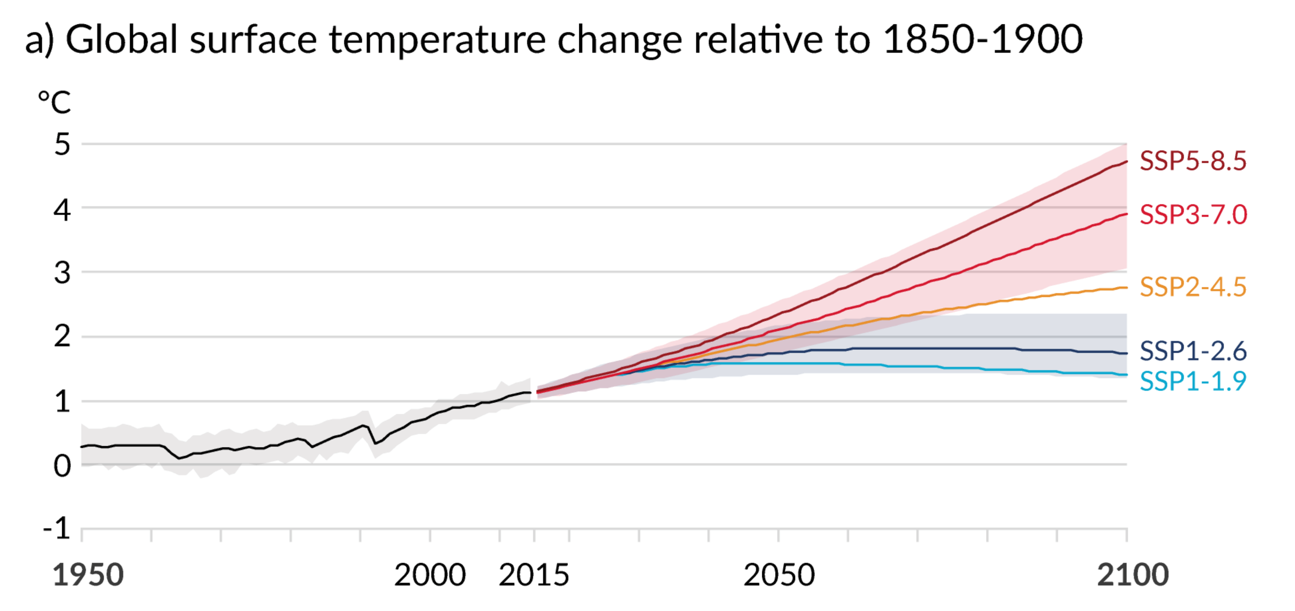
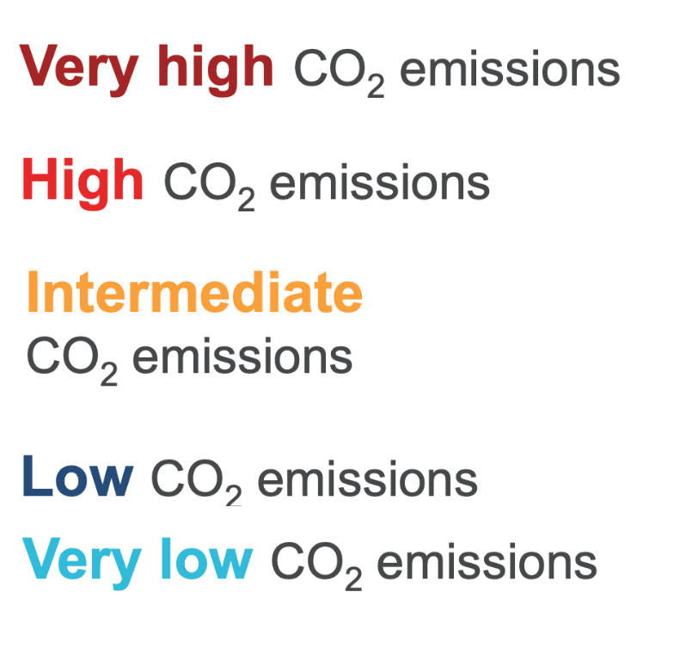
IPCC AR6

Slide 4
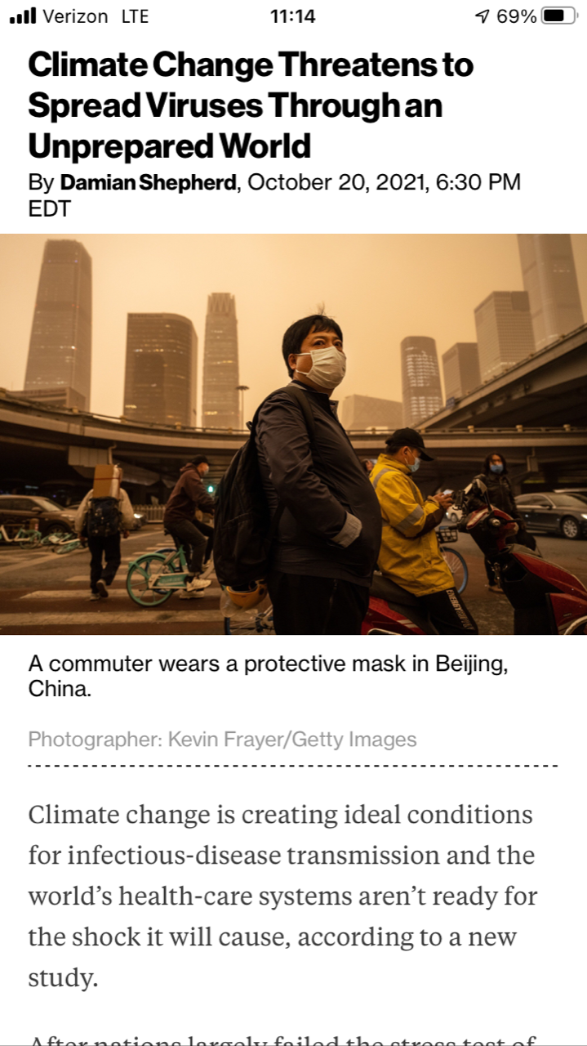
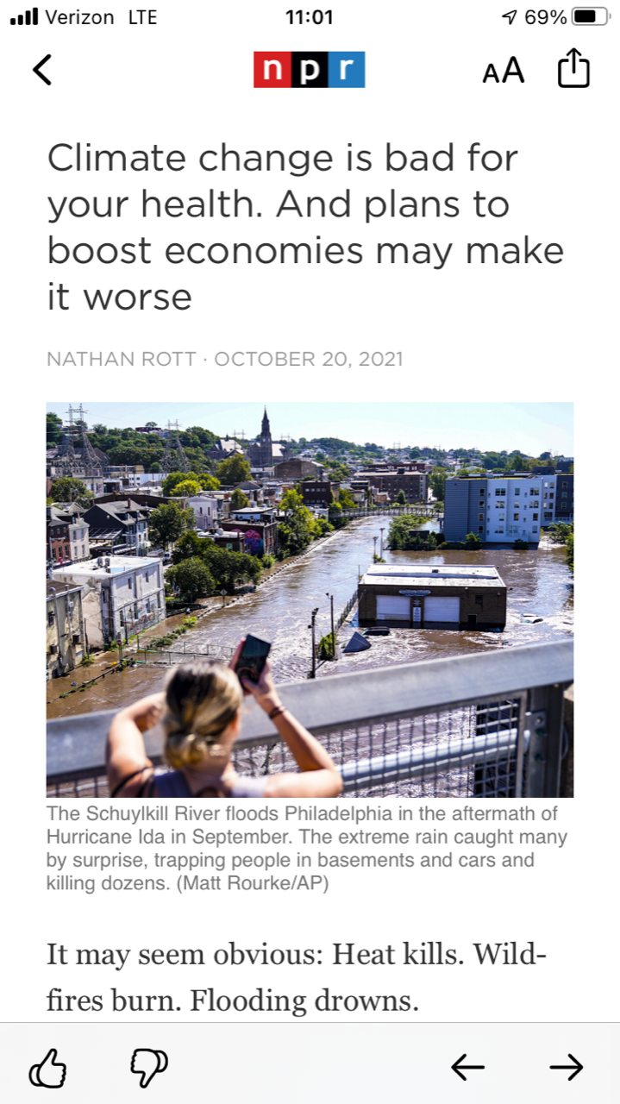

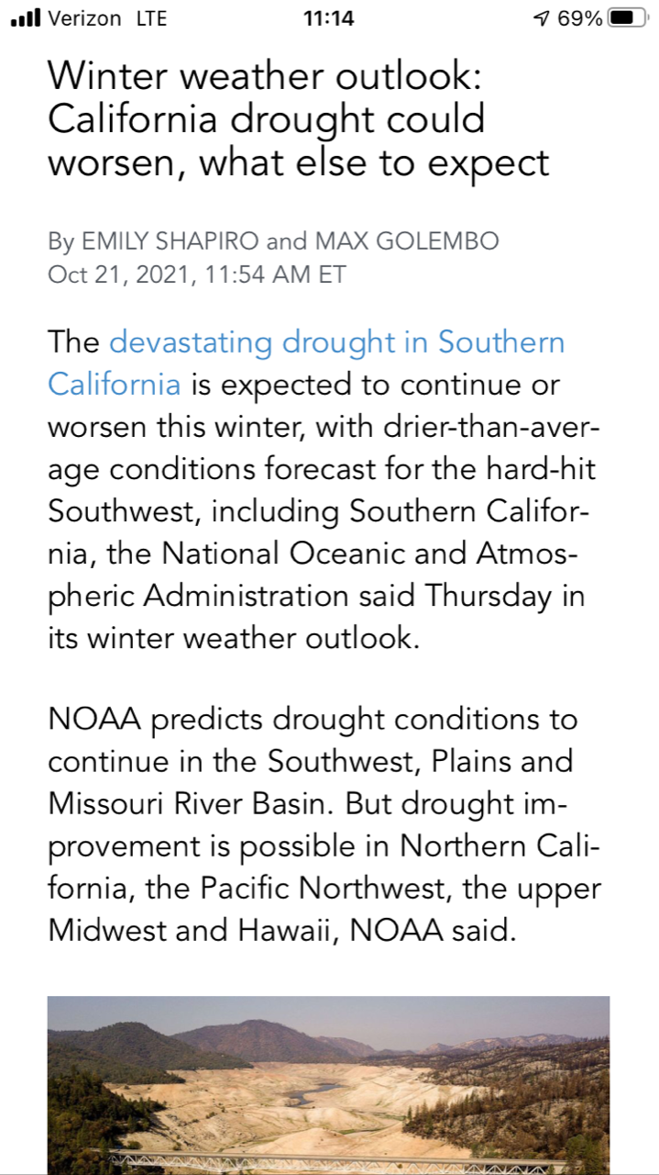
Ross Dixon, Assistant Professor
Department of Earth and Atmospheric Sciences

Slide 5
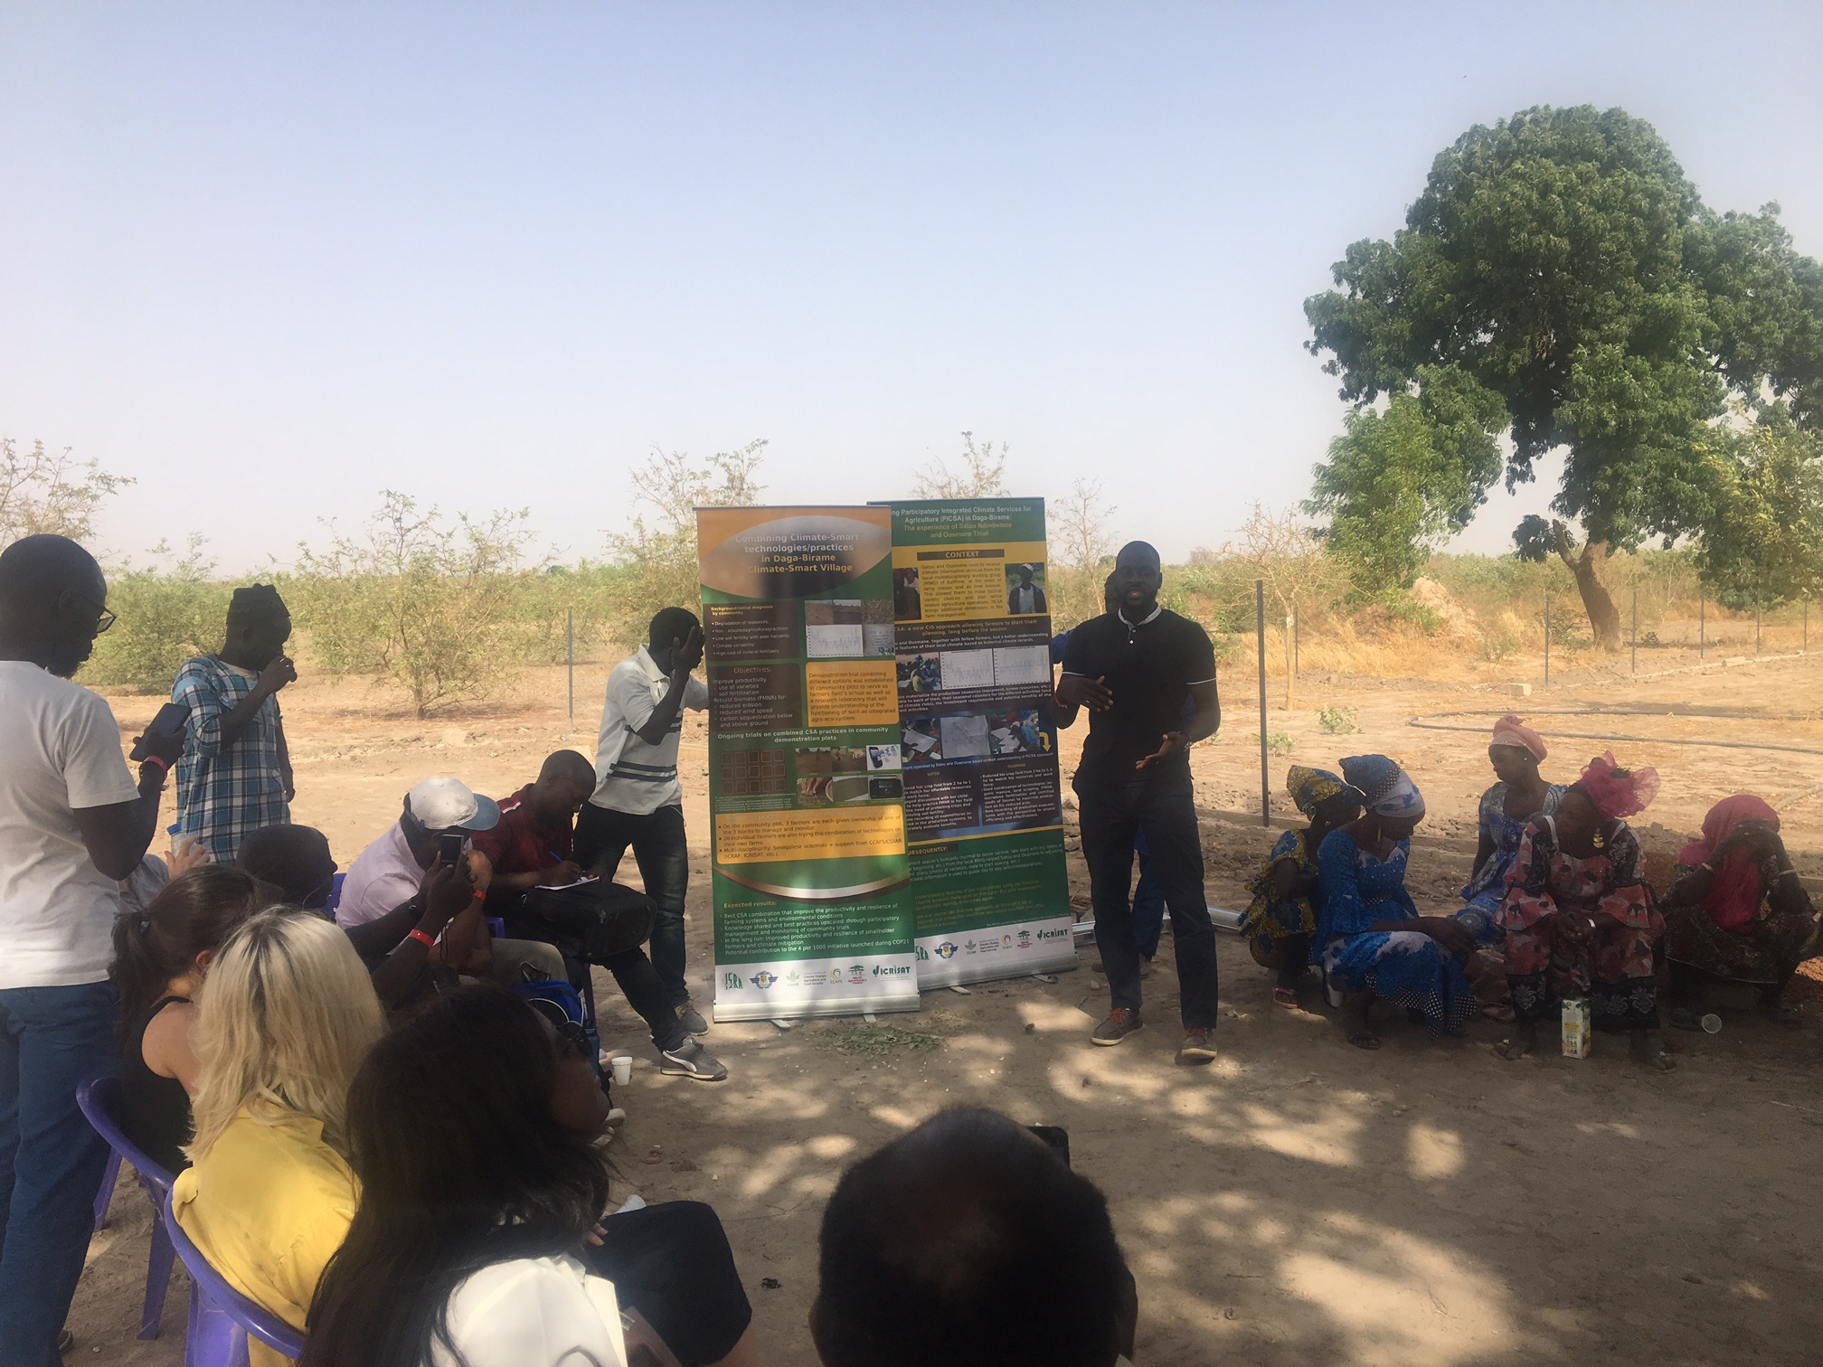
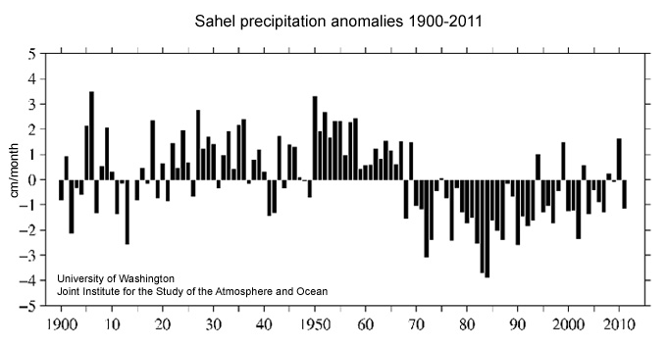
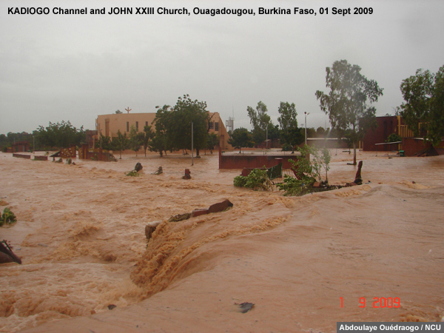
Visit to Climate Smart Village in Kaffrine Region of Senegal, June 2019
Visit to Climate Smart Village in Kaffrine Region of Senegal, June 2019
Ross Dixon, Assistant Professor
Department of Earth and Atmospheric Sciences

Slide 6
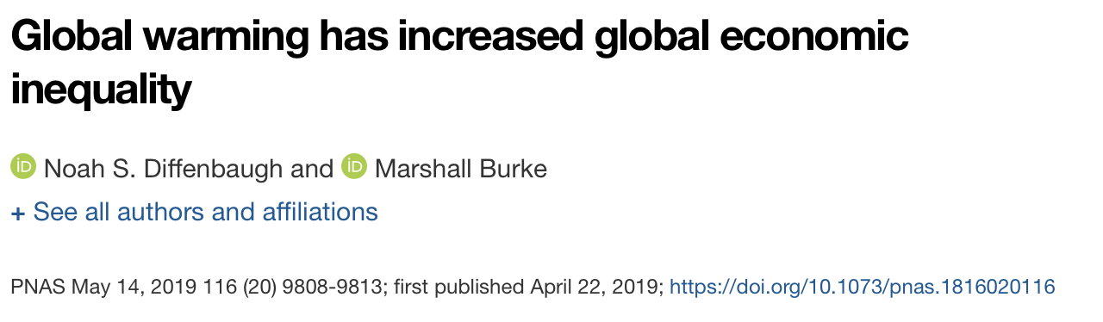
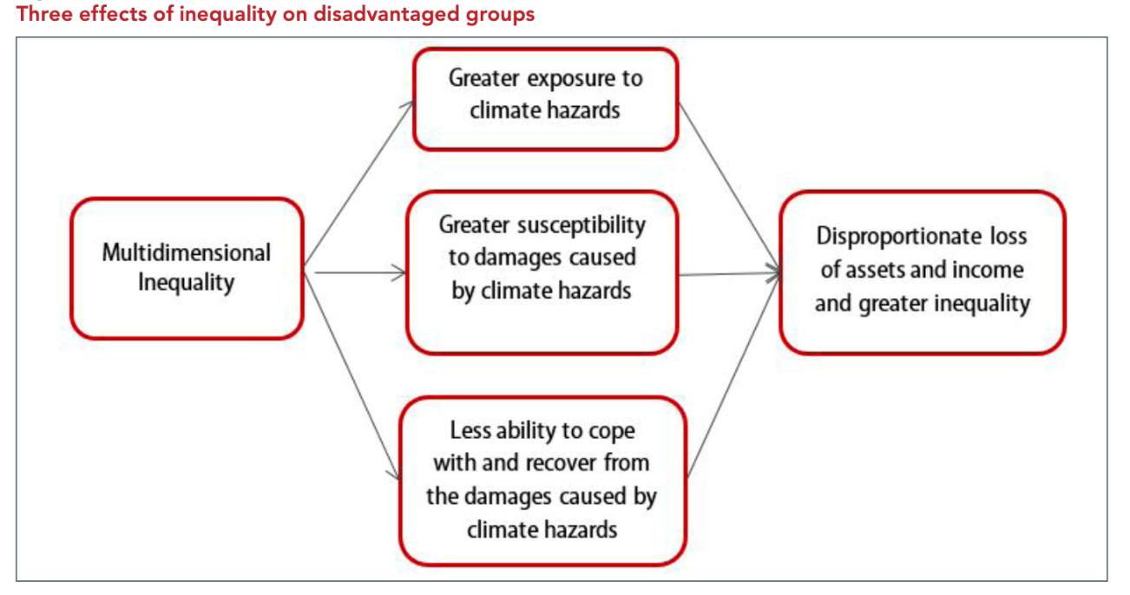

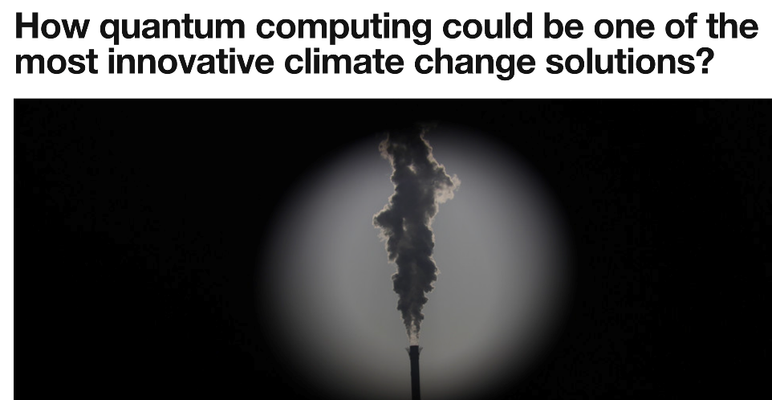
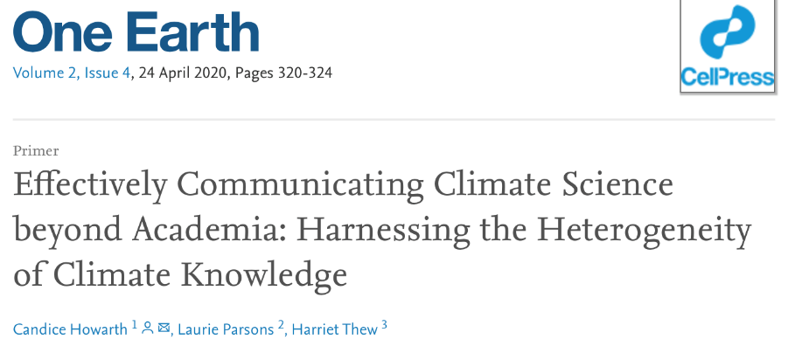
Jeremy O'Brien

Slide 7
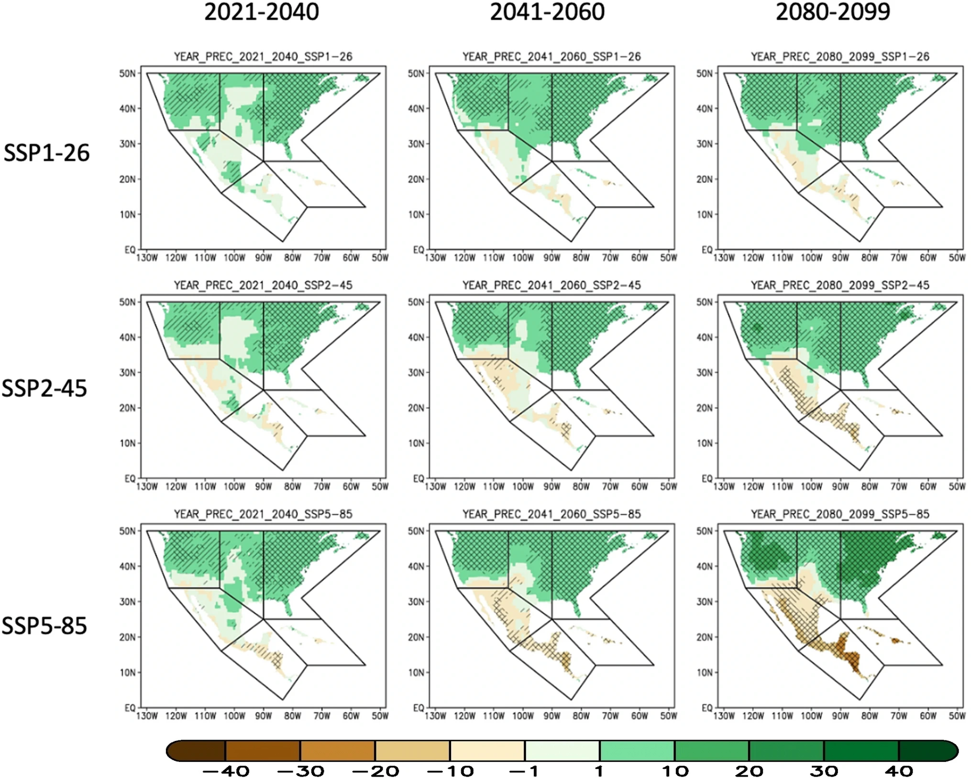
Ensemble Mean Precipitation Change 2080-2099 minus 1995-2014
Uncertainty in Regional Climate Change
Precipitation Change (Percent)
Almazroui et al. (2021)
Earth Syst. Environ.

Slide 8
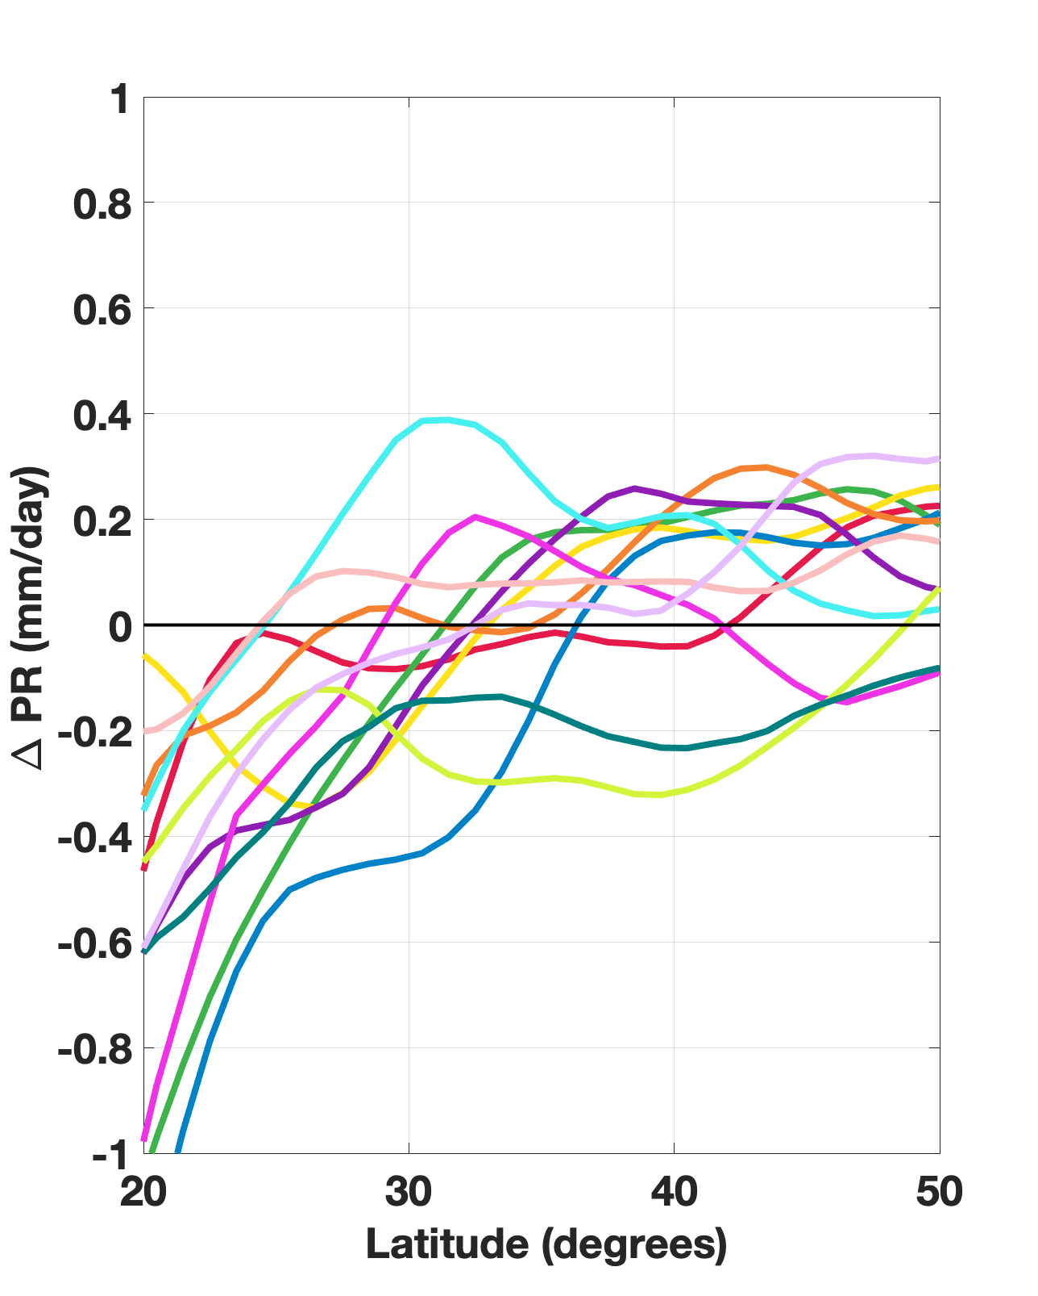
Ensemble Mean Precipitation Change 2080-2099 minus 1995-2014
Uncertainty in Regional Climate Change
Precipitation Change Between 90W and 115W
Precipitation Change (Percent)
Almazroui et al. (2021)
Earth Syst. Environ.

Slide 9
Reality
Precipitation
Sensitivity
Large-Scale
Circulation Patterns
Regional
Circulation Patterns
(2D and 3D)
Boundary Conditions
(SST, land surface)
,
,
Local Physics
(e.g. clouds)
:
,

Slide 10
Reality
Precipitation
Sensitivity
Large-Scale
Circulation Patterns
Regional
Circulation Patterns
(2D and 3D)
Boundary Conditions
(SST, land surface)
,
,
Local Physics
(e.g. clouds)
:
,
Model
Model
Precipitation
Sensitivity
Regional
Circulation Patterns
(2D and 3D)
Large-Scale
Circulation Patterns
Boundary Conditions
(SST, land surface)
,
,
Physical
Parameterizations
:
,

Slide 11
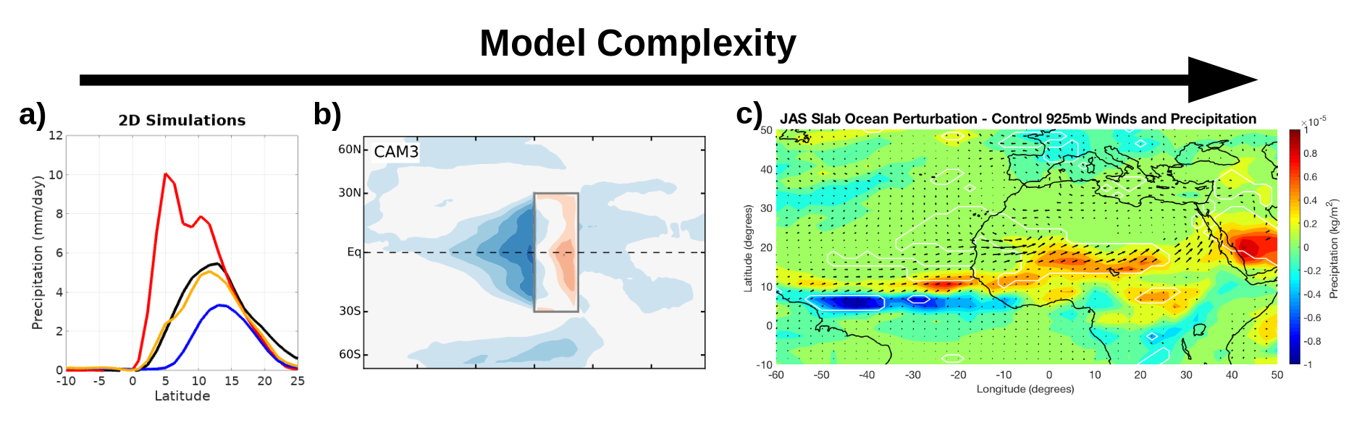
Reality
Precipitation
Sensitivity
Large-Scale
Circulation Patterns
Regional
Circulation Patterns
(2D and 3D)
Boundary Conditions
(SST, land surface)
,
,
Local Physics
(e.g. clouds)
:
,
Model
Model
Precipitation
Sensitivity
Regional
Circulation Patterns
(2D and 3D)
Large-Scale
Circulation Patterns
Boundary Conditions
(SST, land surface)
,
,
Physical
Parameterizations
:
,
2D Simulations
Aquaplanets
Global Climate Models

Slide 12
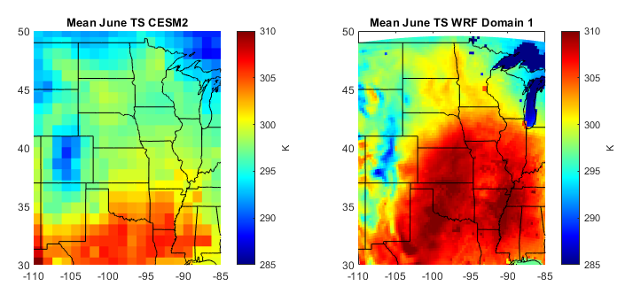
Increase understanding of climate dynamics and projection uncertainty Produce high resolution output for driving impact models, for example, agricultural and hydrological models
Regional Climate Modeling
Global Climate Model
(standard CMIP output)
Regional Climate Model
(WRF run on HCC CraneOPA)
Δx = 50km – 200km
Δt = > 6hr
Δx = 4km – 20km
Δt = hourly

Slide 13

Resilience to regional climate change can be addressed at UNL through:
study of climate dynamics
connecting researchers and stakeholders
communicating climate change
Ross Dixon, Assistant Professor
Department of Earth and Atmospheric Sciences

