Slide 1
Mitigating Emerging Food Safety Hazards:
Food security in the times of COVID-19
Byron D. Chaves, PhD.
Assistant Professor
Department of Food Science and Technology
University of Nebraska-Lincoln
Twitter: @that_bald_prof

Slide 2
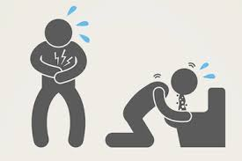
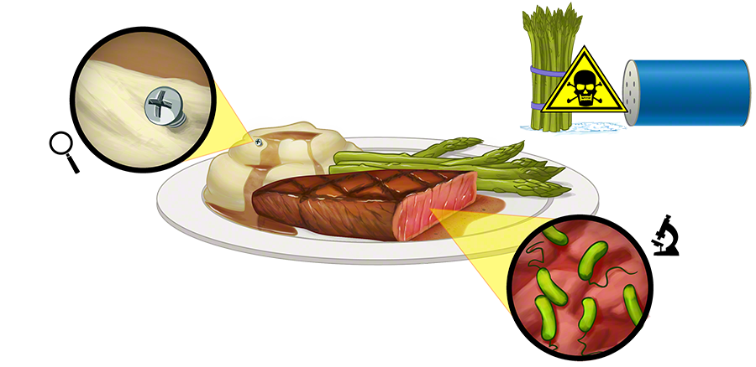
FOOD SAFETY HAZARDS
Biological, chemical, or physical agent that is reasonably likely to cause illness or injury in the absence of its control.
PUBLIC HEALTH BURDEN:
48 million annual cases, 128,000 hospitalizations, and 3,000 deaths
ECONOMIC BURDEN:
$15.5B annual losses
https://www.cdc.gov/foodsafety/foodborne-germs.html
https://www.ers.usda.gov/amber-waves/2015/september/quantifying-the-impacts-of-foodborne-illnesses/

Slide 3
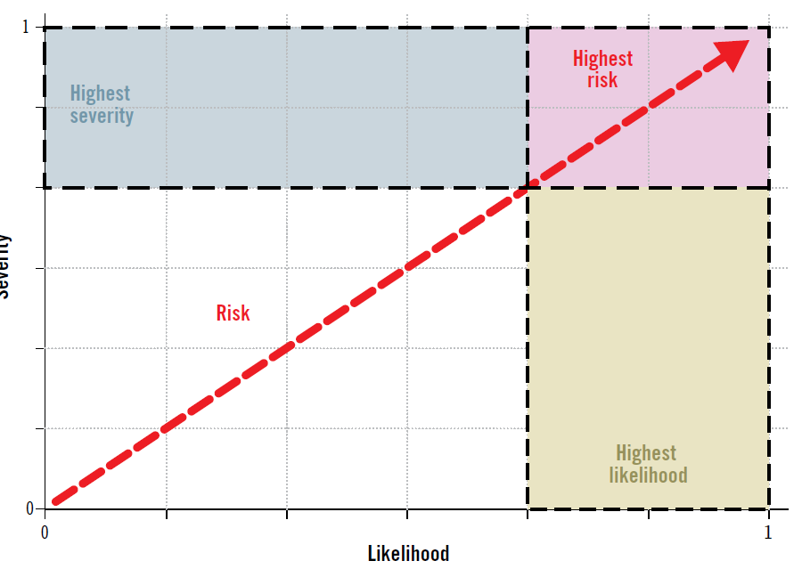
FOOD SAFETY RISK
A probability function of the incidence of occurrence of a hazard and the severity of the illness/injury caused by that hazard
http://www.fao.org/3/cb0887en/CB0887EN.pdf

Slide 4
CHAVES – Food Safety Microbiology Lab
Spread, detection, and control of pathogenic organisms along the farm-to-table continuum.
Design and evaluation of chemical, physical, and biological antimicrobial mitigation strategies to reduce the risk of pathogen transmission and hence, illness in the consumer.
Methodologies to better detect injured bacterial cells in multiple food and animal matrices as well as the phenotypical and genotypical characteristics that allow pathogens to survive, multiple, and even thrive in foods and food processing environments.

Slide 5
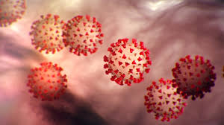
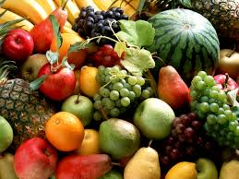
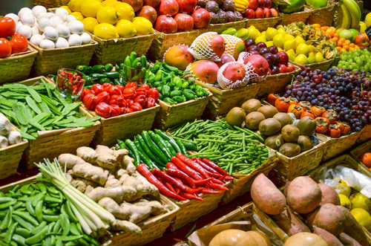

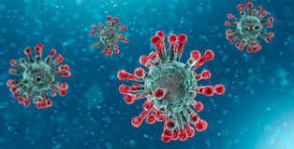
FOOD SAFETY AND COVID-19
Is SARS-CoV-2 a foodborne virus?
FDA/USDA/CDC Joint Statement: “There is no credible evidence that food or food packaging are associated with or are a likely source of SARS-CoV-2 transmission.”

Slide 6

Collaborative Research and Outreach
Intersection of food safety and covid-19
Multi-institutional team of food safety scientists and virologists
Research, extension, and outreach to help mitigate the impact of the covid-19 pandemic in the food industry and the food supply.
Extensive stakeholder involvement
Provide science-based risk management decision tools
@FoodCoVNET on Twitter
foodcov.net

Slide 7
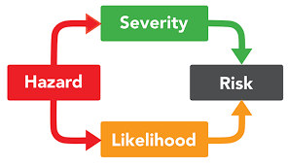
EMPIRICAL EVIDENCE or ANECDOTE?
No internationally recognized public health authority has identified food as a route for COVID-19 infection.
Certain foreign governments pushing for a foodborne transmission agenda
Infamous SARS-CoV-2 pre-print has been retracted.
True foodborne viruses, such as norovirus and hepatitis A, enter the body primarily through oral ingestion from where they infect tissues elsewhere in the human body.
The mere present of a potential hazard does not necessarily represent a risk for human infection.

Slide 8
SCIENCE-BASED RISK MANAGEMENT
EVALUATING VIRAL SURROGATES FOR SARS-CoV-2
STAGE 1 – Method validation for the recover of PRRS virus from food contact surfaces
STAGE 2 – Evaluation of HCoV 229E survival and persistence on food contact surfaces and packaging materials under simulated food processing conditions of cleanliness, temperature, and relative humidity
STAGE 3 – Assessment of viral transfer from contaminated food surfaces to gloves and to clean surfaces using 229E and bacteriophage Phi6 as model organisms

Slide 10

ACKNOWLEDGMENTS
Dr. Janak Dhakal – UNL Food Science and Technology
Dr. Hiep Vu – UNL Animal Science and Nebraska Center for Virology
Dr. Benjamin Chapman – NCSU
Dr. Michelle Danyluk – UF
Dr. Donald Schaffner - Rutgers
USDA-NIFA Grant No: 2020-68003-32789

Slide 11
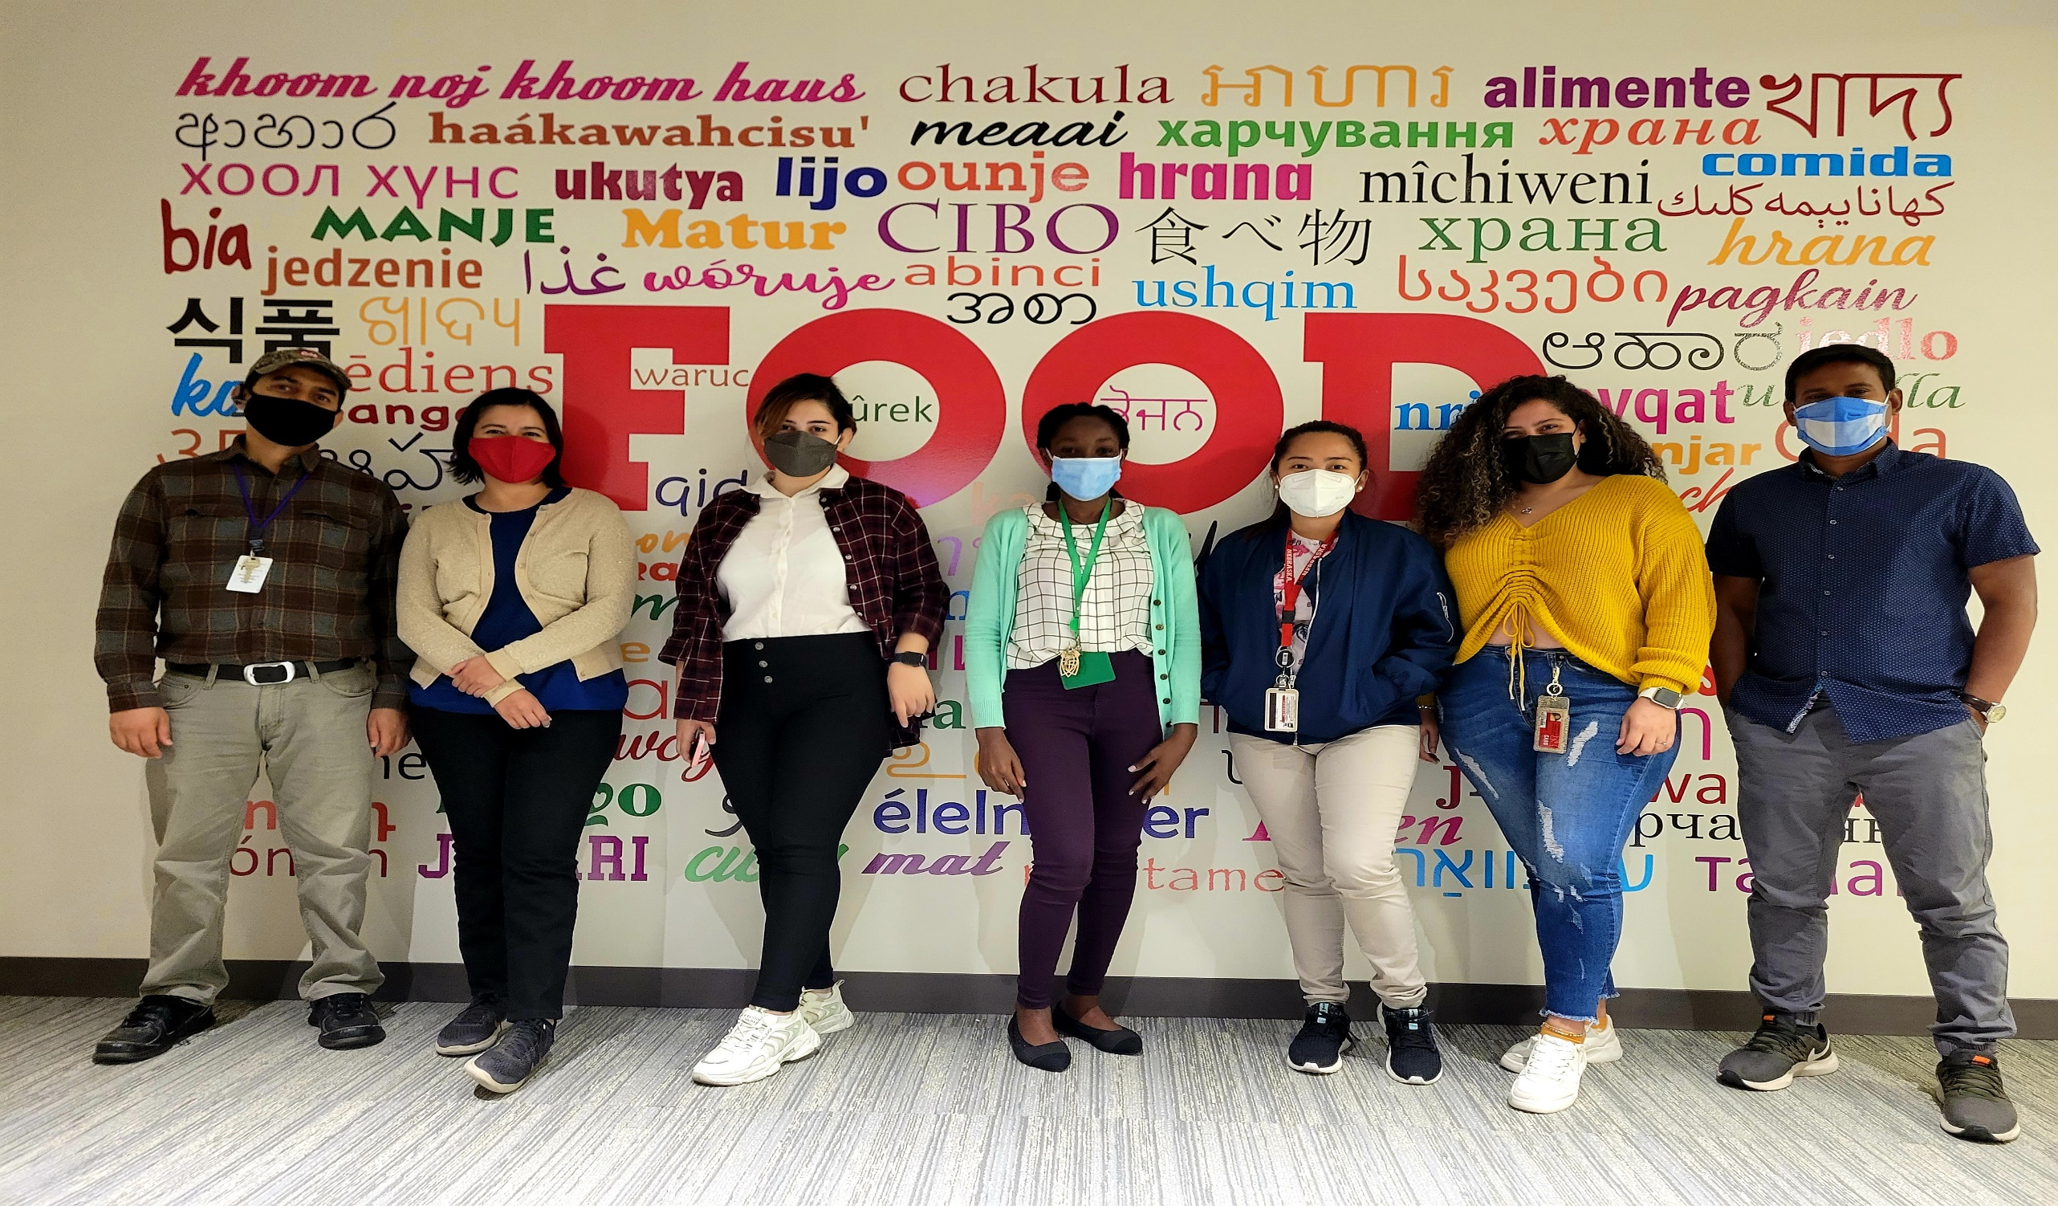
CHAVES LAB – September 27, 2021

