Slide 1
Maintaining Resilient Agricultural Landscapes
NSF-DISES & UN Research Network
Notes:
Thank you for the opportunity to speak today. I am going to talk, briefly, about one of my projects, its link to the Grand challenges, and impact.

Slide 2
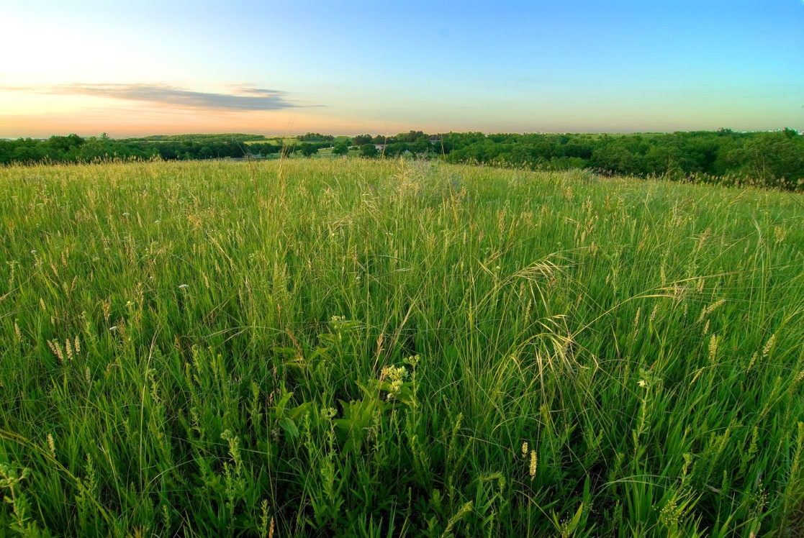
Risk, vulnerability and resilience in agriculture
In our current era of rapid global change, resilient agricultural socio-environmental systems are fundamental for global food security.
Notes:
Resilient agricultural systems are those that can continue to provide food, livelihood security, and important ecosystem services in the face of climate, economic, and other global changes currently threatening agricultural systems.

Slide 3
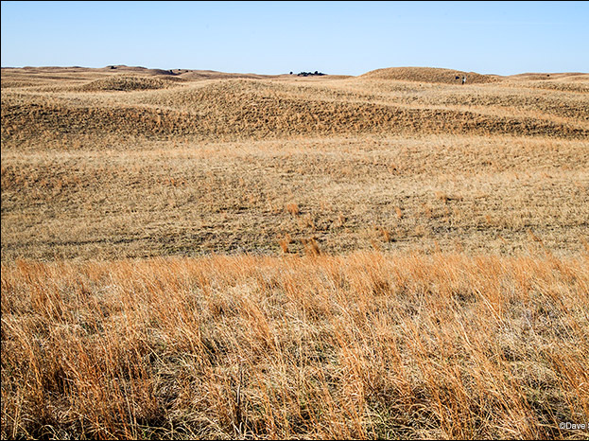
Risk, vulnerability and resilience in agriculture
Yet maintaining resilient socio-environmental agricultural systems is a complex challenge, for which we currently lack critical scientific knowledge.
Notes:
But many aspects of these complex systems are poorly understood, especially the role of scale and feedbacks, and the everchanging relationship between humans and nature.

Slide 4
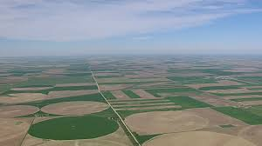
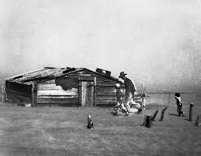
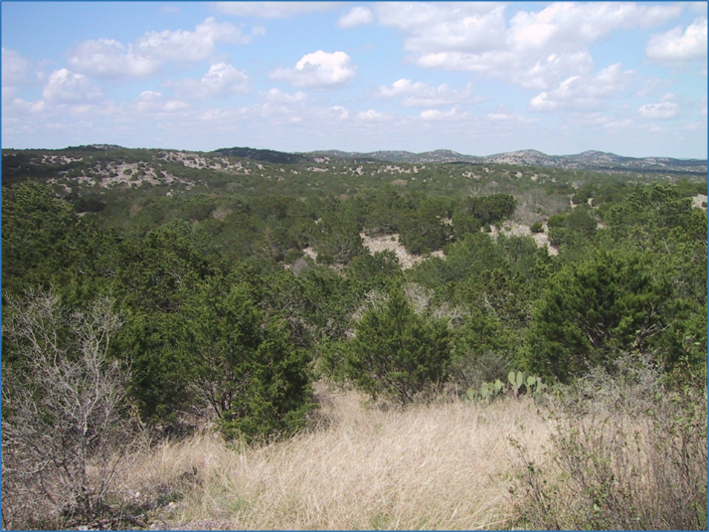
Risk, vulnerability and resilience in agriculture
Modern agricultural systems are vulnerable
to sudden changes that lead to collapse and reorganization; new systems may be less desirable for humanity.
Notes:
History is littered with advanced agricultural civilizations that have collapsed due to agricultural collapse. Often driven by change in a slow driver variable - - often climate.

Slide 5
Resilience in agricultural socio-environmental systems
We are creating a North American Agricultural Research Network, linking:
The USDA LTAR
Living Laboratories Canada
Resnet Canada
The Resilience Alliance
Agricultural sites in Mexico
Notes:
In response to these challenges, we have created a network of networks

Slide 6
Complex socio-environmental working landscapes
Understanding resilience in agriculture, tradeoffs among ecosystems services, and the balance between efficiency and resilience is critical for humanity.
Notes:
Where we seek to understand the resilience of agriculture and agricultural landscapes at multiple scales, and the tradeoffs, implicit and explicit, that agricultural management entails.

Slide 7
Complex socio-environmental working landscapes
We will investigate:
Heterogeneity and scale
Regime shifts and alternative regimes
Thresholds for change
Tradeoffs among suites of ecosystem services
Tradeoffs between efficiency and resilience

Slide 8
Complex socio-environmental working landscapes
This will require:
Interdisciplinarity
Social, ecological, economic (+ sub-disciplines) integration and convergence
Understanding of cross-scale feedbacks and interactions; understanding drivers of change
Notes:
No single discipline can solve these grand challenges. Serendipitous (or more planned) insights from other disciplines can provide advances.

Slide 9
Complex socio-environmental working landscapes
The benefits of this approach:
Potential for convergence
Inference at large scales – North America
Rapid learning – many disciplines, many people, many experiments

