Slide 1
Emergent Phenomena at Quantum Materials Interfaces
Xia Hong
Department of Physics and Astronomy
University of Nebraska-Lincoln

Slide 2
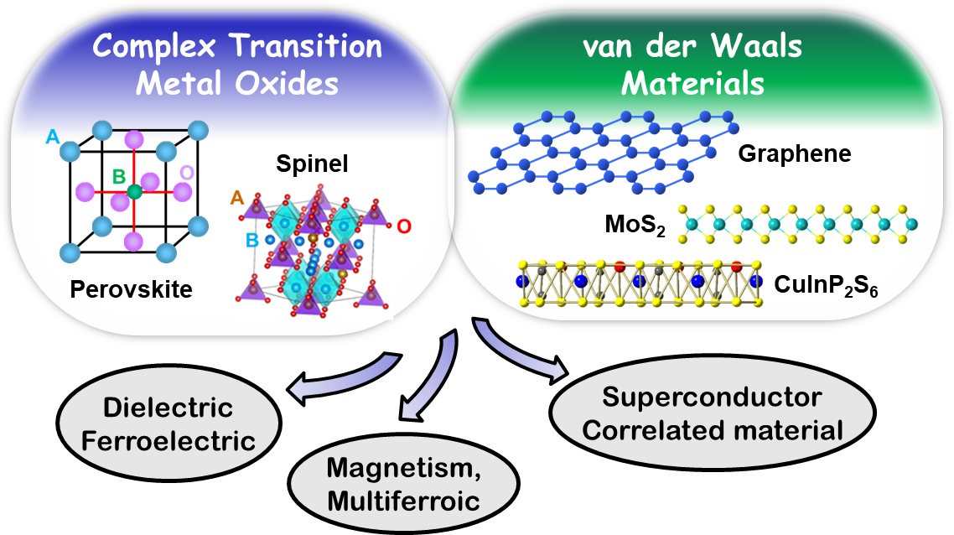
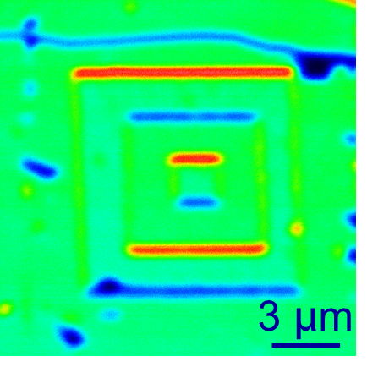
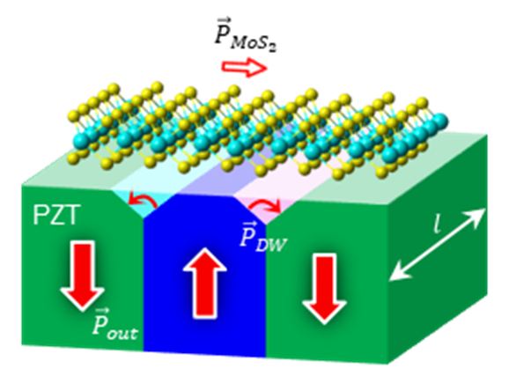
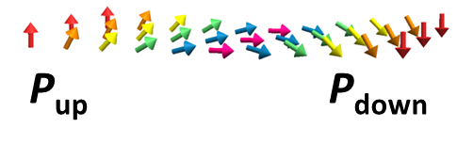
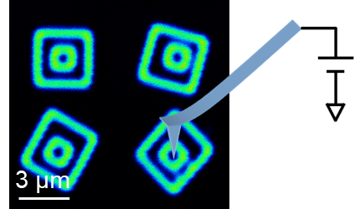
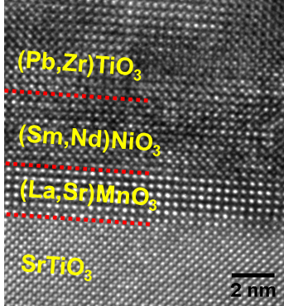
Emergent Phenomena at Ferroelectric Oxide/2D van der Waals Heterointerface
Unconventional optical filtering at the interface of MoS₂/Pb(Zr,Ti)O₃
PZT domain wall
Li et al., Nat. Commun. 11,1422 (2020).
Epitaxial oxide heterostructures
Polar coupling between monolayer MoS₂ and the chiral rotation of surface dipoles at the domain wall of ferroelectric Pb(Zr,Ti)O₃
Collaboration with Yongfeng Lu (ECE) and Evgeny Tsymbal (Physics) groups
Nanoscale domain control and imaging
Chen et al., Adv. Mater. 29, 1701385 (2017).

Slide 3



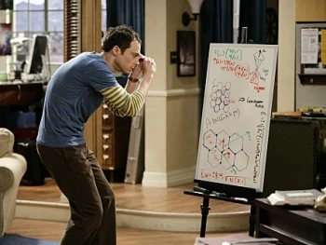
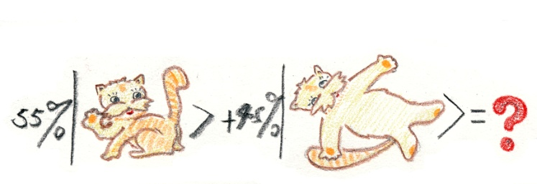
Addressing UNL’s Grand Challenges
Understand and control the properties of novel quantum materials
Develop material platforms for realizing quantum computing, sensing and metrology
EPSCoR EQUATE: team effort on developing quantum materials and technology
Workforce development
Outreach
Climate modeling/prediction
Clean energy
Controlling carbon emissions
Climate resilient applications
Phis’s World: A comic approach to high school physics education
The Big Bang Theory: Sheldon trying to understand graphene

