Slide 1
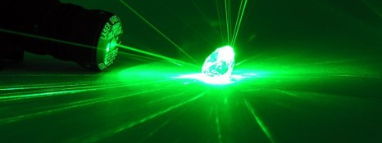
Quantum Sensing
Abdelghani Laraoui, Assistant Professor, Mechanical and Materials Engineering
October 19th, 2021.

Slide 2
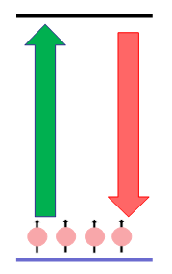

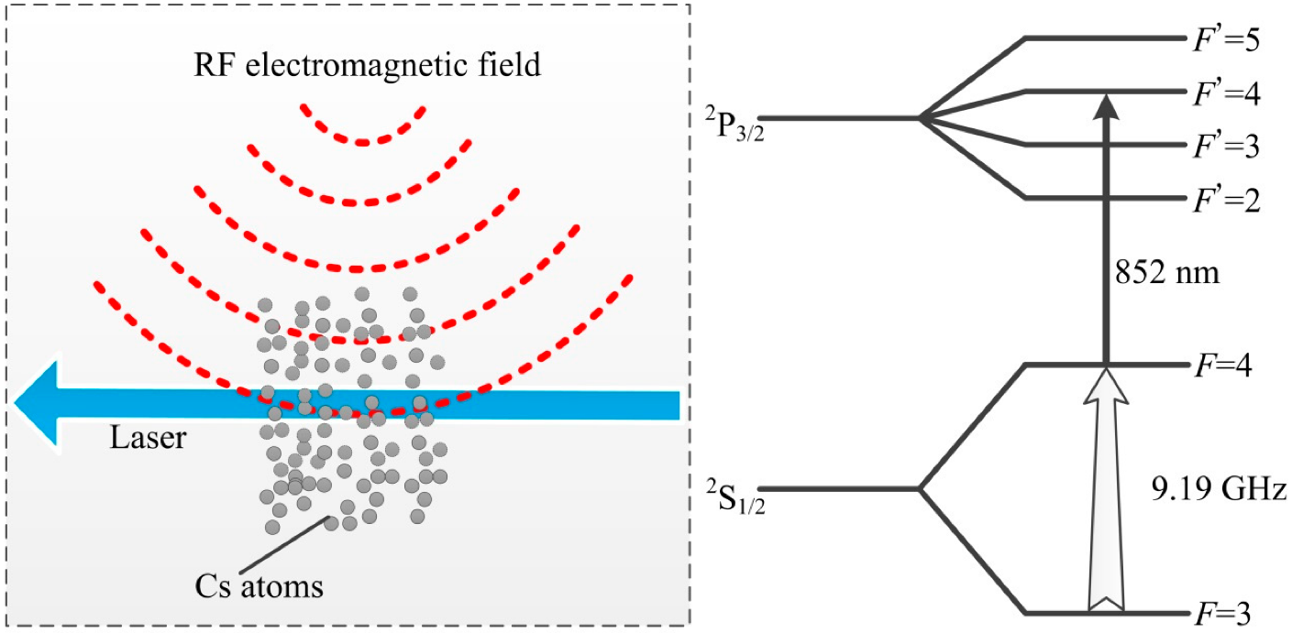
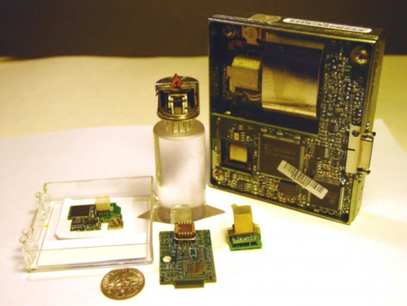
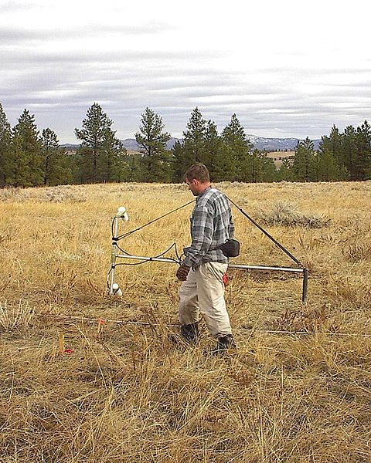
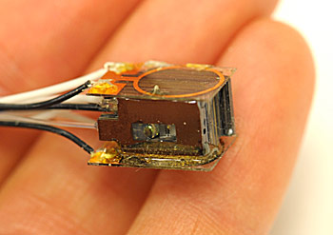
Quantum sensing
Quantum sensor criteria (analogous to DiVincenzo’s):
Discrete energy levels
Initialization into single state
Coherent control via external driving (laser, MW/RF, etc.)
Energy levels shift in response to environment (temperature, magnetic field, electrical field, time, position, gravity…).
Early quantum sensors (atomic vapor)
Clocks (GPS)
Magnetometers
Geophysics biomedical
2014
NIST
NIST
(1 second drift in 300 million years)
Sandia NL
EPA website

Slide 3
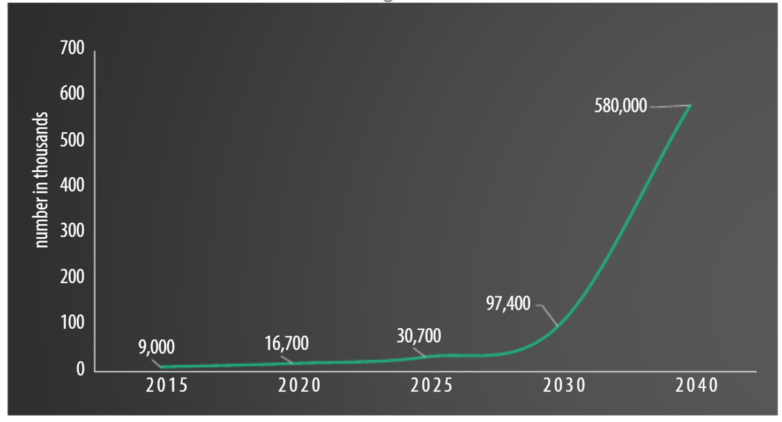
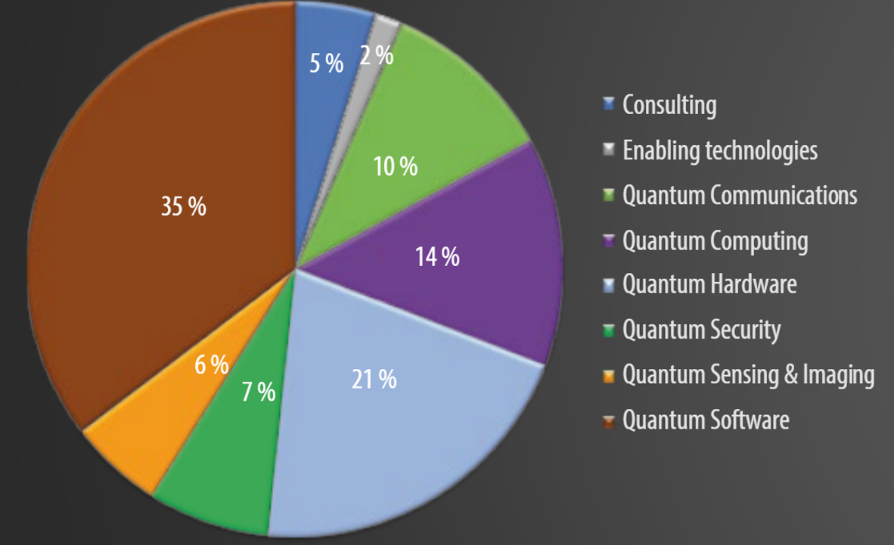

Quantum sensing: Impact and connection to UNL’s Quantum science and engineering challenges
The application of quantum sensors is mainly found in industries such as military and defense, automotive, space, and healthcare, among others. Applications range from providing highly accurate positioning data to detecting submarines in the world’s oceans.
The Global Quantum Sensors Market was valued at USD 439.76 million in 2020, and it is expected to reach USD 702.16 million by 2026, registering a CAGR of 8.4% during the period of 2021-2026.
The global market size for quantum technologies is expected to grow to more than $ 16 B in the next ten years with an estimation of with almost 600,000 new jobs in 2040
Distribution of quantum companies per sector
Estimated job growth in quantum technologies
The Quantum Ecosystem and Its Future Workforce: https://doi.org/10.1002/phvs.202000044
With $22 B worldwide investment in quantum science research, it is critical that UNL and Nebraska to be part of the next quantum revolution and remain at the forefront of research and education of quantum science and engineering. Such leadership will secure tomorrow’s economic well-being, which will depend on educating a qualified workforce.
New quantum sensors are expected to lead to the improvement of multiple sensing technologies, ranging from accurate atomic clocks, sensitive quantum gravitometers, low-noise quantum interference microscopy, nano-MRI, single cell microscopy….

Slide 4
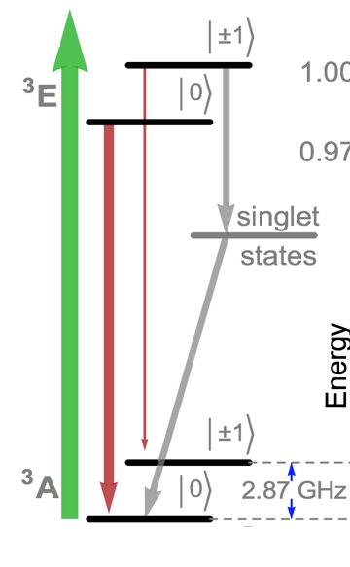
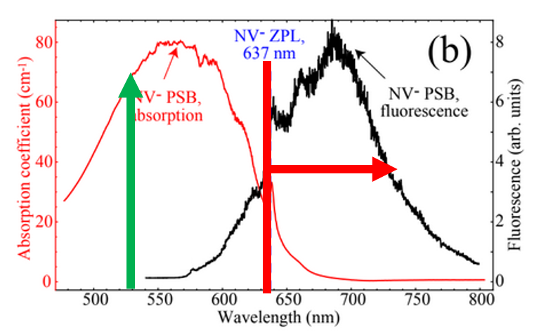
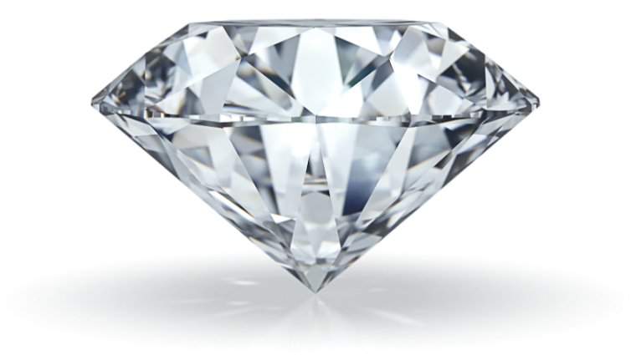
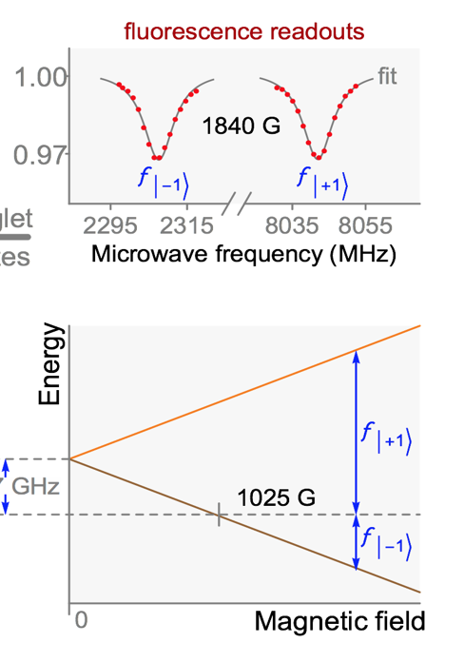
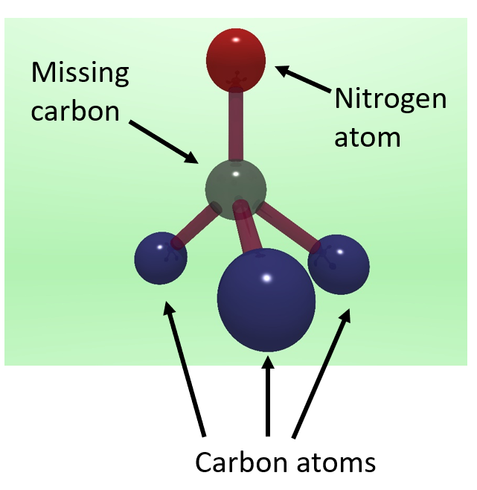
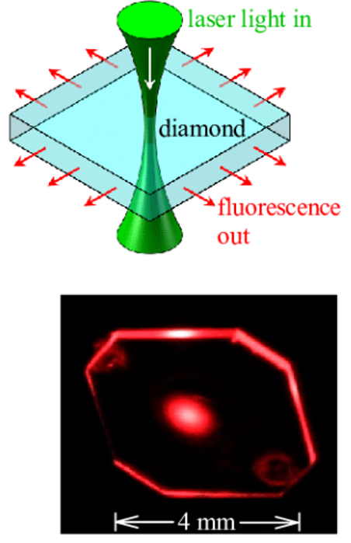
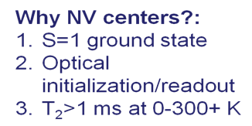
Diamond Quantum Sensing
Nitrogen vacancy (NV) center in diamond
NV emission and absorption spectra
Optical detected magnetic resonance: Zeeman splitting
C3v symmetry
NV₀, NV⁻
6 e-, 2 unpaired (gs)
Marcus W. Doherty, et al., Physics Reports 528, 1–45 (2013)

Slide 5

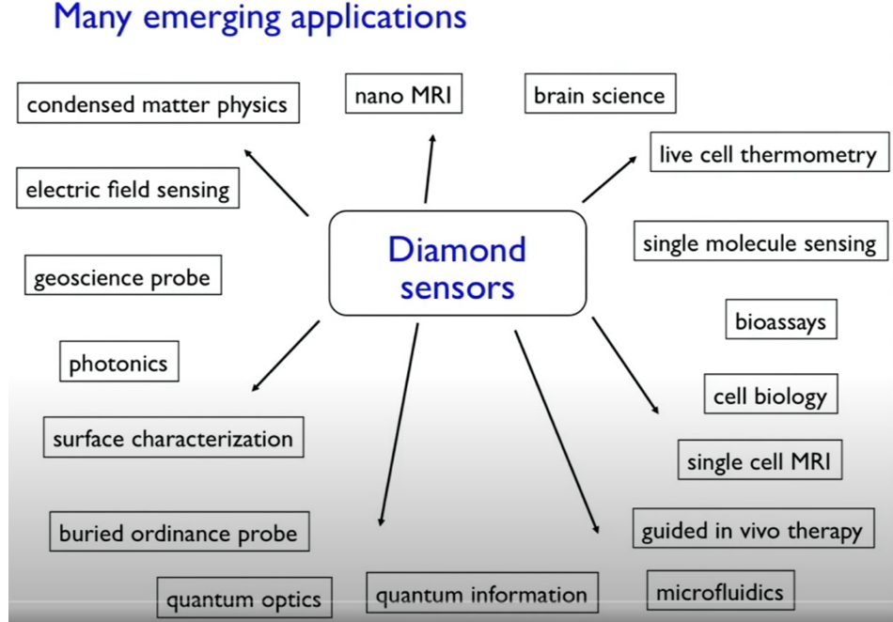
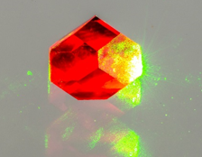
Diamond Quantum Sensing
Temperature, strain, pressure
Photograph by Jon Newland (Warwick)
Credit: Prof. Ronald Walsworth, Electrical and Computer Engineering, UMD

Slide 6
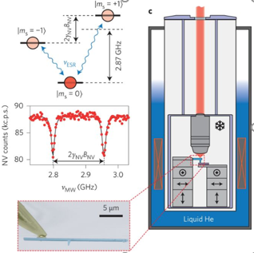
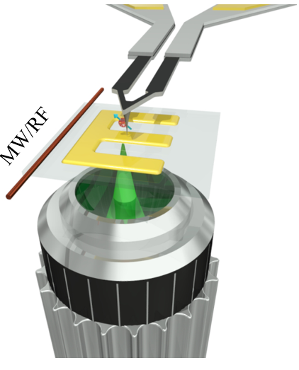
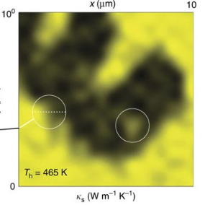
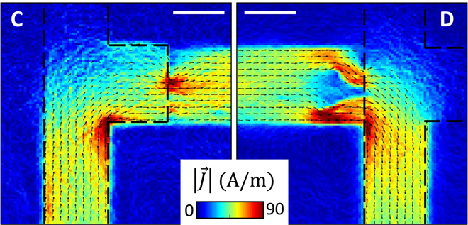
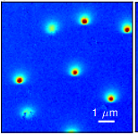
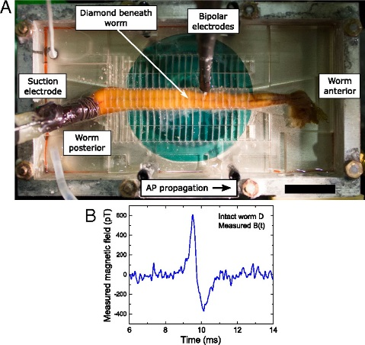
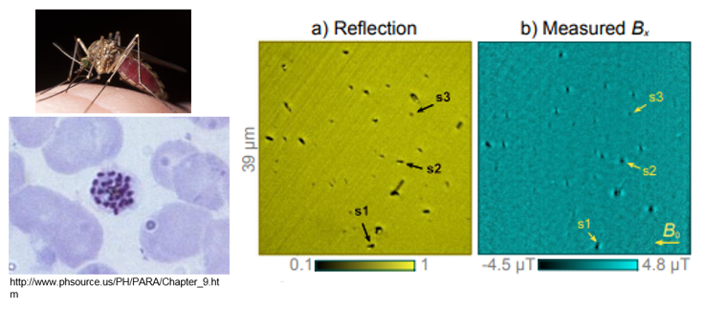
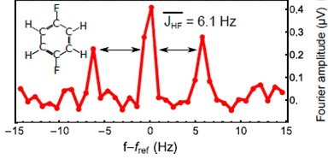
Diamond Quantum Sensing
Condensed Matter Physics
Thermal conductivity mapping
Graphene current imaging
Superconductivity
Tetienne et al. Science Adv. (2017)
Biosensing
Thiel et al., Nature Nano. (2016)
A. Laraoui et al. Nature Comms (2015)
Neuron recording
Imaging individual malarial nanocrystals
NMR spectroscopy
A. Laraoui, et al, Nature comm. (2013), Nature comm. (2017); J. Smits…, A. Laraoui, et al. Science Advances, under review (2019).
Barry et al. PNAS (2016)
Fescenko, Laraoui, et al, Phys. Rev. Applied 11 (3), 034029 (2019)

Slide 7
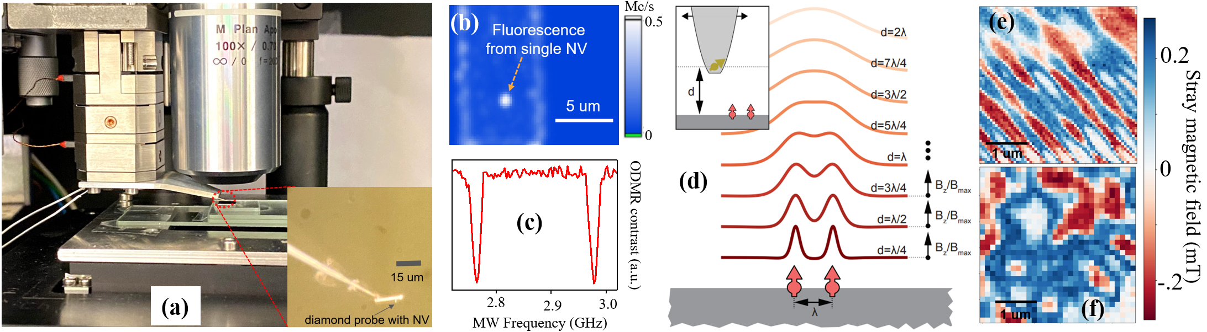
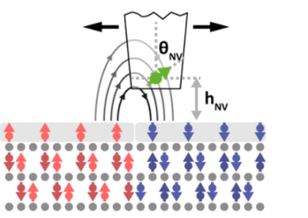
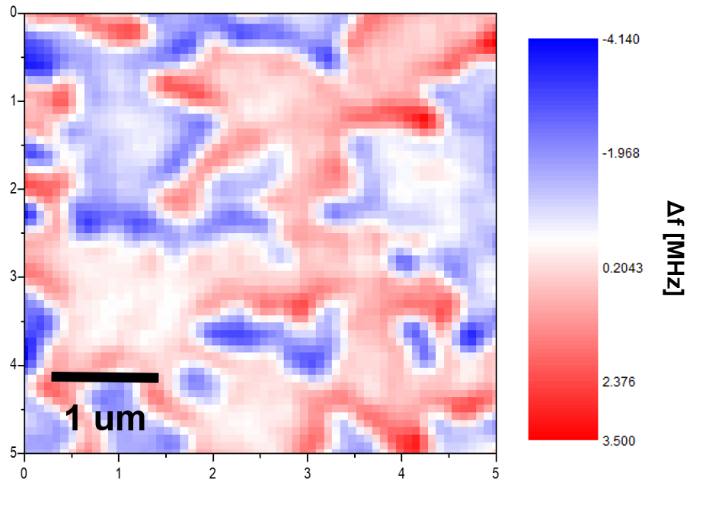
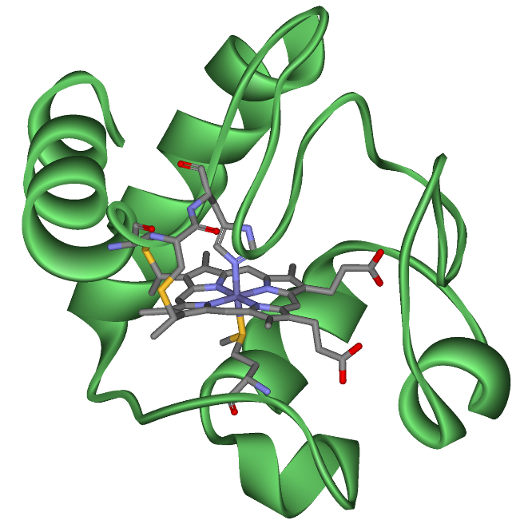
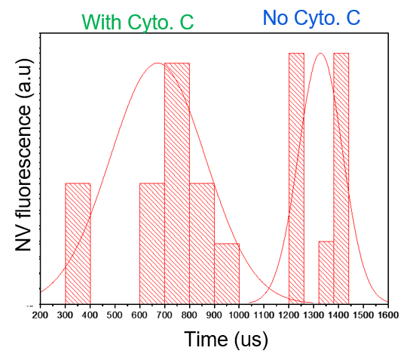
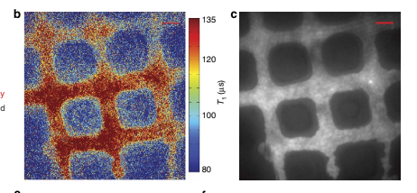
Diamond quantum sensing current projects at UNL
Nanoscale mapping of spin textures and magnon modes in quantum materials: Physics: Binek (Cr₂O₃), Hong (NCO), Xu (TmIG), Kovalev (magnon modeling), Skomski (Entanglement enhanced quantum sensing), Sellmyer (new rare-earth qubit system)
Diamond magnetic imaging in chromia film
Biosensing, nanoscale thermometry, spin molecular systems, 2D materials, quantum optics: MME (Ghashami, Shield), Chemistry: Lai, Sinitskii), Physics (Liou, Dowben), ECE (Bao, Argyropoulos, M. Schubert, E. Schubert, Laura Wang)
4:1607 | DOI: 10.1038/ncomms2588
cytochrome C:
one of the mitochondrial proteins that is released into the cytosol when the cell is activated by an apoptotic stimulus
Diamond mapping of Fe content in cytochrome C

Slide 8


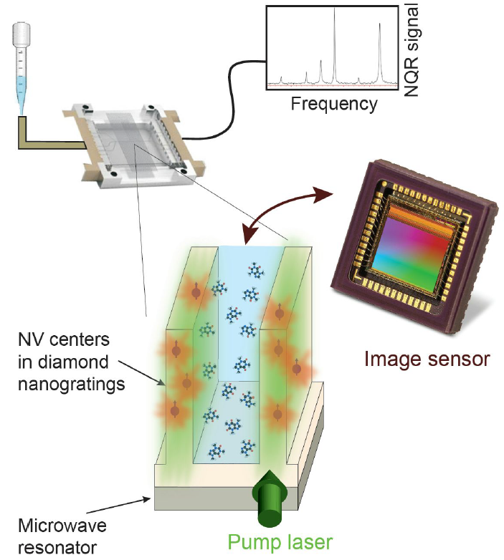
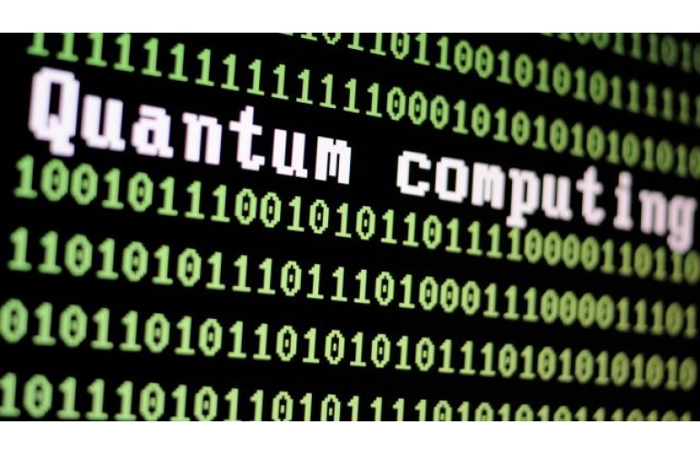
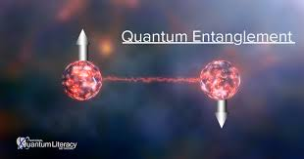
Link to other UNL’ grand challenges
Offer training, workshops, and funding on community-based research and collaborative learning practices to connect scholars, practitioners, community leaders in new quantum technologies
Designing and deploying innovative methods, tools, and technologies for food and water inspection, genetics, etc.
Quantum Microfluidic NMR
NMR Signal
Quantum literacy
Quantum Technologies

