Slide 1
KUDOS
Office of Research and Economic Development
OPEN Forum May 4, 2015

Slide 2
Shane Kimbrough
Many thanks for helping the Research Communications team with website changes and tech support during ORED’s April events.

Slide 3
Sara Frizzell
Thanks for being our tireless leader and taking on every challenge with us!

Slide 4
Michael Nastasi
Thank you for your leadership as the Energy Center moves forward.

Slide 5
Lacey Rohe
Thanks for helping with the NUtech budget process.

Slide 6
Ember Welsch
Special thanks for helping out the Nebraska Center for Energy Sciences Research during a staffing transition.

Slide 7
My pre-award team colleagues – Kate, Abby, Elijah, Kacey, Andrea
Thanks for making every day an enjoyable adventure! You serve our faculty and staff with excellence, grace and good humor, no matter the circumstances. You continually raise the bar of pre-award service at UNL and beyond.

Slide 8
Joel Brehm
Once more, his creativity and “can do” attitude saved the day when a faculty member asked for his help with an illustration for a major journal’s PR on an impossibly short deadline. The eye-catching images grabbed media attention for UNL research.

Slide 9
Chris Stoik
Special thanks for stepping up and successfully filling the void left by Kurt Preston’s departure.

Slide 10
Kacey Nelkin Pedersen
Thanks for co-leading three NURAMP workshops this semester. You’re fantastic.

Slide 11
Peg Filliez
Kudos for masterfully coordinating the on-campus interview schedules for the Museum director search.

Slide 12
Post Award Team
Thank you for taking the time to research terms and conditions on your awards and providing superb customer service to our faculty and staff.

Slide 13
Eric Linville
Thanks for being great to work with and always responding so quickly to my questions.

Slide 14
Ashley Washburn & Vicki Miller
Kudos on delivering a dynamic NURAMP presentation on communicating with the public about research.

Slide 15
Jan Wassenburg
Thanks for all your help preparing for classes and other events in the Whittier training room.

Slide 16
Peg Filliez & Mike Zeleny
Thanks for all of your guidance on hiring new staff at NUtech!

Slide 17
Kathi Malone
Thank you for taking on the task of managing NMEP.

Slide 18
Peter Stewart
In recognition of the amazing work he has done to pull IRB data out of the deepest, darkest corner of NUgrant (and for putting up with my query requests)! Thank you, Peter.

Slide 19
Jodie Richardson & Rose Robotham
Thanks for new website content at nutechventures.org.

Slide 20
Ashley Washburn & Karen Underwood
Thanks for keeping your senses of humor and professional demeanors in the midst of the avalanche of events that is April in ORED.

Slide 21
Suzanne Reinke
Thank you for joining the post award team– you've been a very welcome addition!

Slide 22
Donna Geviss & Belinda Gillam
Thank you for taking the extra time to work with Suzanne during the transition.

Slide 23
Matthew Dwyer
Thanks for your significant contributions in helping us successfully submit our proposal for American Public and Land-grant Universities’ Innovation and Economic Prosperity designation. Matthew worked with the IEP committee on multiple versions of the draft, helped polish the final draft to improve its presentation and advised on improving consistency throughout the proposal. We are incredibly grateful for Matthew’s support —it was a critical element of our successful submission!

Slide 24
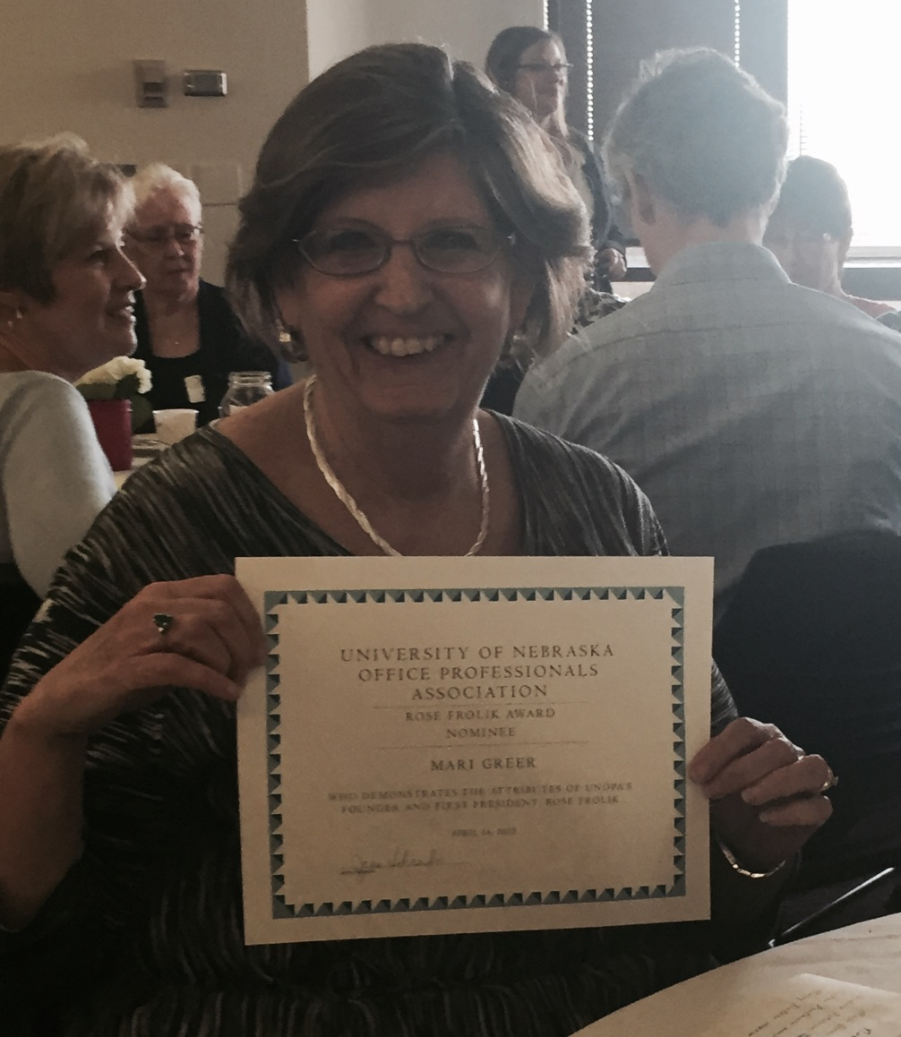
Mari Greer
Congratulations on receiving the Rose Frolik Award from the University of Nebraska Office Professionals Association.

