Slide 1

Will there be enough water to grow enough food?
David Molden
International Water Management Institute

Slide 2
International Water Management Institute
Vision: Water for a Food Secure World
Mission: Improve Land and Water Management for food, livelihoods and environment
Offices across Asia and Africa

Slide 3
Presentation
Drivers of water use and their consequences
Future Water Needs
Adaptive Responses

Slide 4
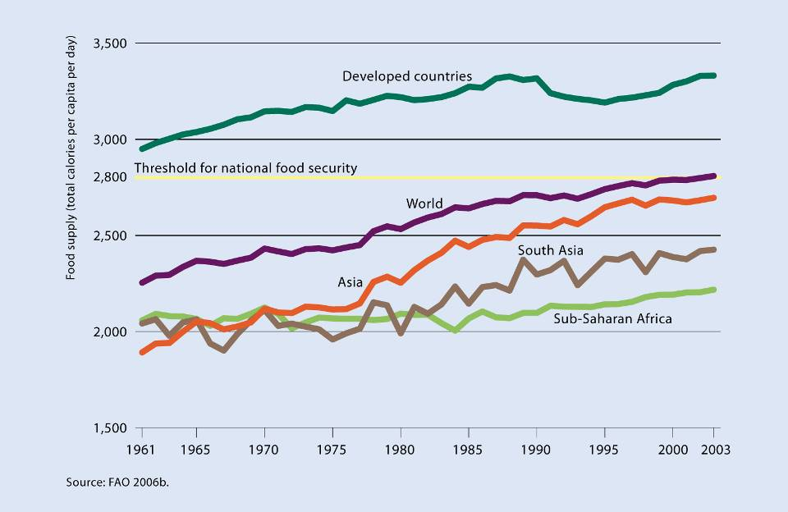


One liter of water produces one calorie on average
One liter of water produces one calorie on average
Food Supply in Calories
Notes:
4

Slide 5
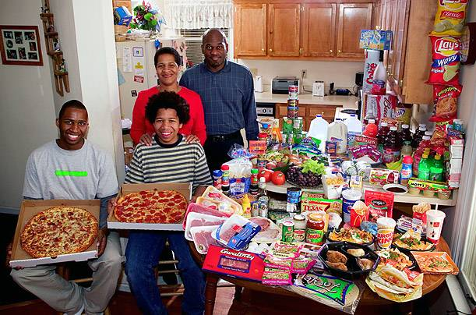
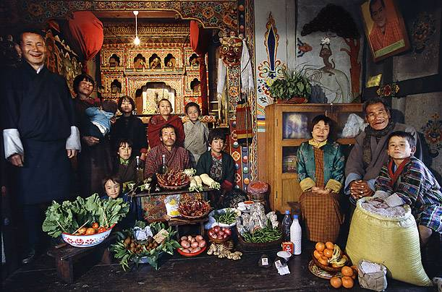
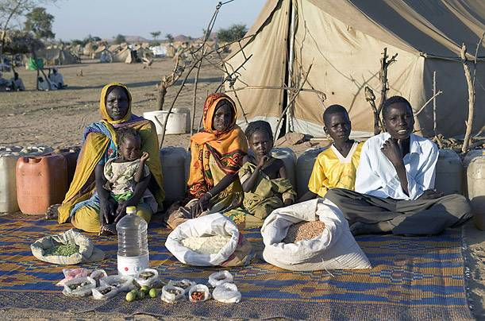
Diets and water
Between 2,000 and 5,000 liters per person per day – depending on type and amount of food eaten and how it is produced

Slide 6

Investing in Irrigation
2.5
320
World Bank lending for irrigation
Irrigated Area
280
2.0
240
1.5
200
160
Food price index
1.0
120
Living Planet Index Freshwater Species
80
0.5
40
Africa Irrigation
0
0
1960
1965
1970
1975
1980
1985
1990
1995
2000
2005
Notes:
6

Slide 7
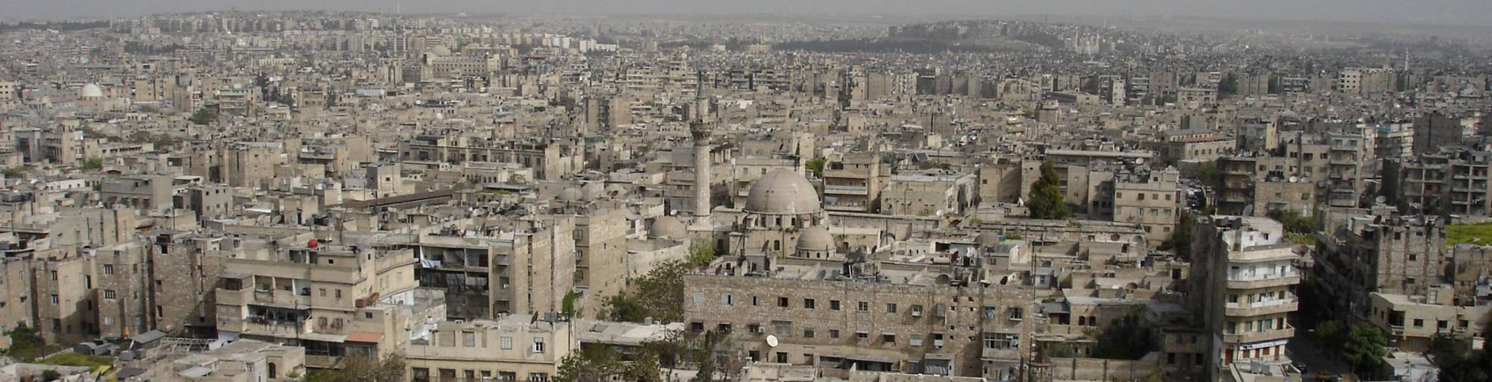
Other Water Pressures
Drivers of Water Use
Urbanization - Cities are projected to use 150% more water in 2025
Land Degradation – limits further productivity increases
Climate Change – Shifting patterns of water availability – potential yields decline in Africa
Energy – Production and use by agriculture is in competition with hydropower
Notes:
7

Slide 8
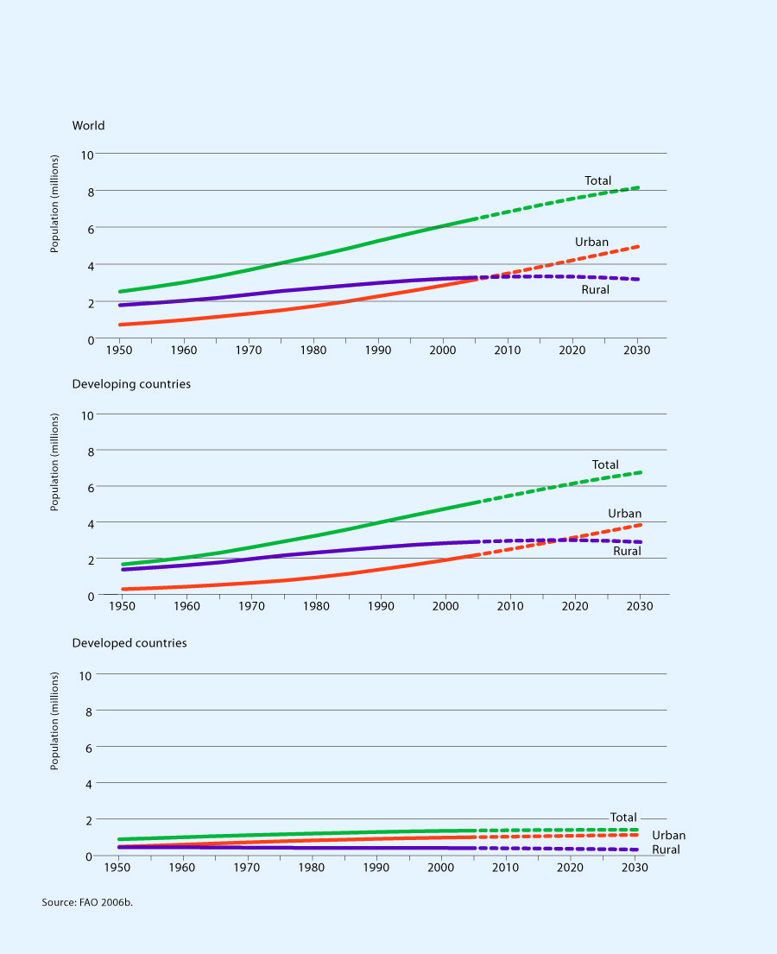
Urbanization

Slide 9
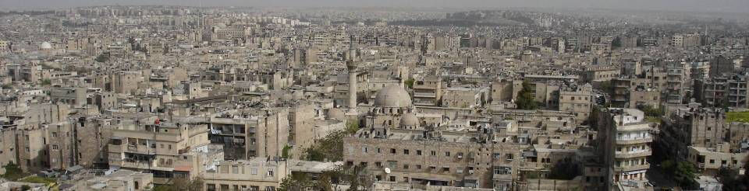
Urbanization
Increased demand for water for cities
Reallocation from irrigation to cities
Cities generate more wastewater – an important source of agricultural supplies
Changes in dietary preferences – farmers respond to different demands
Voting dynamics shift
Cities offer jobs – competition for rural employment

Slide 10
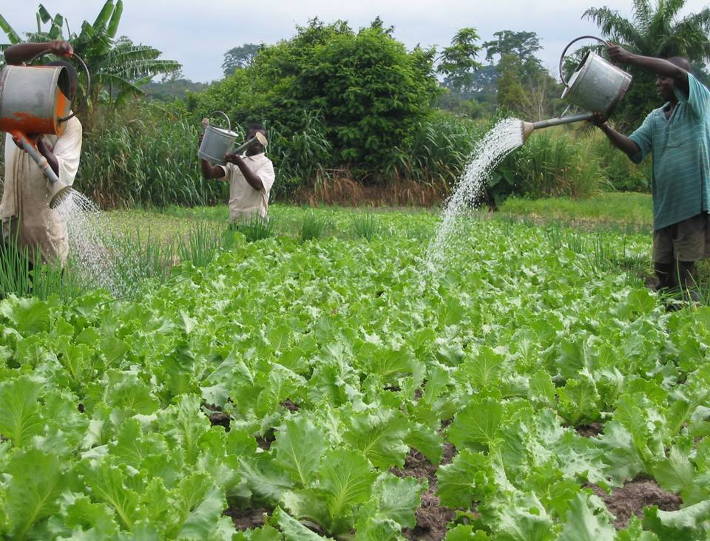
55

Slide 11
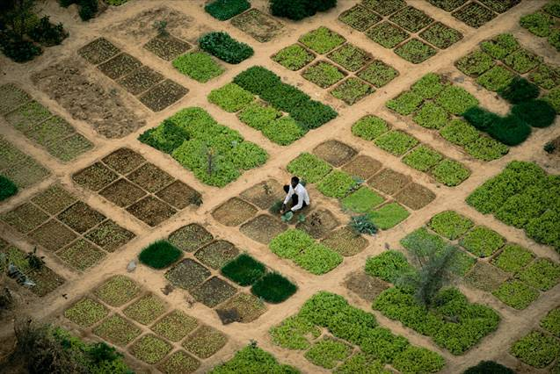
Notes:
Copyright Yann Arthus-Bertand Earth From Above (check website).

Slide 12
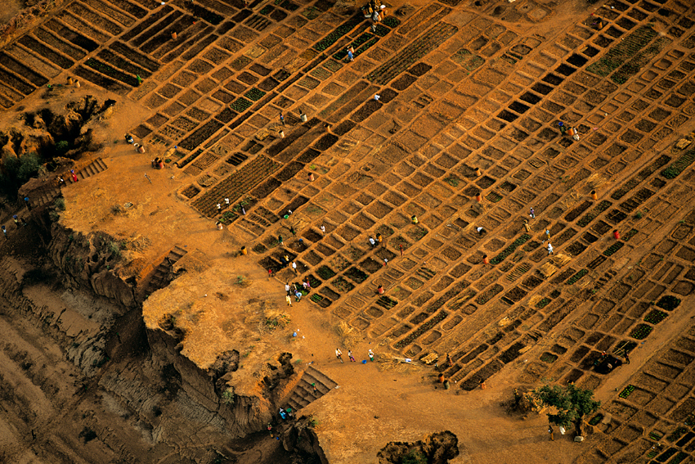

Slide 13
Limits – reached or breached
River basins closed – Colorado, Murray Darling, Yellow, Indus, Amu Darya ……… no additional water left
Groundwater overdraft – in agricultural breadbaskets
Fisheries – ocean and freshwater at a limit, aquaculture will become more prevalent
Livestock – limit on extent of grazing land, more will come from mixed and industrialized production

Slide 14
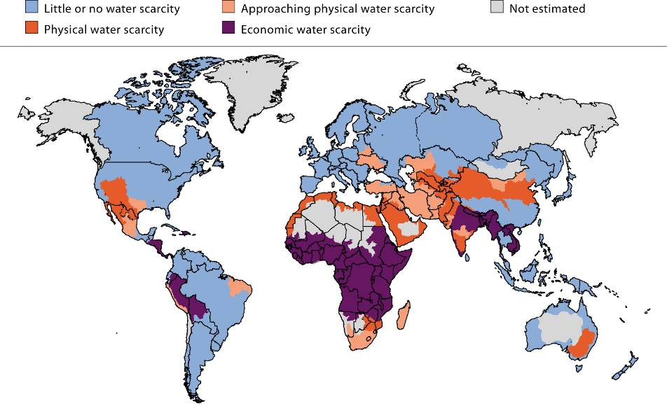
Water Scarcity 2000
1/3 of the world’s population live in basins that have to deal with water scarcity

Slide 15



Will there be enough water to end hunger, and sustain ecosystems?
A question posed to 700 researchers and practitioners who put together the Comprehensive Assessment of Water Management in Agriculture.

Slide 16
Answer from the Comprehensive Assessment –
Will there be enough water to grow enough food, reduce poverty and support ecosystems?
No, unless ….
We change the way we think and act on water issues.

Slide 17
WHAT OF THE FUTURE?

Slide 18
Per capita meat demand (kg/cap/yr)
140
data
projections
120
100
USA
80
Meat consumption kg/cap/yr
60
China
40
World
20
India
1961
2003
2050

Slide 19
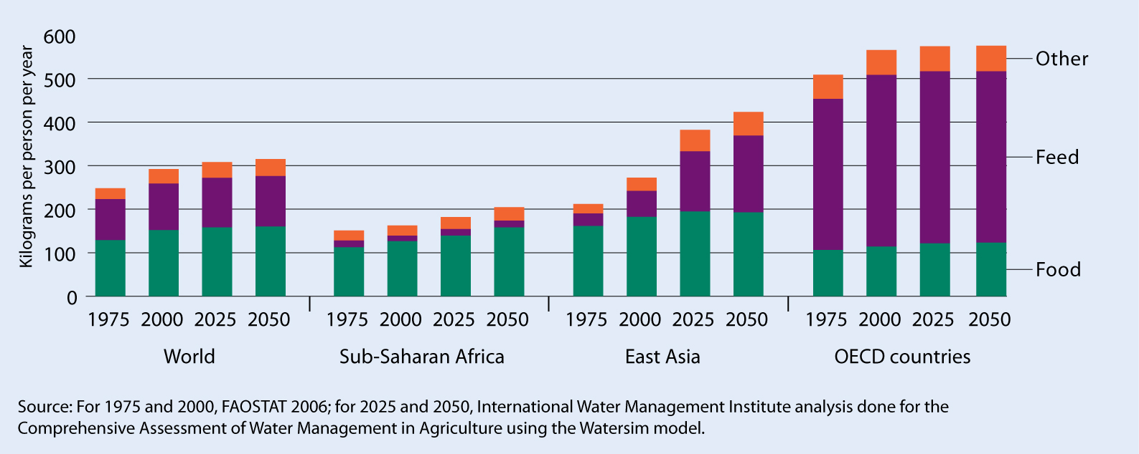
How much more cereals?
Food demand doubles over the next 50 years because of diet and population growth
Water Needs (ET) will double – without water productivity gains

Slide 20
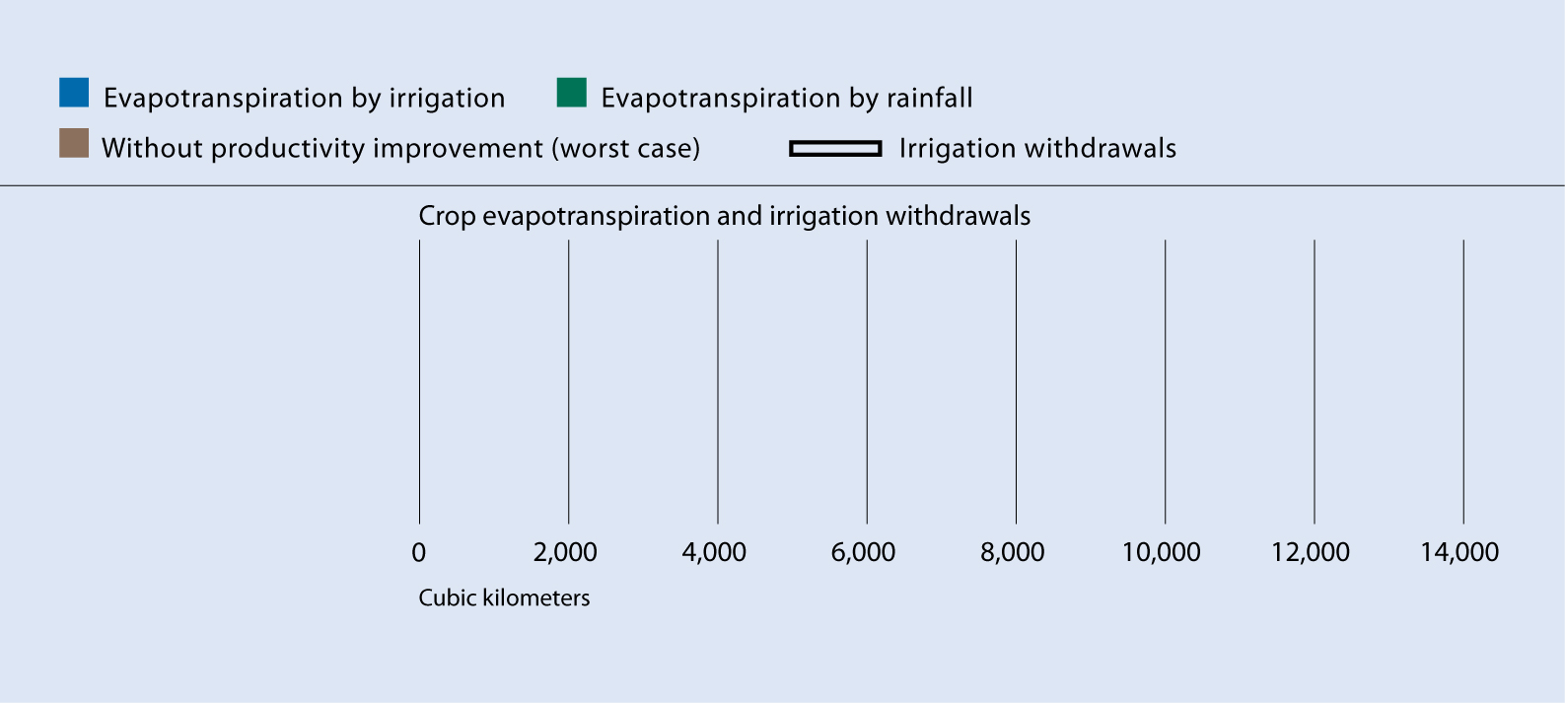
Water Use – Today and 2050
Today
2050
No Water
Productivity Gains
Based on IWMI WaterSim analysis for the CA
Without Water Productivity Gains,
Crop ET doubles by 2050

Slide 21
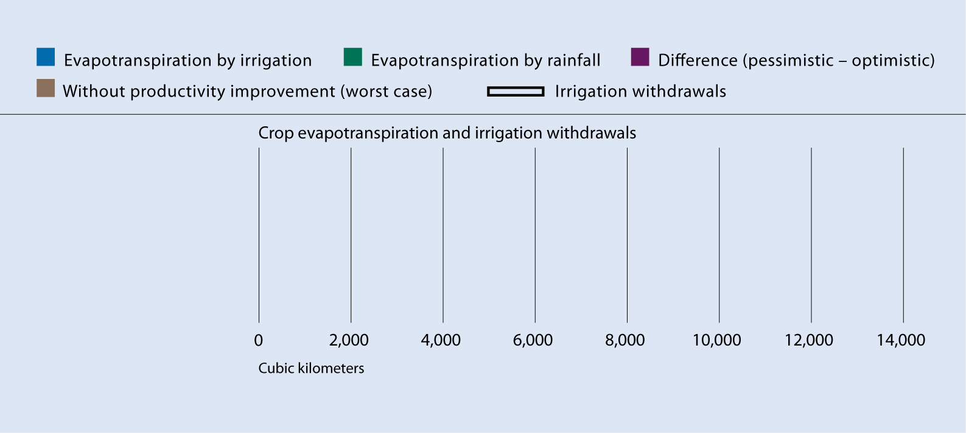
Water Use – Today and 2050
Today
No Water
Productivity Gains
2050
CA Scenario
CA Scenario: Policies for productivity gains, upgrading rainfed, revitalized irrigation, trade
Based on WaterSim analysis for the CA

Slide 22
Water for Biofuels
Water use per liter of biofuel production
 | Litres of ET | Litres of Irrigation water
China | 3800 | 2500
India | 4100 | 3500
US | 1750 | 300
Brazil | 2250 | 200

Slide 23
Biofuels: India: and in 2030 (WaterSim analysis by IWMI). Green solution with blue impacts
Water for biofuels*
Water for food and feed today
Future water for food, CA scenario
Approaching water scarcity
Water scarce
No water scarcity
0%
60%
75%
100%
% of potentially utilizable water withdrawn for human purposes
*Assumes that 10% of gasoline demand is met by biofuels by 2030

Slide 24
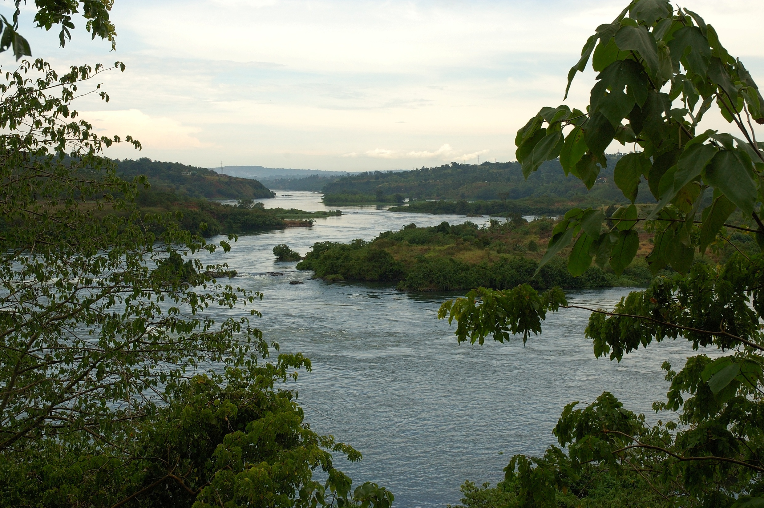
The Nile Basin More irrigation? More rainfed?

Slide 25
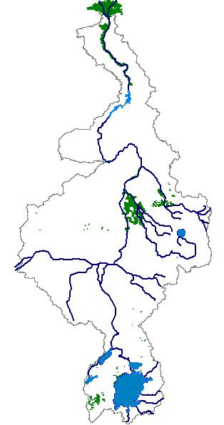
A blue water view of the Nile

Slide 26

Irrigation Schemes
Country | Irrig. Water Requirement, m3/ha/yr | Irrigation Potential, ha | Irrigated Area, ha
Burundi | 13,000 | 80,000 | 0
DRC | 10,000 | 10,000 | 0
Egypt | 13,000 | 4,420,000 | 3,078,000
Eritrea | 11,000 | 150,000 | 15,124
Ethiopia | 9,000 | 2,220,000 | 23,160
Kenya | 8,500 | 180,000 | 0
Rwanda | 12,500 | 150,000 | 2,000
Sudan | 14,000 | 2,750,000 | 1,935,200
Tanzania | 11,000 | 30,000 | 10,000
Uganda | 8,000 | 202,000 | 9,120

Slide 27
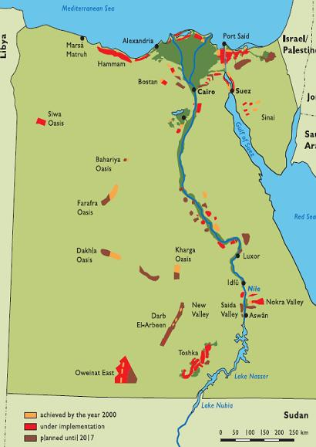
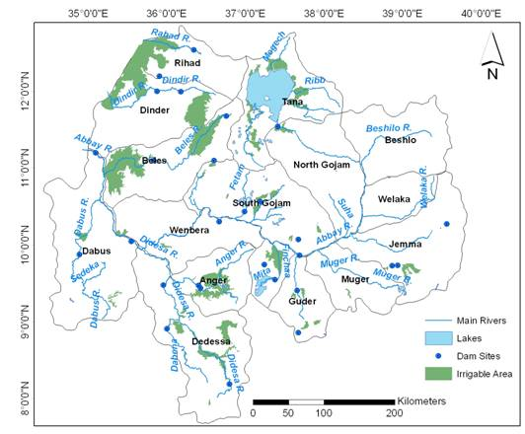
Irrigation Schemes, current & future …

Slide 28
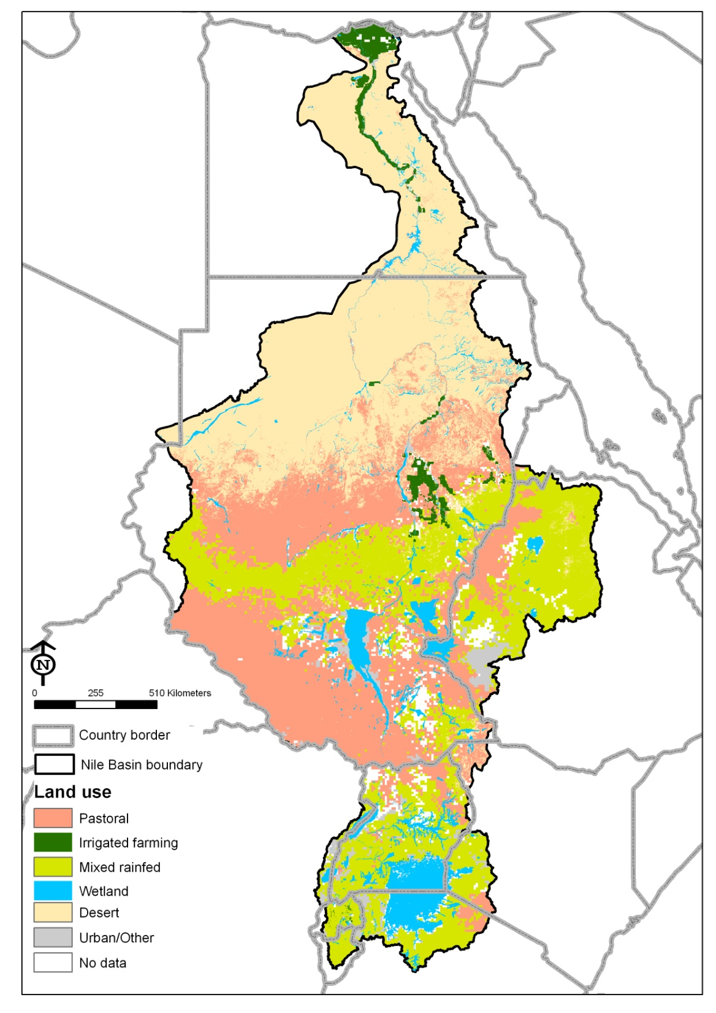
A green-blue view
Irrigated
Rain = 1745 km³
Rainfed ET – 190 km³
Irrigated ET – 67 km³
Outflow – 10 to 30 km³
Limited options to expand irrigation – but gets attention
Ample options to upgrade agriculture on rainfed lands –
gets little attention
Pastoral
Rainfed
Wetlands

Slide 29
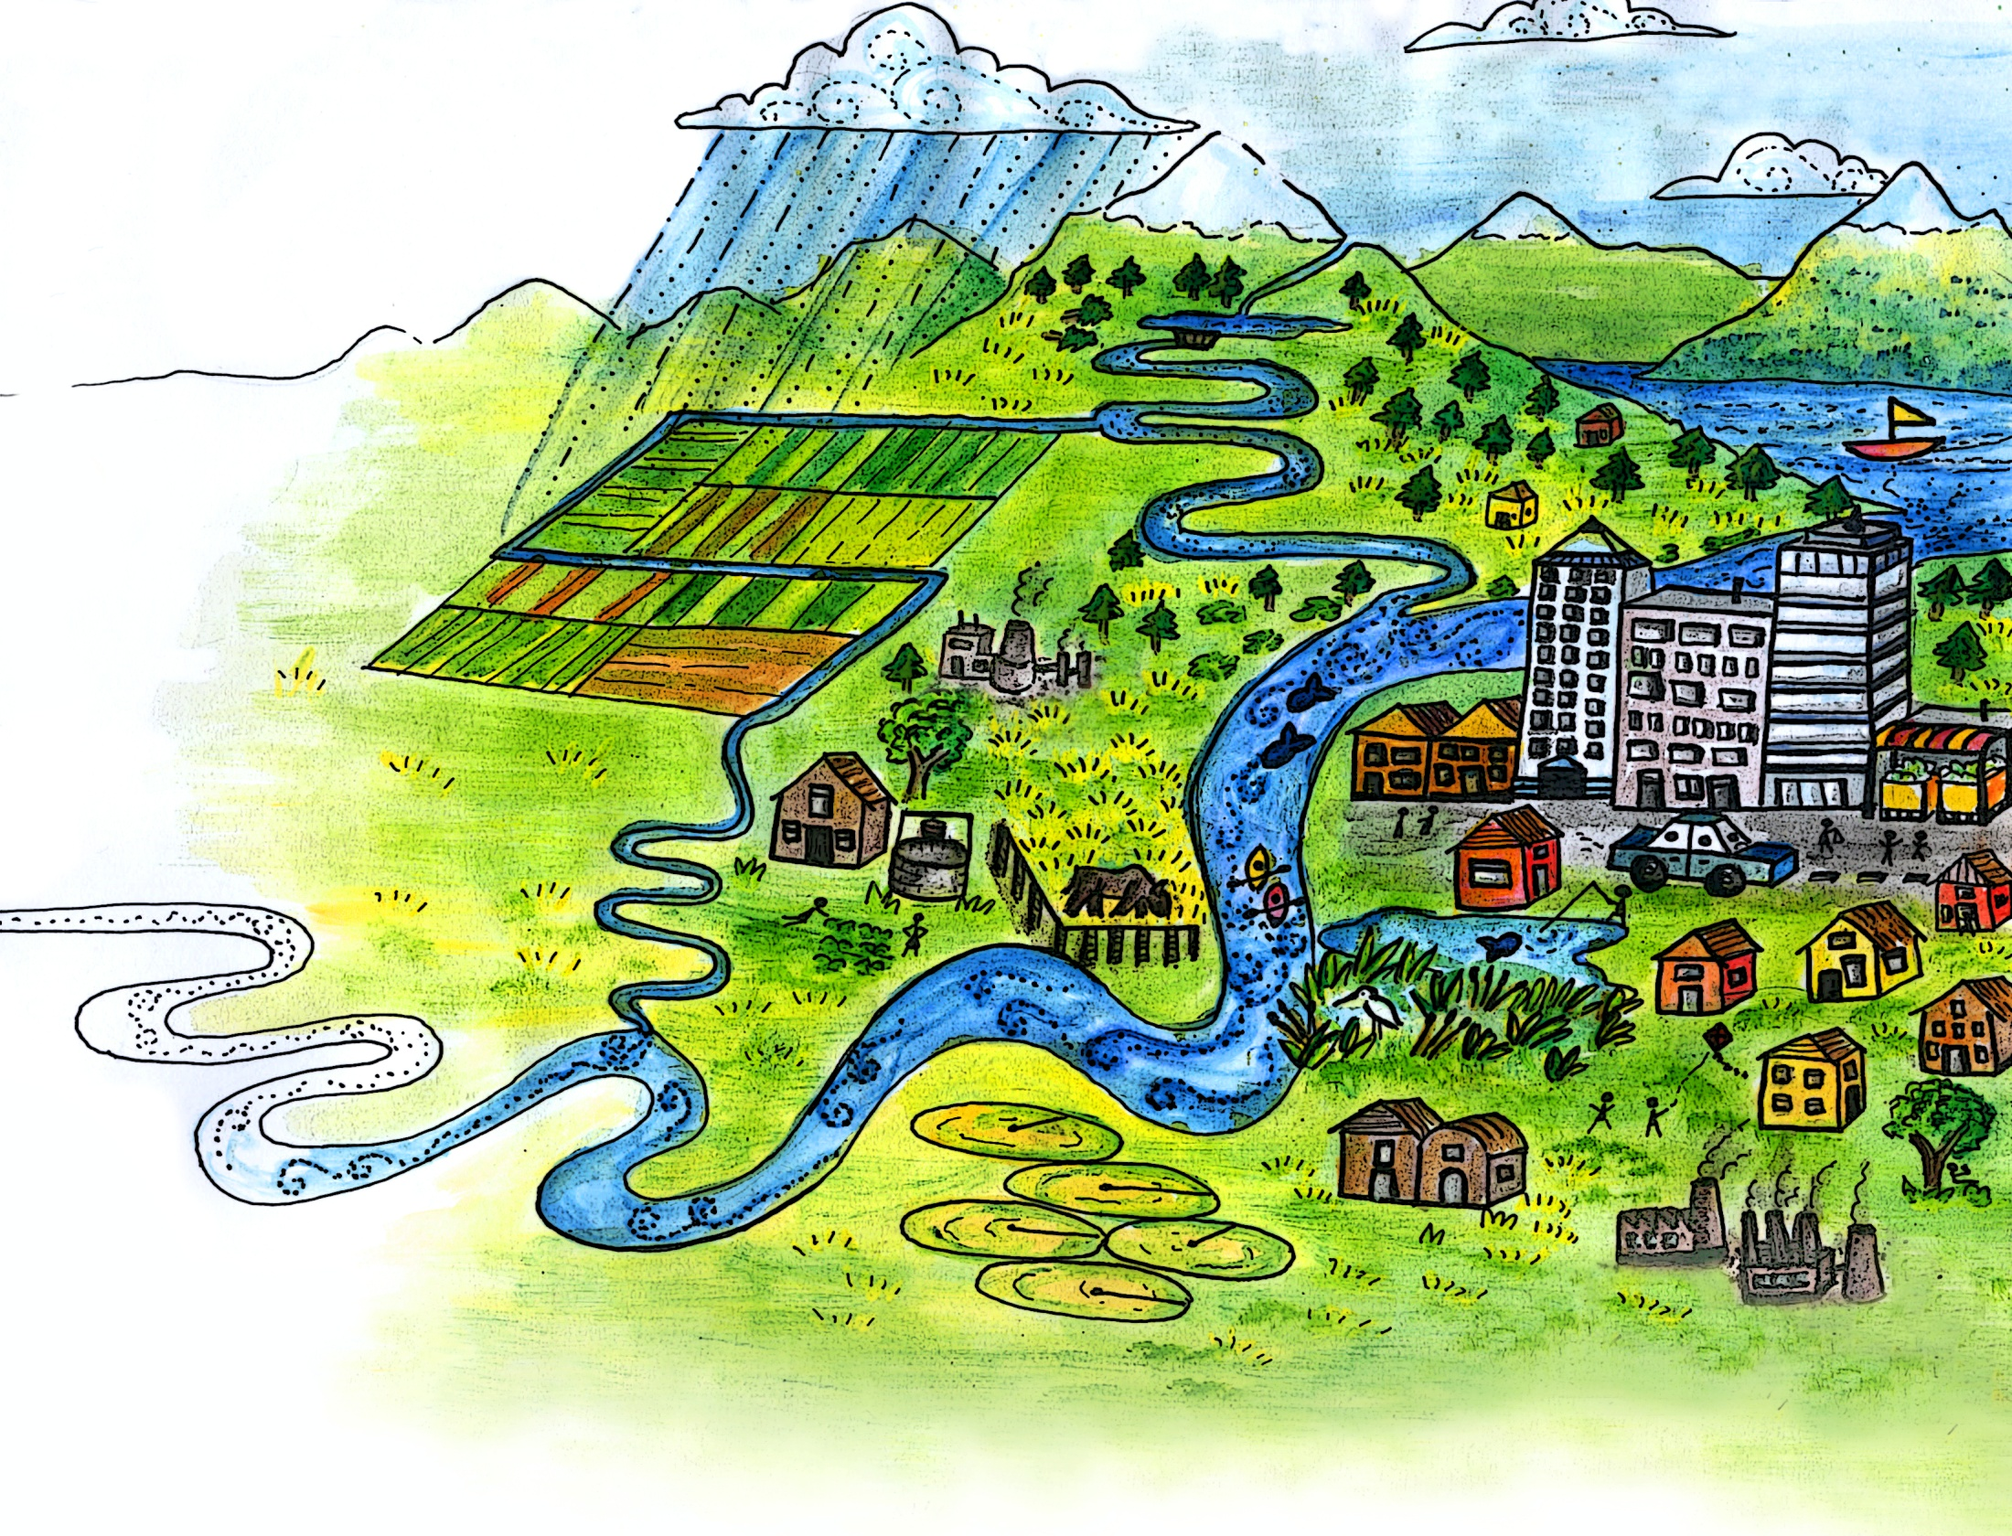
Unlocking the potential
Olivia Molden

Slide 30
Get water to poor people
Around 70% of the world’s under-nourished live in rural areas where non-agricultural livelihood options are limited.
Use it Better
Improve and Safeguard Water Access
Access to Technologies

Slide 31
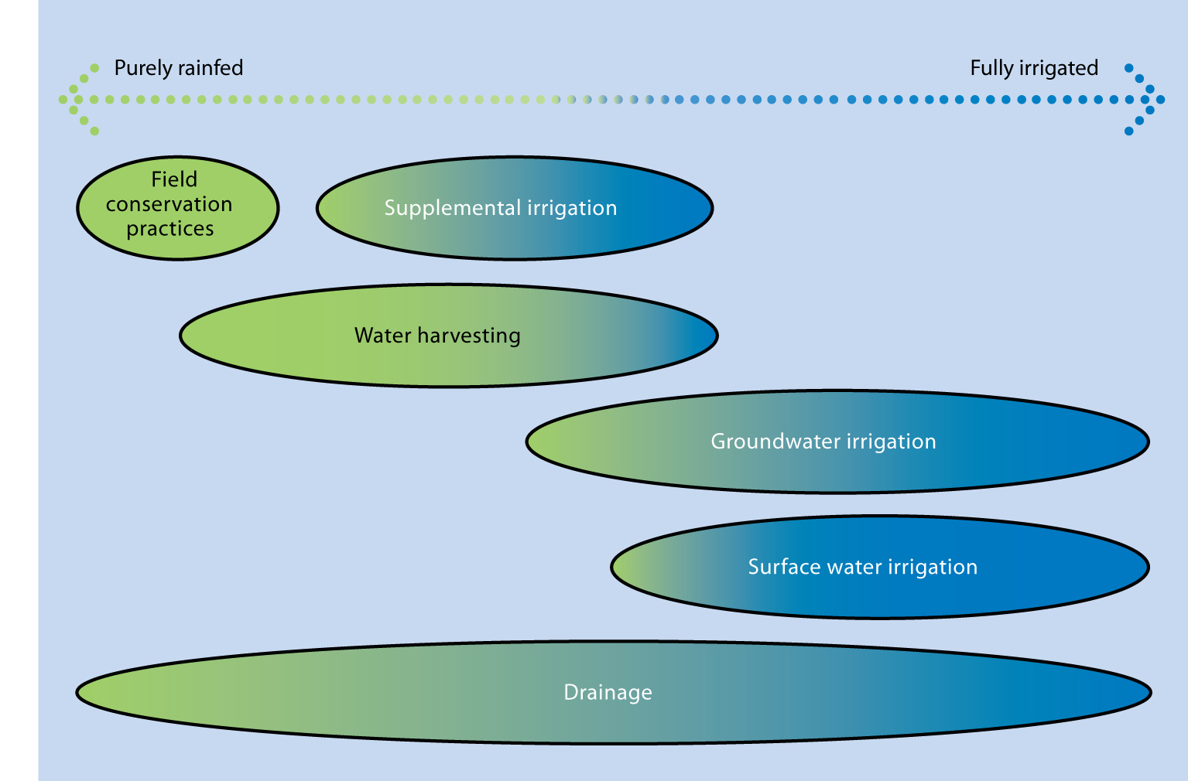
Consider A Range of Agricultural Water Management Options
Fish, Livestock, Crops, Ecosystem Services

Slide 32
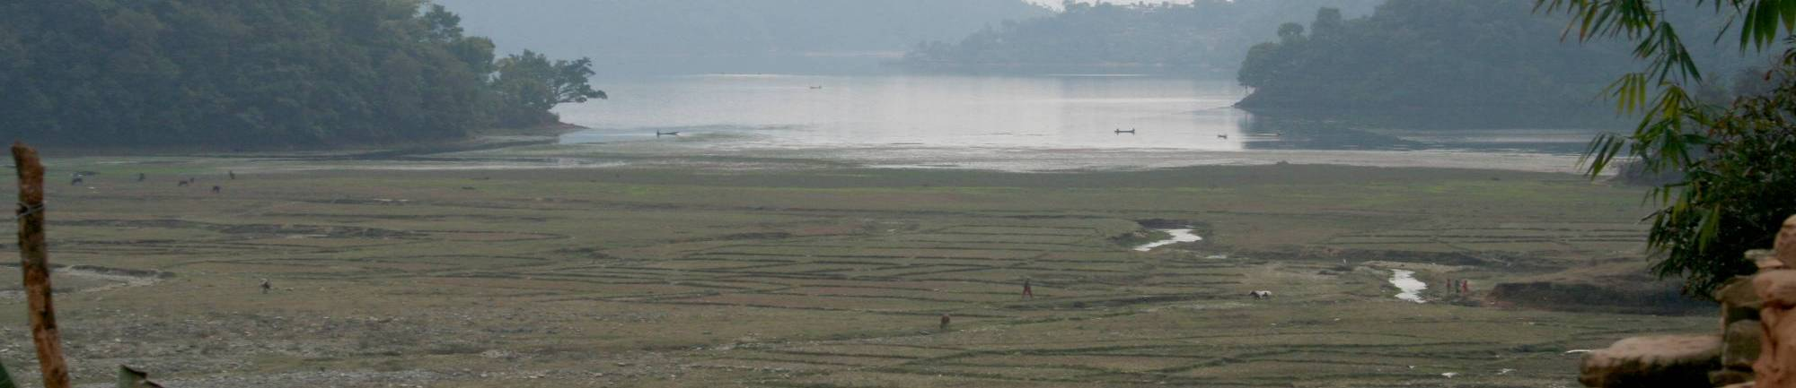
Water storage mitigates variability
Water Storage Mitigates Climate Variability
But need to re-think water storage: role of groundwater and soil moisture.
And beyond: insurance, local trade
6150
7,000
6,000
4729
5,000
3255
4,000
2486
3,000
Cubic meters per capita
1287
1406
2,000
746
1,000
4
43
0
Laos
China
Brazil
Kenya
South
Africa
Ethiopia
Thailand
North
Australia
America
Source: World Bank data from ICOLD
Notes:
32

Slide 33
Increase Water Productivity
Physical Water Productivity – more crop per drop
To reduce future water needs
For food production increases
Economic Water Productivity – more value per drop
For more income, growth
Integrated, multiple use systems

Slide 34
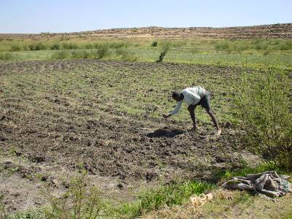
Opportunities in Rainfed Landscapes
Largest opportunities to improve WP are in rainfed landscapes – low WP, high poverty
Technology
water harvesting, supplemental irrigation
Field water conservation to reduce evaporation (convert E to T)
Improved nutrients
Varieties – drought resistance
Expand Policies to include upgrading rainfed systems

Slide 35
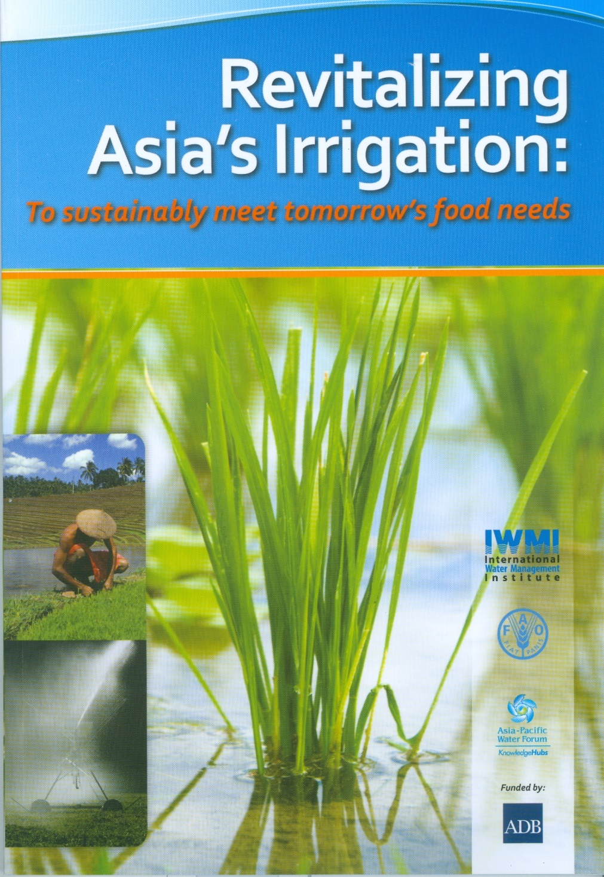
Asia needs to feed an extra 1.5 billion people by 2050, with food needs projected to double.
Cannot rely on rainfed alone
Asia contains 70% of the world’s irrigated area
Important to do it right for:
Climate change
Food security
Environment
Large scope to improve
Performance
Water productivity variations

Slide 36
Increase Water Productivity
Physical Water Productivity – more crop per drop
To reduce future water needs
For food production increases
Economic Water Productivity – more value per drop
For more income, growth
Integrated, multiple use systems

Slide 37
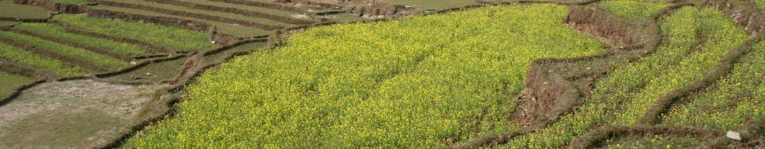
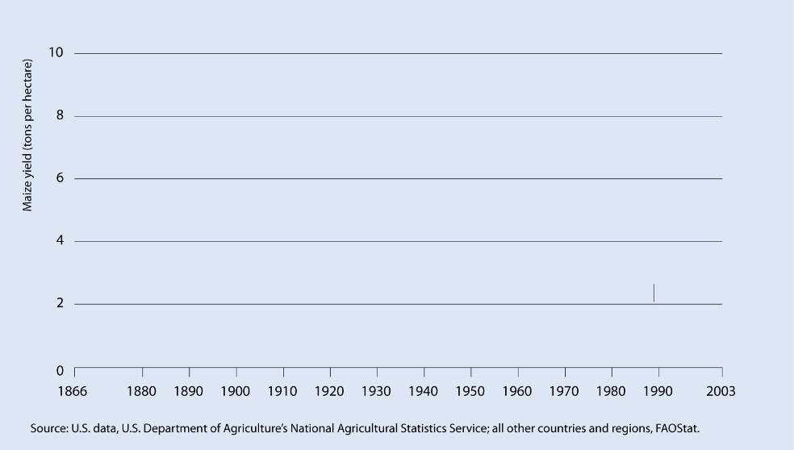
Productivity
United States
Maize yield (tons/hectare)
China
Latin America
Sub-Saharan Africa

Slide 38
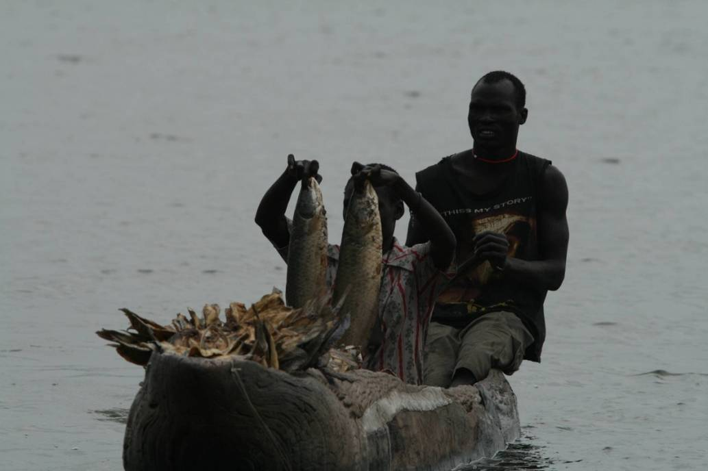
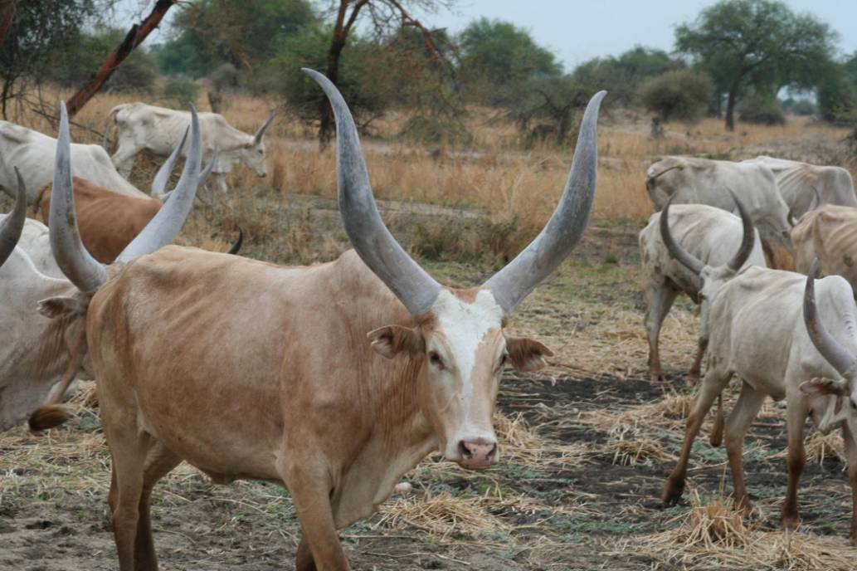
WP for Livestock and Fish
Beef 0.03 to 0.1 kg/m³ (ET)
Fish 0.05 to 1.0 kg/m³ (ET)
Rapid increase in consumption of fish, meat, milk, with income
Huge scope for improvement – feed source, and animal husbandry important

Slide 39
Range of water productivities in biological, economical and nutritional terms for selected commodities
Product | Water Productivity
 | Kilograms per cubic meter ET | Dollars per cubic meter ET | Protein grams per m³ ET | Calories per m³ ET
Wheat ($0.2 per kilogram) | 0.2-1.2 | 0.04-0.30 | 50-150 | 660-4,000
Rice ($0.31 per kilogram) | 0.15-1.6 | 0.05-0.18 | 12-50 | 500-2,000
Maize (0.11 per kilogram) | 0.30-2.00 | 0.03-0.22 | 30-200 | 1,000-7,000
Beef ($3.0 per kilogram) | 0.03-0.1 | 0.09-0.3 | 10-30 | 60-210
Fish (aquaculture)ª | 0.05-1.0 | 0.07-1.35 | 17-340 | 85-1,750
ªIncludes extensive systems without additional nutritional inputs to superintensive systems
Source: Muir, 1993; Verdegem, Bosma, and Vereth 2006; Renault and Wallender 2000; Oweis and Hachum 2003; Zwart and Bastiannsen 2004

Slide 40
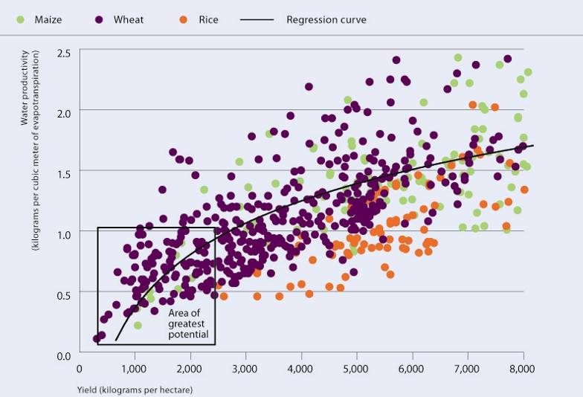
Water productivity rises faster at lower yields and levels off at higher yields
WP in
Kg/m3
Yield in
Kg/ha
Source: Adapted from Zwart and Bastiaanssen 2004
In Water for Food, Water for Life, Earthscan Publishing

Slide 41
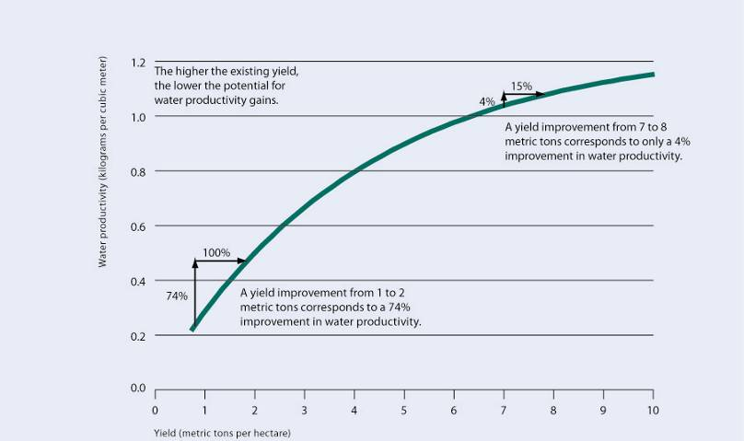
Water productivity is subject to diminishing returns
Source: Based on the yield-water productivity relationship for rainfed cereals in Rockström (2003)
In Water for Food, Water for Life, Earthscan Publishing

Slide 42
The highest gains in water productivity for common crops such as rice, wheat and maize are likely in areas where yields are still low
Ratio
1.2
Biomass/transpiration
1.0
0.8
Yield/transpiration
0.6
0.4
Yield/ET
(highly productive area, like Lower Yellow River Basin)
Yield/ET
(high potential, like the Sahel)
0.2
0
-50
years
-25
years
Now
+25
years
+50
years
Source: Schematic developed for the Comprehensive Assessment of Water Management in Agriculture

Slide 43
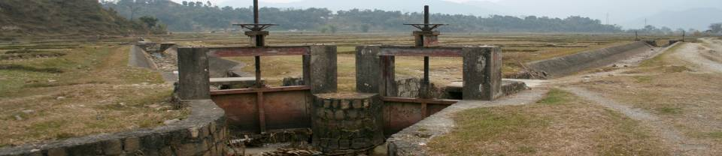
Caution – It is not easy
Adoption rates are low – water productivity not necessarily a farmer concern, need to understand political-economy of water use
Scale effects: Farm water productivity gains can increase basin depletion, not save water
Need to understand tradeoffs and align incentives of different actors by a variety of means (economic incentives, allocation)

Slide 44
Engage in Policy Reform
Poverty, hunger, gender inequality, and ecosystem degradation continue - not because of technical failings but because of political and institutional failings
Diversity is a key to resilience
No blueprints - need to craft local solutions
Notes:
44

Slide 45

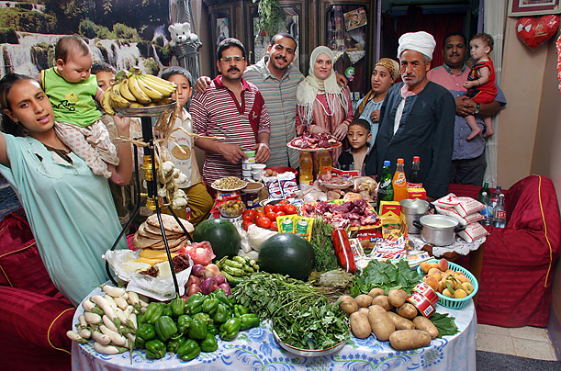

Address Drivers of Change
Our policies and actions outside the water sector;
Agriculture
Business
Trade
Response to climate change
Diets
Energy/biofuels
have a profound impact on water resources.
Photos from Diet for a Small Planet
Notes:
45

Slide 46
Make difficult choices now, not later; Try to increase the pie – share the benefits
But difficult choices remain:
Water storage for agriculture – water for environment
Upstream – Downstream
Productivity - Equity
This generation – the next one (GW decline)
Notes:
46

Slide 47
Make better water choices
Start with rain when thinking about water, work locally, think ecosystems, engage in policy and politics
Produce more with less water from a range of agricultural water management options
Look for untapped opportunities: rainfed systems across SS Africa
Irrigation productivity gains across Asia
Solutions require us to think beyond water entry
Lighten your footprint

