Slide 1

UNL Research Strengths & Needs
Panel Discussion
August 23, 2012

Slide 2
Agenda
Julie Honaker (Special Ed & Communication Disorders)
Namas Chandra (Mechanical & Materials Engineering)
Fred Luthans (Management)
Debra Hope (Psychology)
Scott Stoltenberg (Psychology)
Mario Scalora (Psychology)
Timothy Carr (Nutrition and Health Sciences)

Slide 3
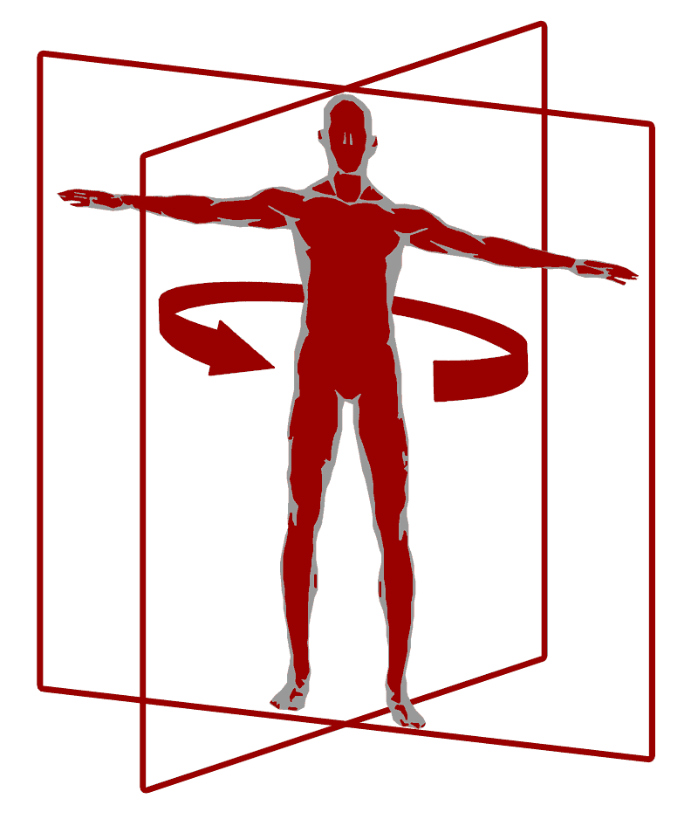
Julie A. Honaker, Ph.D.
Assistant Professor
Director, Dizziness and Balance Disorder Lab
Department of Special Education and Communication Disorders
julie.honaker@unl.edu
402-472-5493
http://cehs.unl.edu/dizzinesslab/

Slide 4
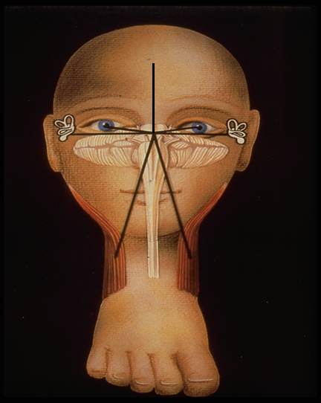
Brief Overview of My Research
Effects of sports-related head trauma on the balance system
Assessment of balance dysfunction across one’s lifespan
Identification of objective balance measures for predicting falls

Slide 5
Concussion Research Initiative
WHY:
  1. Dizziness is one of the most common complaints post-head injury
Unrecognized balance problems may lead to:
  Anxiety & depression
  Headache
  Sleep disturbances
  Poor academic performance
  Debilitating symptoms

Slide 6
Concussion Research Initiative
PURPOSE:
  1. To identify balance function changes over time
  2. To improve traditional concussion measurements
SIGNIFICANCE:
  Increase understanding of results from sport injury
  To introduce more objective measures for concussion assessment and recovery monitoring

Slide 7
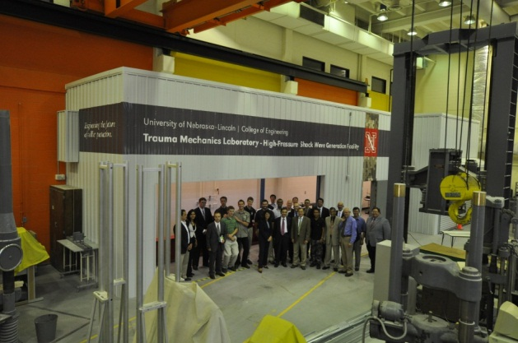
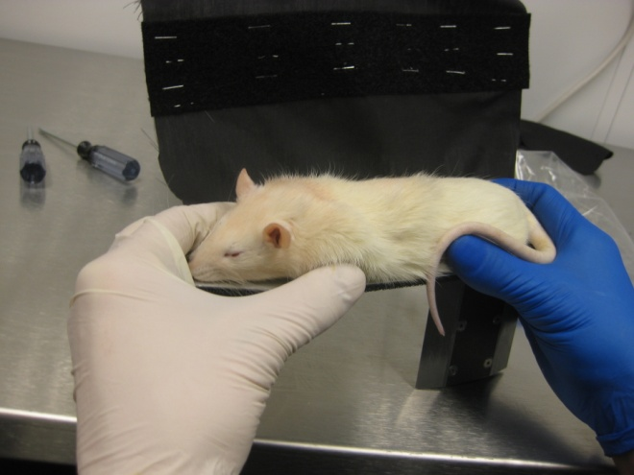
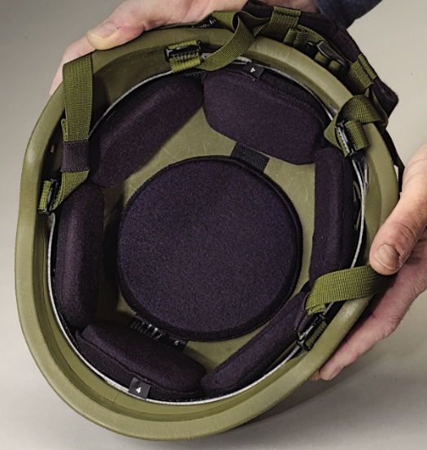
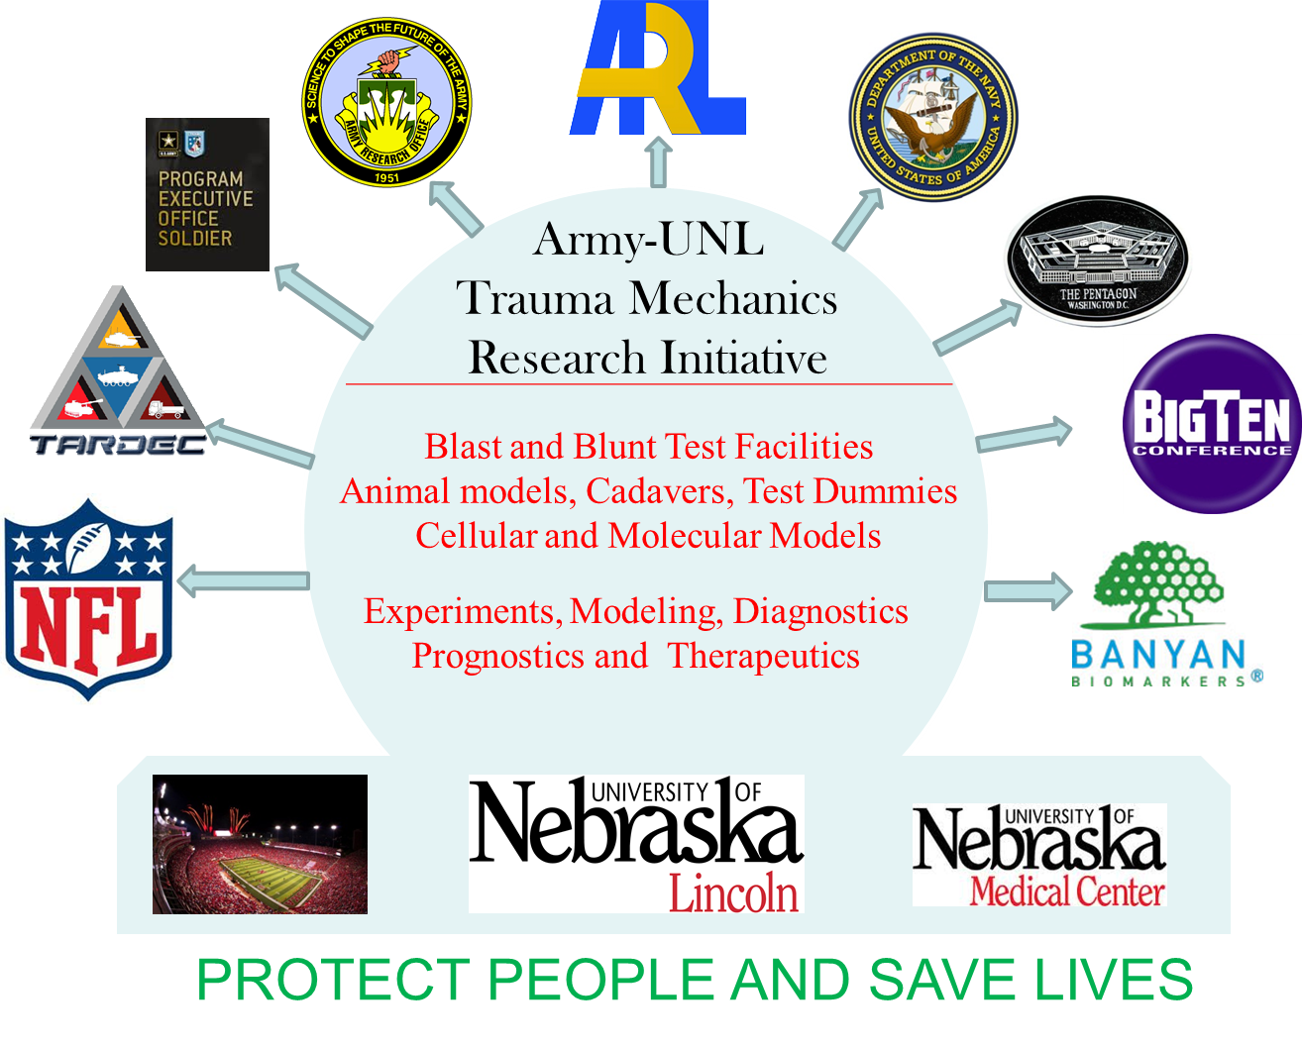
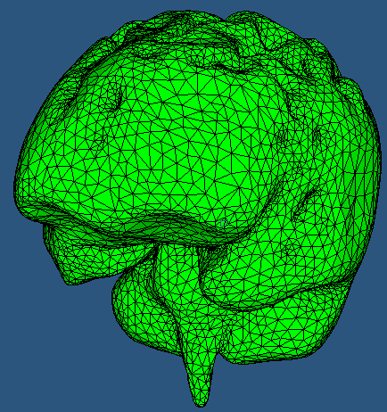
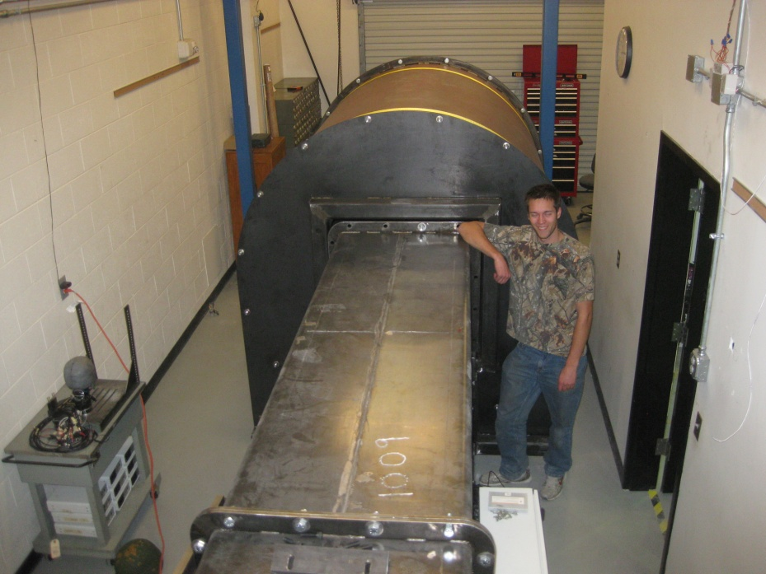
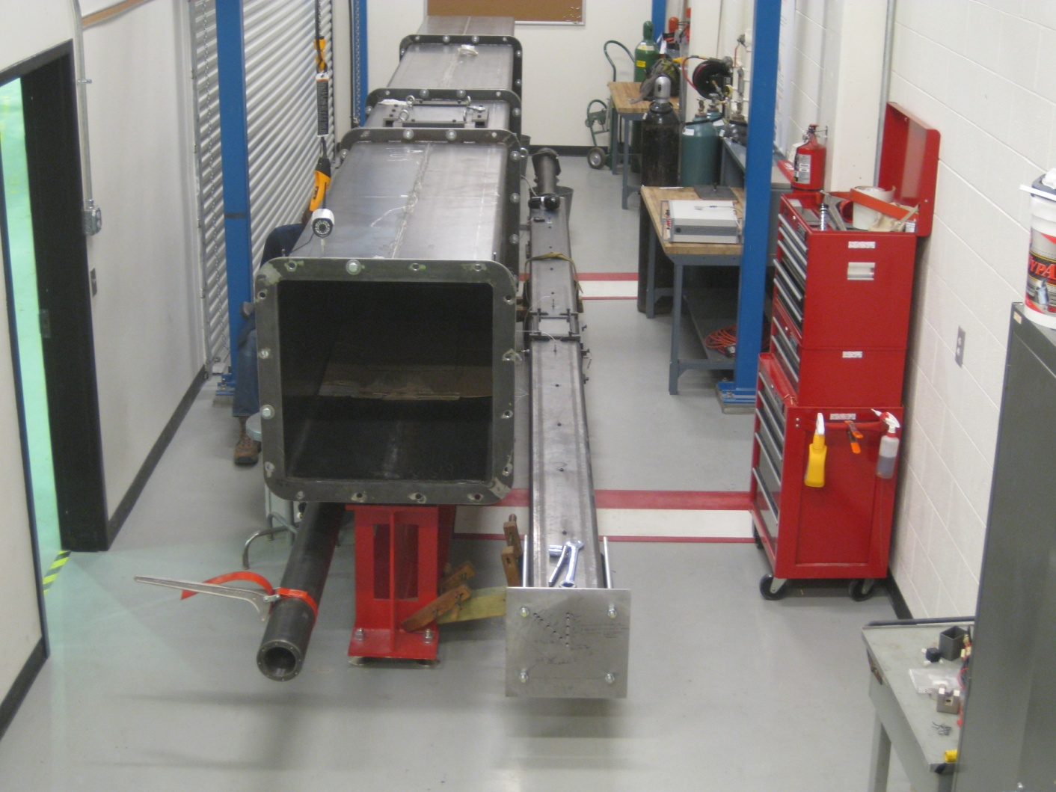
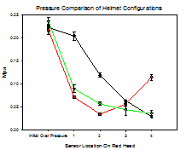
Namas Chandra
University of Nebraska-Lincoln
Our approach to Sports Injuries
Elmer-Koch Professor of Engineering
August 2012

Slide 8

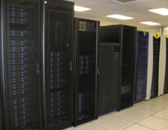
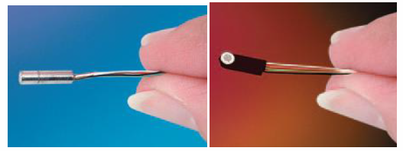
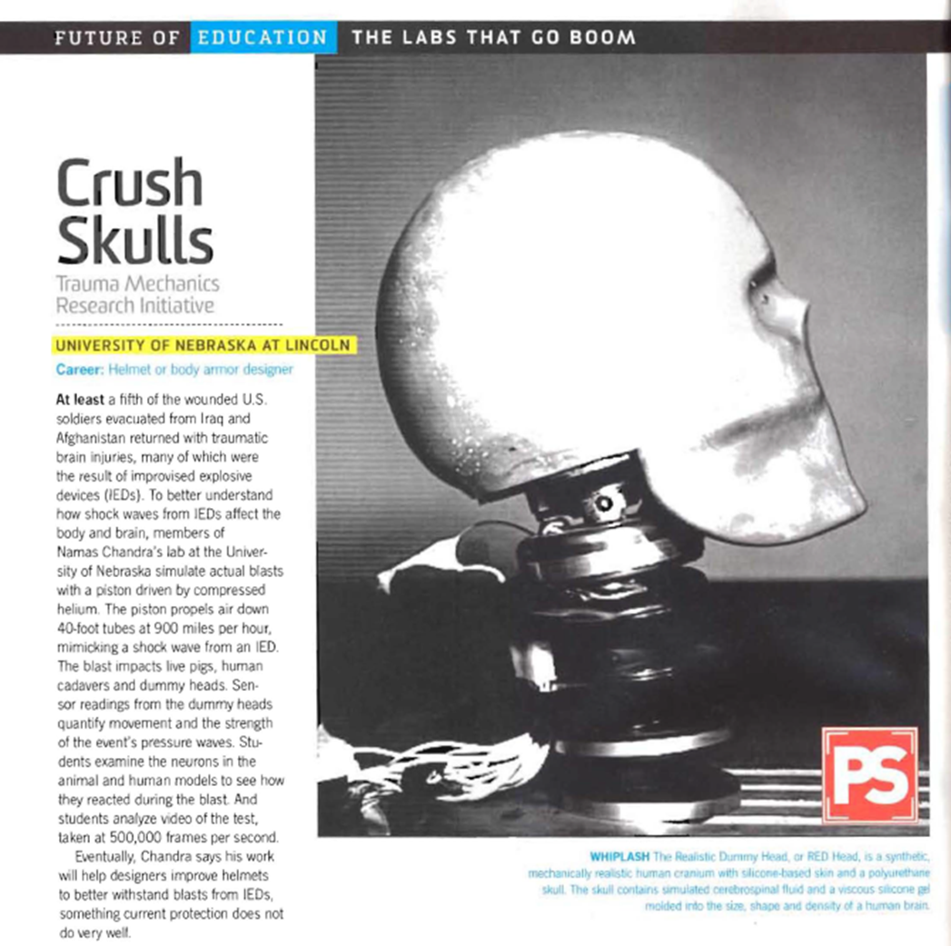


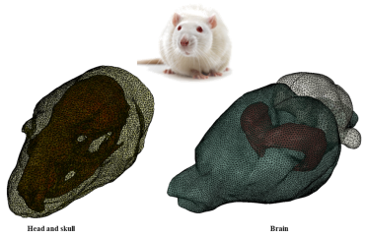
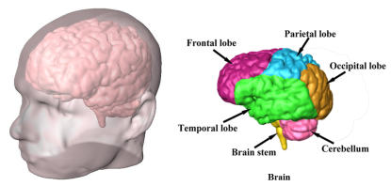
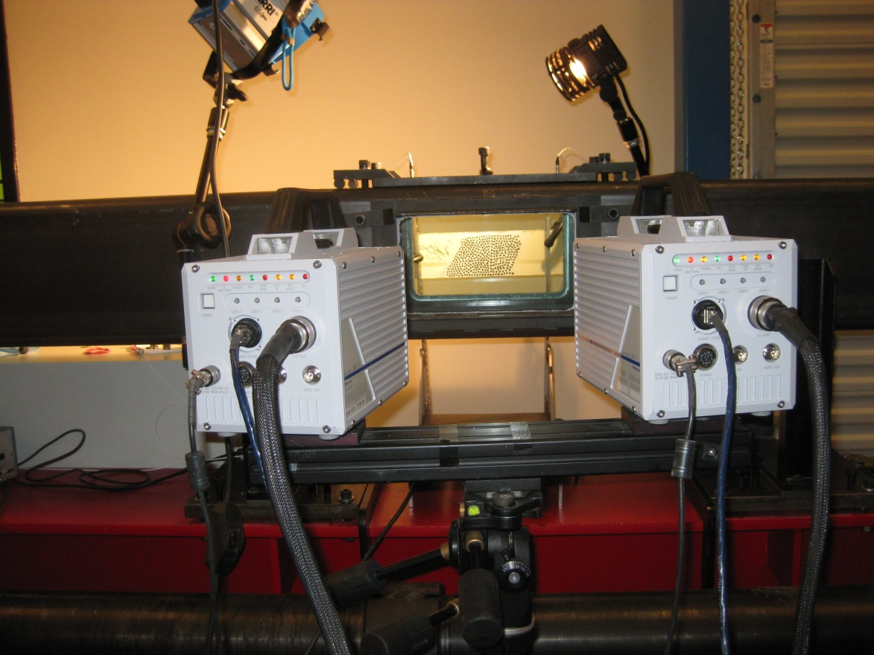

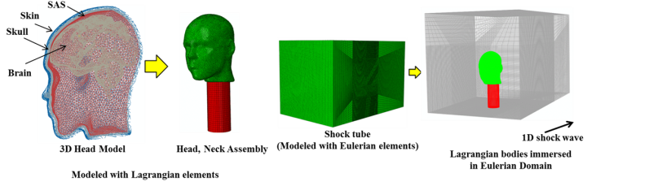
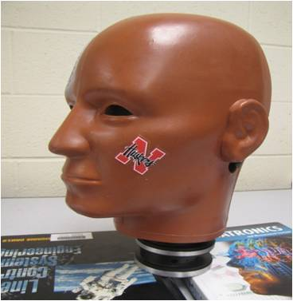
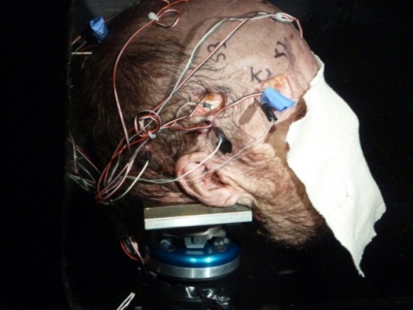
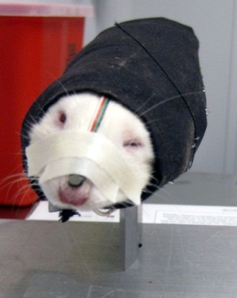
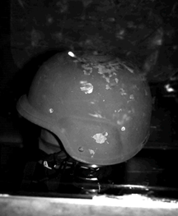
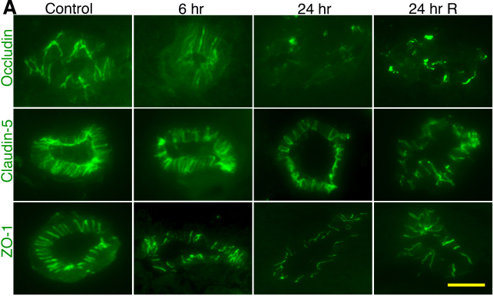
Experiments
Trauma mechanics
research facility
Simulations
Accomplishments

Slide 9
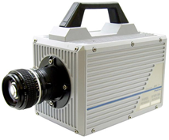
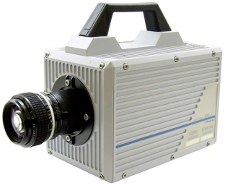
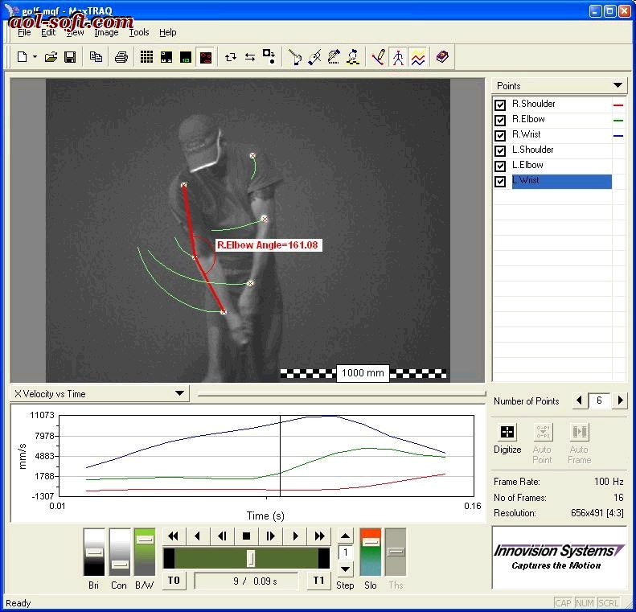
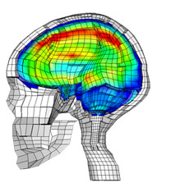
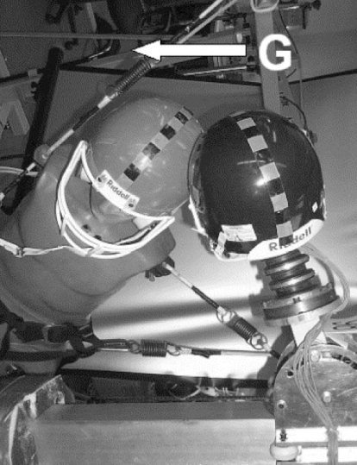
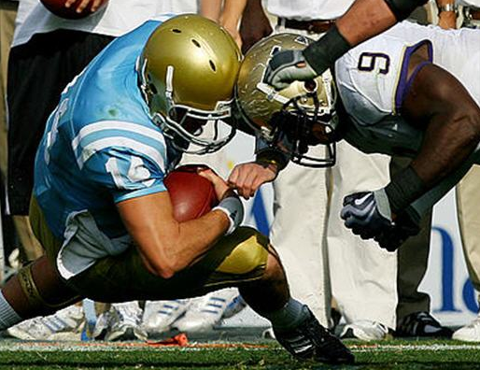
Football concussion: Our approach
Biomechanical analysis using MaxTRAQ 3D
Data from MaxTRAQ 3D given as input in experiment and simulation
High speed camera
High speed camera
Collision during play
Collision during play
Finite element modelling
Experimental modeling of actual collision.
Notes:
We can add ideas regarding tau protein (NFL); Headforms (Natick); Helmet (PEO); Shock-structure interactions (ARO); materials testing (ARL); Sensors/cell testing (Navy/Pentagon); Concussion (CFL); Underbody blast (Tardec); biomarkers (Banyon)

Slide 10
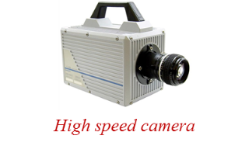
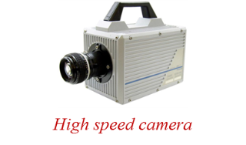
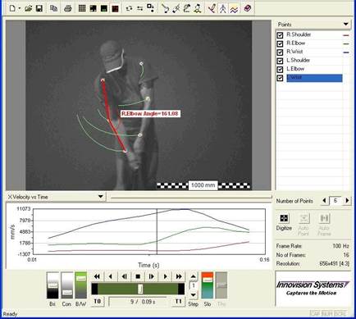
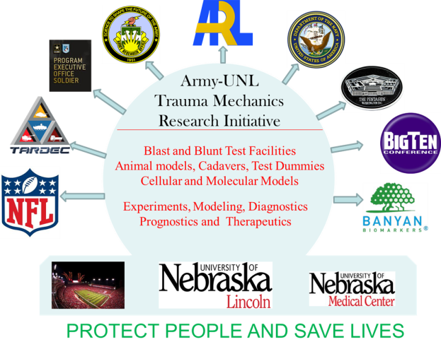
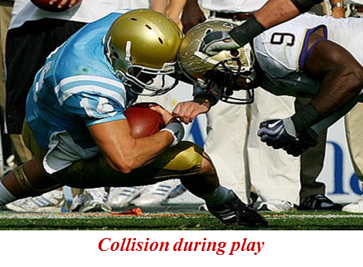
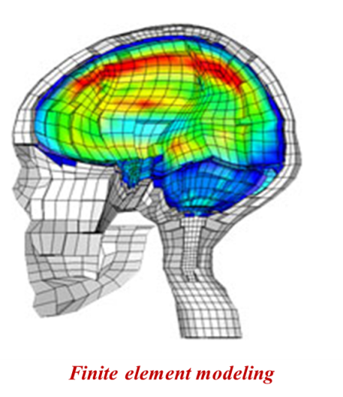
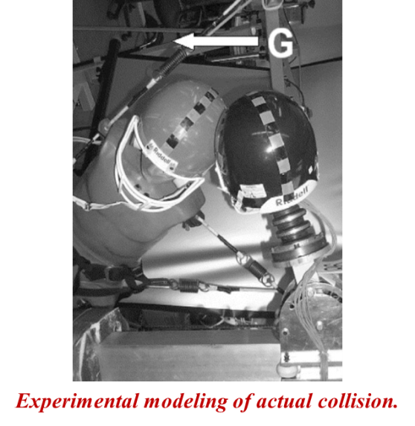
Football concussion: Our approach
Biomechanical analysis using MaxTRAQ 3D
Better helmets
Lesser concussions
Quality lives
Data from MaxTRAQ 3D given as input in experiment and simulation
Notes:
We can add ideas regarding tau protein (NFL); Headforms (Natick); Helmet (PEO); Shock-structure interactions (ARO); materials testing (ARL); Sensors/cell testing (Navy/Pentagon); Concussion (CFL); Underbody blast (Tardec); biomarkers (Banyon)

Slide 11
Luthans Psychological Capital (PsyCap)
Background and Implications for Selection, Development and PERFORMANCE of Athletes
Fred Luthans (fluthans1@unl.edu)
U. of Nebraska Distinguished Professor of Organizational Behavior
Researcher, Author and past President of Academy of Management

Slide 12
Luthans Background /Roots
Positive Reinforcement and my approach of OB Mod
Self-Efficacy (Meta-analysis )
Follow Bandura ( Stanford, but PhD from my school U. Iowa)
Positive Psychology ( Inaugural Summit & my application )
Highlights on PsyCap
Starting 2002 in top journals (Google Fred Luthans, Wikipedia)
PsyCap book ( Oxford U. Press, 2007 and now new edition)
Many published research articles ( meta-analysis in HRDQ)
Evidence-Based Selection, Performance and Development
Both self-report and new, innovative Implicit measures and interviews to minimize inflated scores and social desirability.

Slide 13
time to move to
Research and apply our Psychological Capital (PsyCap) using scientific criteria meeting positive psychological resources
Hope ( Will and the Way, Rick Snyder, KU)
Efficacy (Confidence and Belief, Bandura)
Resiliency ( Bounce Back and Beyond, Masten)
Optimism ( Positive Attribution Style, Seligman and Future Expectations, Scheier & Carver )
Time to discover the HERO Within (our athletes’ PsyCap)
Selecting the best athletic talent, enhancing their personal growth and well-being, and coaching improved performance and development for athletic excellence.

Slide 14
PROPOSED FUTURE RESEARCH DIRECTIONS
  Build out research and effective application to athletics.
  Alternatives measures ( I-PCQ ) and develop PsyCap in athletic contexts (positive teams, cultures, universities)
  Better understand the complexity-- fMRI, qualitative (interviews) and especially mixed methods studies.
  Develop PsyCap interventions -- self-development, coach led development, and also athlete selection, performance, and team-building (collective PsyCap)
  Explore applicability of Davidson’s ( U. Wisconsin) work on the “Emotional Brain” leading to behavioral styles.
Not the answer to athletic performance and well being, but too much research evidence, potential and fit to ignore.

Slide 15
Dr. Debra A. Hope
Professor
Department of Psychology
Director, Anxiety Disorders Clinic
(a specialty clinic in the UNL Psychological Consultation Center)
Clinical Director, Weibling Project for the Psycholegal Study and Treatment of Discrimination
dhope1@unl.edu

Slide 16
Goal: Use understanding of nature of anxiety to inform treatment technologies and then make good treatment broadly available.
Basic Processes in Anxiety
  Anxious people literally see the world differently (attentional biases)
  Functional and dysfunctional coping strategies
Impact of anxiety on behavior and performance
  Anxiety interfering with social skills or public speaking
  Sports Anxiety – anxiety preventing participation in everyday athletic activities
Intervention, including clinical trials
  Developing, testing and disseminating effective treatments for anxiety-related problems

Slide 17
Goal: Understand, prevent, and intervene on mental health impacts of discrimination.
Weibling Project for the Psycholegal Study and Treatment of Discrimination http://psychology.unl.edu/weibling/
Personal experiences of discrimination and stigma impact mental health
Stigma related to mental health problems increases social anxiety and may prevent people from seeking needed services
Impact of public policy on well-being for stigmatized groups

Slide 18
Tools I Could Bring
Computer-based assessment of attentional biases
Assessment of anxiety with a variety of strategies including self-report, physiological markers, behavioral observation.
Knowledge of individual and group interventions to prevent, manage or reduce stress and anxiety
Knowledge of clinical trials methodology
Telehealth
Assessment and intervention around experiences of bias or discrimination
Outpatient clinics for mental health services

Slide 19
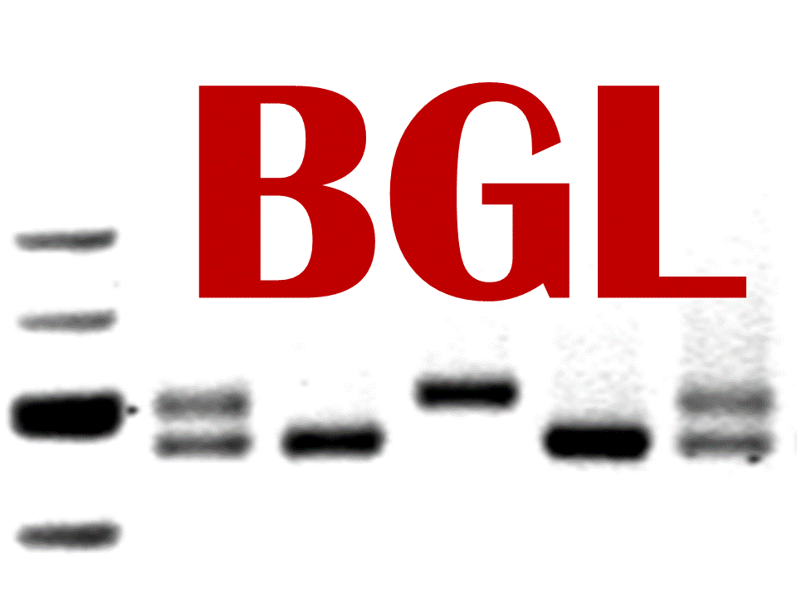
Dr. Scott F. Stoltenberg
Assistant Professor
Department of Psychology
Behavior Genetics Laboratory
sstoltenberg2@unl.edu

Slide 20
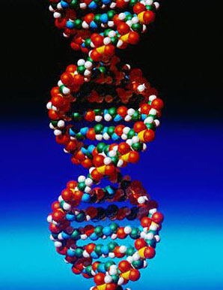
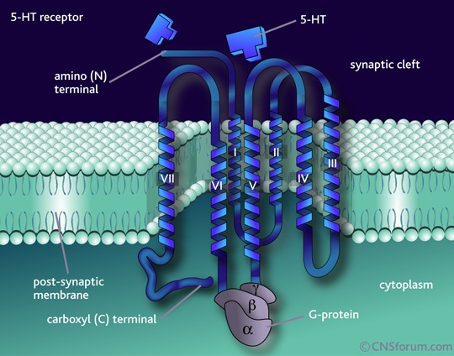
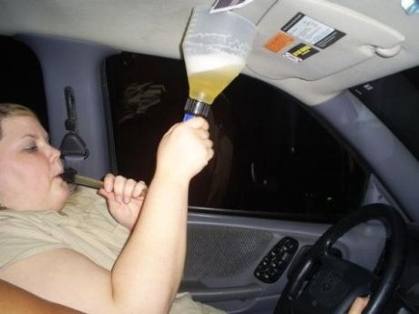
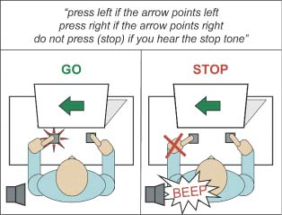
Pathways from genes to behavior

Slide 21
Behavior Genetics Laboratory
Purpose: to understand pathways from genes to behavior
Potential for collaboration
  individual differences in athletic performance or risk for injuries is likely to be, at least in part, due to genetic differences between people
    traits such as impulsivity, anxiety and aggression are influenced by genes and may mediate this pathway
  it is easy to collect genetic material for these studies
    saliva or cheek cells
  BGL routinely extracts DNA and performs genotyping and collects behavioral data

Slide 22
Safety Issues & Athletics
Mario Scalora, Ph.D.
Professor, Department of Psychology
mscalora1@unl.edu

Slide 23
Threats to Campuses, Athletic Departments & Student Athletes
Stalking
Domestic Violence
Harassment of Personnel
Communications from Disturbed Individuals
Disgruntled Fan Activity
Threatening Communications/ Managing Challenging Electronic Communications
Extremist activity & violence

Slide 24
Noteworthy Trends in Electronic Communications
Threatening language more prevalent
Increased threatening e-mail and other electronic/internet activity
More intense emotionally driven activity and rhetoric
More extremist language from range of domestic and transnational sources
Victims set higher threshold for reporting electronic threats

Slide 25
Extremist Groups: Tactical Changes
More decentralized organization
Heightened use of internet to educate, recruit and incite activity
Desire for higher media attention—higher profile activity
Focus toward high profile and “soft” targets
More provocative activity
Notion of “justified violence”
Coordinated attack strategies often utilizing secondary devices

Slide 26
Dr. Timothy Carr
Professor and Interim Chair
Department of Nutrition and Health Sciences
tcarr2@unl.edu

Slide 27
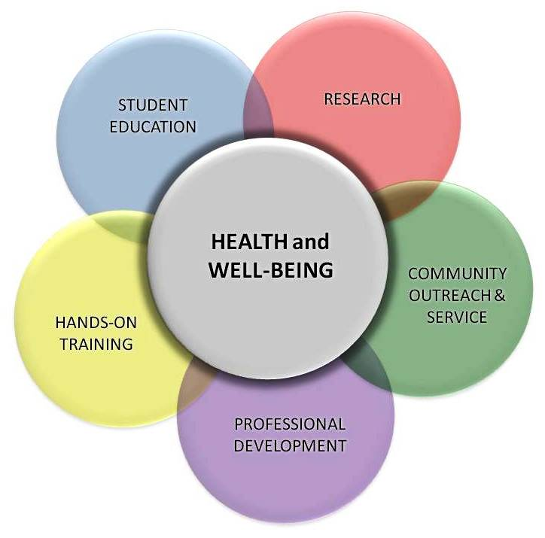
Nutrition and Health Sciences
Department Core

Slide 28


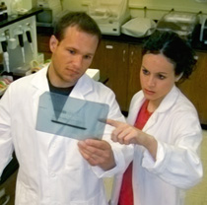
Nutrition and Health Sciences
Research Focus Areas
Nutrition Education;
Dietetics;
Community Health
Exercise Physiology & Nutrition
Nutrigenomics;
Cellular/Molecular Nutrition

Slide 29
Nutrition and Health Sciences
Expertise and Methodologies
Dual-energy X-ray absorptiometry (DXA): Body composition
Hydrostatic weighing: Body composition
Electromyography and mechanomyography: Muscle fatigue and function
Ultrasound: Muscle size
Blood chemistry: Lipids; inflammation markers
Diet assessment: Complete nutrient intake analysis

Slide 30

Questions?
For more information and updates:
http://research.unl.edu/events/athleticsandresearch/
http://research.unl.edu
©2010 The Board of Regents of the University of Nebraska. All rights reserved.
Notes:
30
30
30
30
30
30

